Slide 1
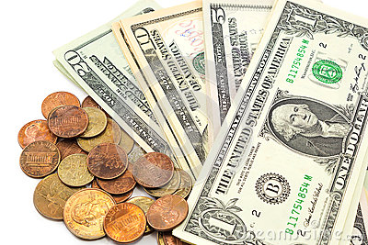
The Characteristics of Money
SS.3.E.1.2 List the characteristics of money.

Slide 2
We use money everyday. Did you ever wonder how we came to use the coins and bills we have in our pockets and purses today?

Slide 3
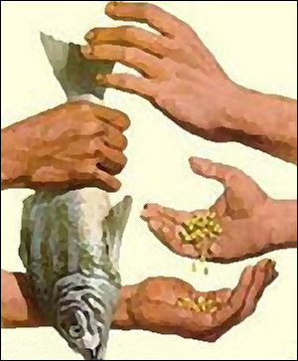
People used to trade things like animals, food, shells and lots of other objects to get goods and services.

Slide 4
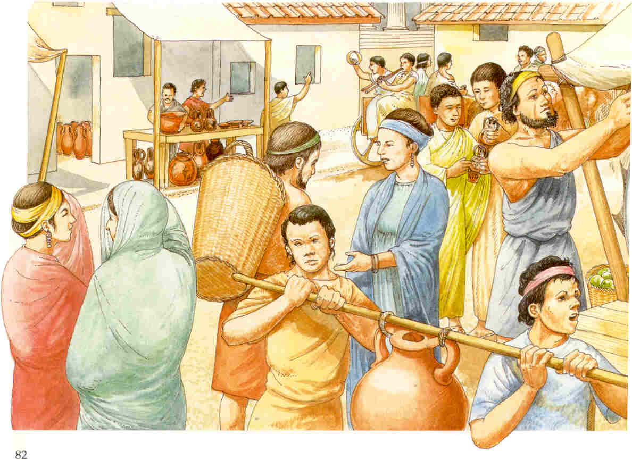
People decided that carrying animals, food, shells, and other objects with them was not at all convenient.

Slide 5
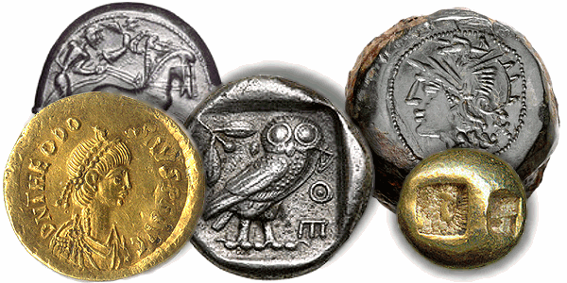
Money was invented because it did not break or rot and could be easily carried.

Slide 6
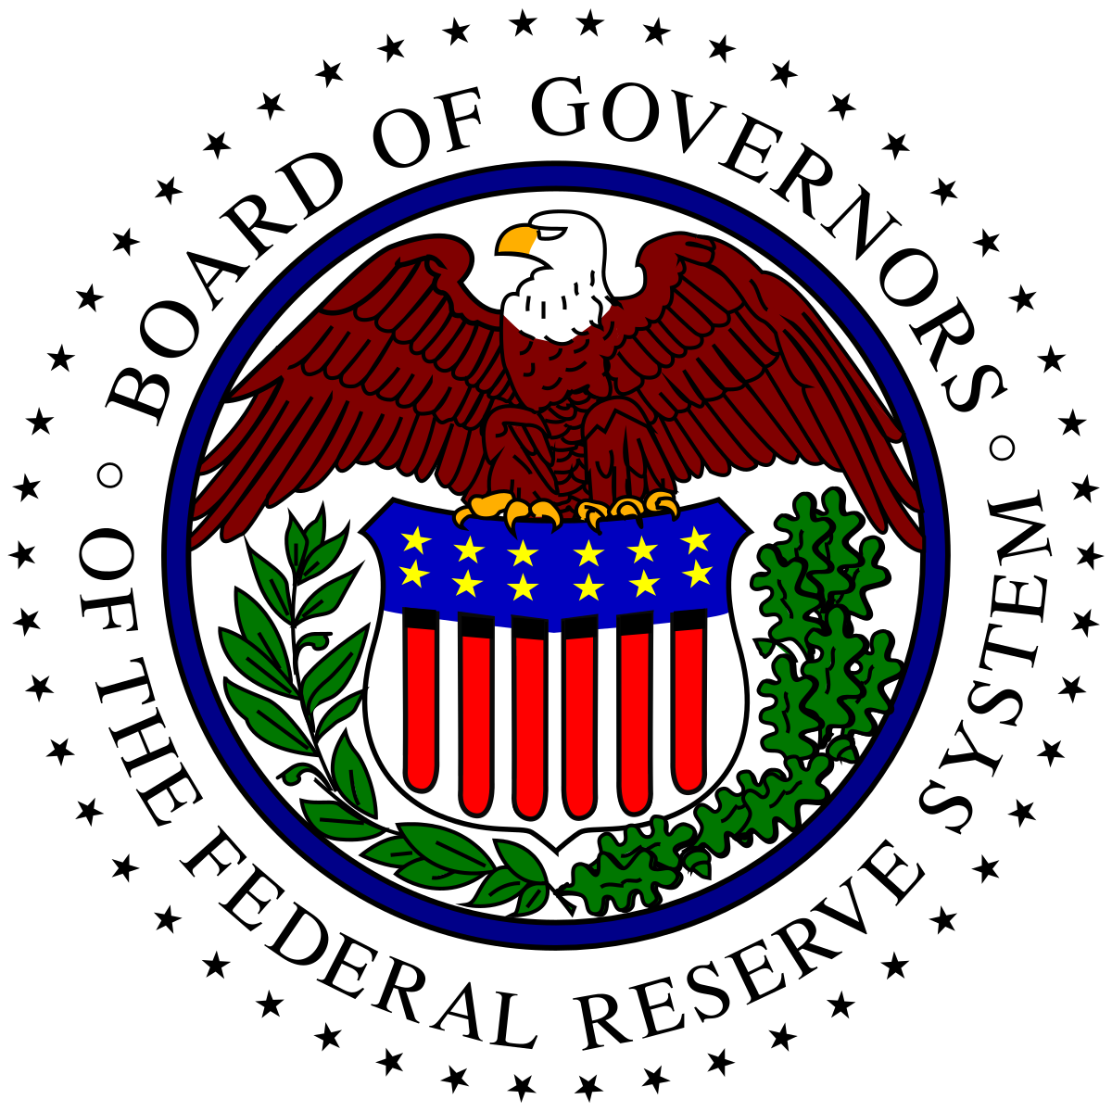
In the United States, The Federal Reserve is called our central bank. This means that ‘The Fed’ plays a big part in how we get and use money.

Slide 7
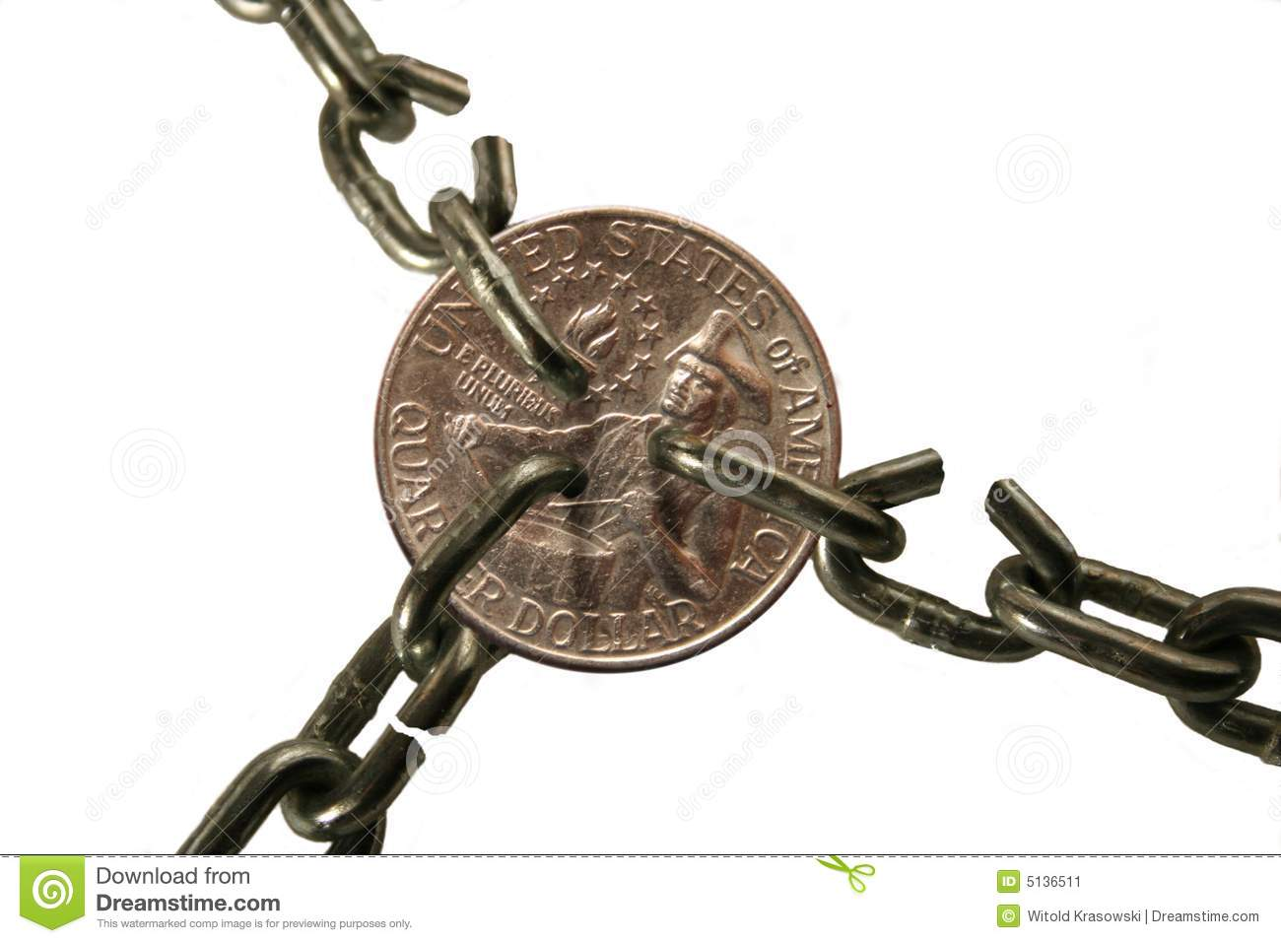
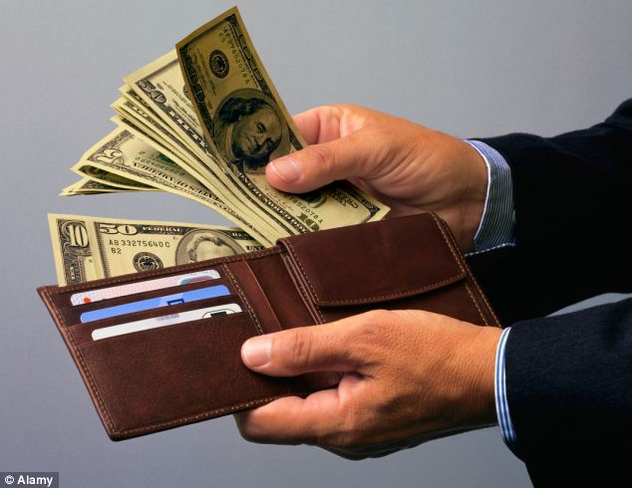
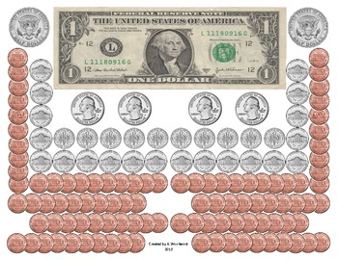
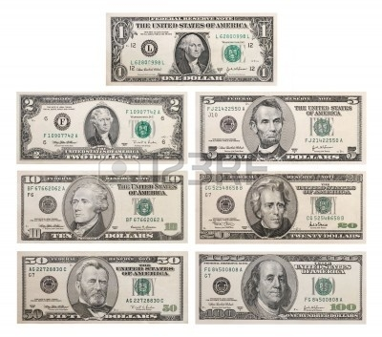
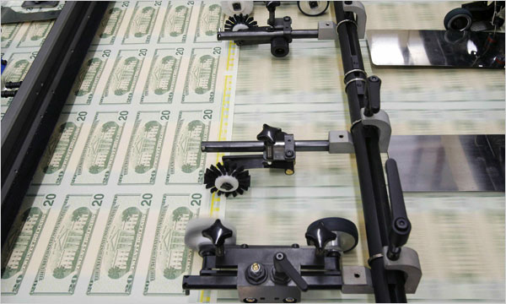
Over many years, people agreed that money should have certain qualities, or characteristics. There are 6 characteristics of the money we use everyday

Slide 8
1. Money must be durable. Durability means that money must be strong enough to be used over and over again.

Slide 9
2. Money must be portable. Portability means that money can be carried easily.

Slide 10
3. Money must be divisible. Divisibility means that money can be divided into smaller units of value.

Slide 11
4. Money must be uniform. Uniformity means that no matter when it is printed, it will always have the same value.

Slide 12
5. Money is in limited supply. This means that The Federal Reserve decides how much money is made and put into circulation for people to use.

Slide 13
6. Money must be accepted. Acceptability means that everyone recognizes and will take money for payment of goods and services.

Slide 14
Think about the 6 characteristics of money. Which one do you think is the most important? Can you think of other things that have the same characteristics of our money that could also be used to buy things?

Slide 15
Photo Credits
https://www.google.com/search?site=&tbm=isch&source=hp&biw=1280&bih=646&q=money&oq=money&gs_l=img.3..0l10.1720.2289.0.3048.6.6.0.0.0.0.78.324.5.5.0....0...1.1.64.img..1.5.323.0.U-GBq09U-_w#tbm=isch&q=coins+and+bills&imgrc=7YQPKKWhfVo7VM:
https://www.google.com/search?site=&tbm=isch&source=hp&biw=1280&bih=646&q=money&oq=money&gs_l=img.3..0l10.1720.2289.0.3048.6.6.0.0.0.0.78.324.5.5.0....0...1.1.64.img..1.5.323.0.U-GBq09U-_w#tbm=isch&q=trading+in+ancient+egypt&imgdii=b3csWsHfqJsraM:&imgrc=aUJJQLU8vZ8poM:
https://www.google.com/search?site=&tbm=isch&source=hp&biw=1280&bih=646&q=money&oq=money&gs_l=img.3..0l10.1720.2289.0.3048.6.6.0.0.0.0.78.324.5.5.0....0...1.1.64.img..1.5.323.0.U-GBq09U-_w#tbm=isch&q=ancient+money&imgrc=gCMKQ6LewQjotM:
https://www.google.com/search?site=&tbm=isch&source=hp&biw=1280&bih=646&q=money&oq=money&gs_l=img.3..0l10.1720.2289.0.3048.6.6.0.0.0.0.78.324.5.5.0....0...1.1.64.img..1.5.323.0.U-GBq09U-_w#tbm=isch&q=federal+reserve&imgrc=jteex2o8ZzEcHM:
https://www.google.com/search?site=&tbm=isch&source=hp&biw=1280&bih=646&q=money&oq=money&gs_l=img.3..0l10.1720.2289.0.3048.6.6.0.0.0.0.78.324.5.5.0....0...1.1.64.img..1.5.323.0.U-GBq09U-_w#tbm=isch&q=carrying+money&imgrc=x2Ln5nteAeZbPM:
https://www.google.com/search?site=&tbm=isch&source=hp&biw=1280&bih=646&q=money&oq=money&gs_l=img.3..0l10.1720.2289.0.3048.6.6.0.0.0.0.78.324.5.5.0....0...1.1.64.img..1.5.323.0.U-GBq09U-_w#tbm=isch&q=equal+coins+and+bills&imgrc=YST905ihqdOshM:
https://www.google.com/search?site=&tbm=isch&source=hp&biw=1280&bih=646&q=money&oq=money&gs_l=img.3..0l10.1720.2289.0.3048.6.6.0.0.0.0.78.324.5.5.0....0...1.1.64.img..1.5.323.0.U-GBq09U-_w#tbm=isch&q=coins+and+bills&imgdii=GxxHKx-OoPXiTM:&imgrc=ANvzZN_2tPSZvM:
https://www.google.com/search?site=&tbm=isch&source=hp&biw=1280&bih=646&q=money&oq=money&gs_l=img.3..0l10.1720.2289.0.3048.6.6.0.0.0.0.78.324.5.5.0....0...1.1.64.img..1.5.323.0.U-GBq09U-_w#tbm=isch&q=paying+with+money&imgrc=W9Bj79dJ9ycZUM:

