Slide 1
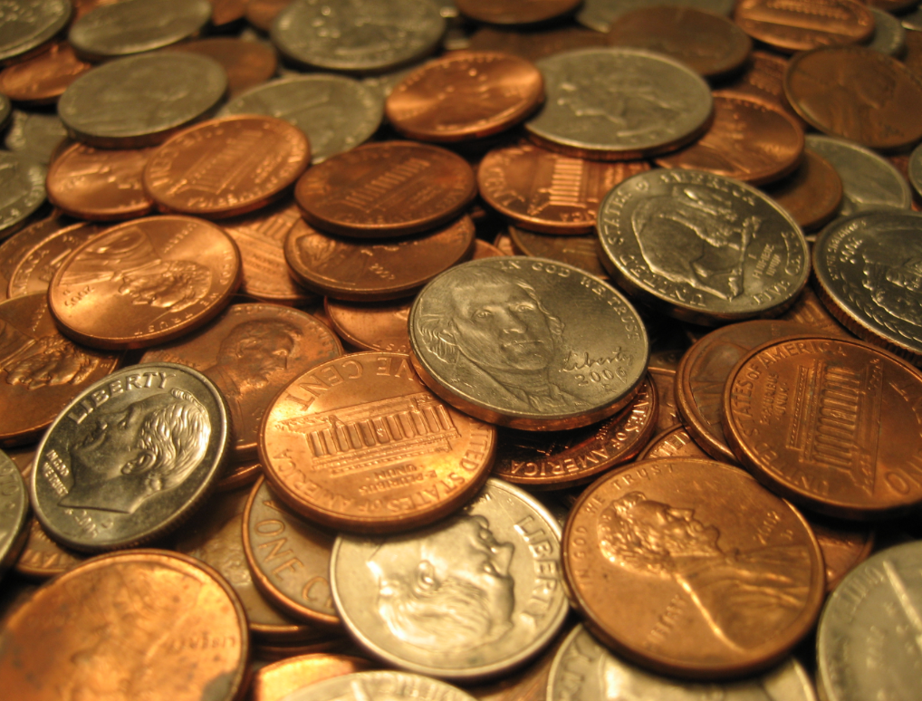
Coins and Bills
SS.K.E.1.2 Recognize that United States currency comes in different forms.

Slide 2
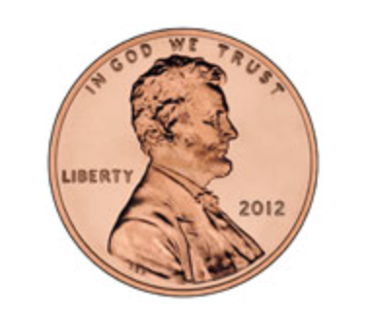
A penny is a coin.
1 cent

Slide 3
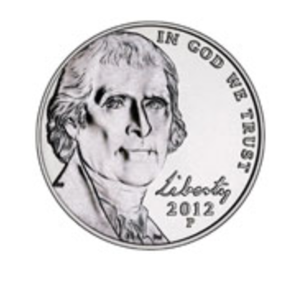
A nickel is a coin.
5 cents

Slide 4
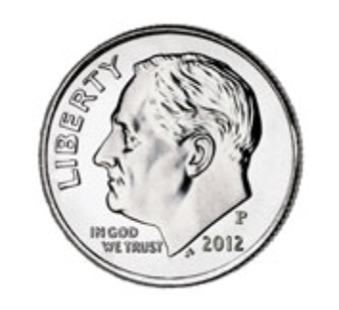
A dime is a coin.
10 cents

Slide 5
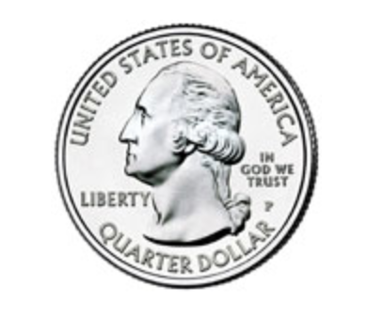
A quarter is a coin.
25 cents

Slide 6
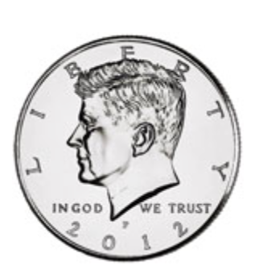
A half dollar is a coin.
50 cents

Slide 7
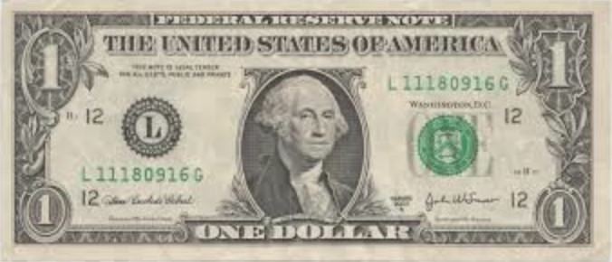
A dollar is a bill. Bills are made of paper.
100 cents = 1 dollar

Slide 8
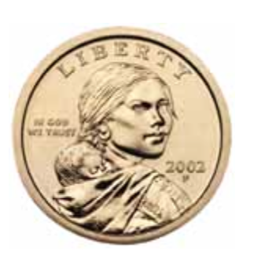
A dollar can also be a coin.
1 dollar

Slide 9
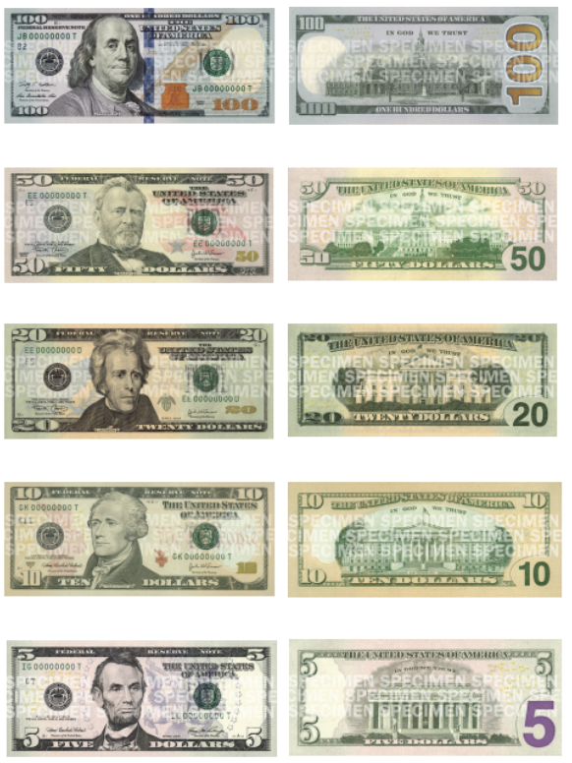
There are many other types of bills.

Slide 10
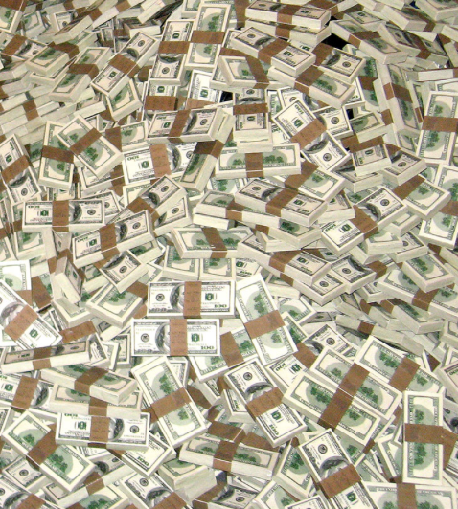
Money comes in different forms.
coins
bills

Slide 11
Photo Credits
https://www.usmint.gov/kids/teachers/coinCurricula/
http://www.newmoney.gov

