Slide 1
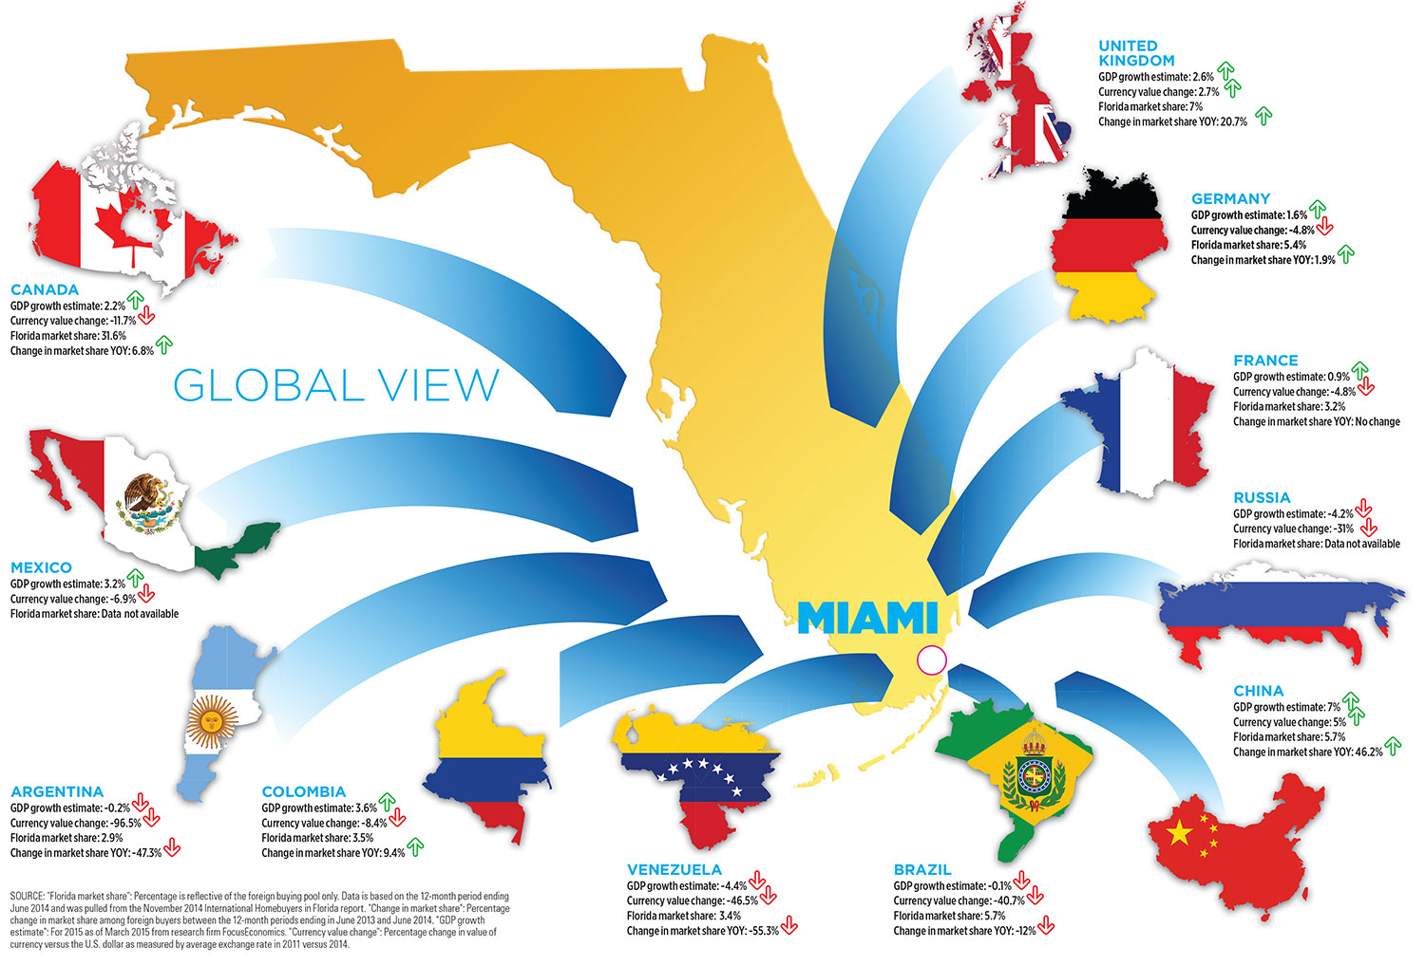
Florida: Business Connections with the United States and the World
Explain Florida's role in the national and international economy and conditions that attract businesses to the state.

Slide 2
Florida has beautiful beaches, a great climate, and many fun and interesting places to visit. But why else would someone move to Florida? As it turns out, Florida offers many advantages to people who are looking for a job or wanting to start a business.
http://www.floridatrend.com/article/6846/top-10-reasons-to-do-business-in-florida?page=1

Slide 3
Technology: Florida is one of the world’s top-ranked places in attracting technology-related businesses. The state exports over 13 billion dollars in high-tech goods and services, and is one of the top states in awarding science and engineering doctorates.
Chelsea Smartt, an assistant professor of entomology, studies disease-transmitting mosquitoes in a University of Florida laboratory. In 2007, public and private sector investments in research at 13 Florida universities rose by nearly $77 million to reach a total of more than $1.6 billion. [Photo courtesy of University of Florida]

Slide 4
Entrepreneurs: Florida is considered to be efficient and effective in helping entrepreneurs start new businesses. Florida’s universities provide on-site training to help students successfully start and grow their businesses, and Florida Institute for Commercialization of Public Research helps future entrepreneurs find good investment opportunities and financial support in business-building.
http://www.research.usf.edu/rf/sii/

Slide 5
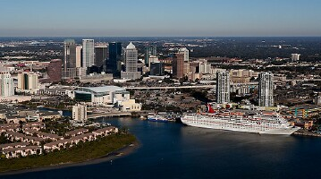
Global Connectivity: Florida has 19 major airports, 14 deep-water shipping ports, interstate highways and railway networks, and is home to Kennedy Space Center. Enterprise Florida the official economic development organization for the state, helps businesses relocate to Florida from overseas and Florida-based businesses looking to expand internationally.
Orlando International Airport
Tampa International Airport
Port of Tampa

Slide 6
Workforce Talent: Florida was named the No. 1 state for workforce in CNBC’s 2008 “America’s Top States for Business” study. No resident lives more than 50 miles from a college or university, and the state offers training programs and industry certifications starting in high school to help provide a well-trained, employable workforce.

Slide 7
These are just a few reasons why Florida is important to the national and international economy. Learn more about it at:
http://www.floridatrend.com/article/6846/top-10-reasons-to-do-business-in-florida?page=1

