Slide 1
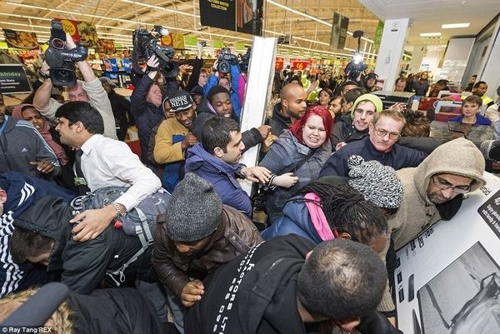
Limited Resources
SS.2.E.1.1 Recognize that people make choices because of limited resources.

Slide 2
If you could buy one thing, right now, and money was not a problem, what would you buy?

Slide 3
We all have wants and needs. Sometimes we can get them, but sometimes we cannot.

Slide 4
When many people want something but there is not enough for everyone to have it, we call this a limited resource.

Slide 5
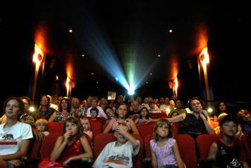
You want to see a movie, but the movie is sold out. The seats in the movie theater are limited resources.

Slide 6
You have to make a choice. Do you go to another movie or do you wait for the next show time?

Slide 7
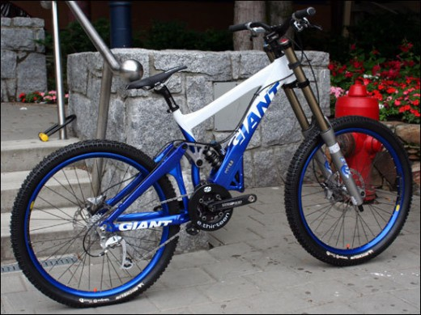
You want to buy a new bike. The bike costs $50 but you only have $40. In this case, money is a limited resource.

Slide 8
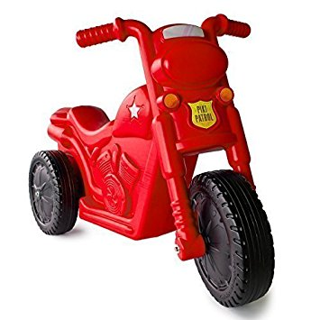
You have to make a choice. Do you save more money to buy the bike you want, or do you choose to buy a cheaper bike?

Slide 9
There are many limited resources that are not related to things we want to buy.

Slide 10
There is a limited amount of water in the world. Water is a limited resource.

Slide 11
There is a limited amount of oil in the world. Oil is a limited resource.

Slide 12
Because many things that we want are limited resources, we have to make choices about the things we buy.

Slide 13
Because money is a limited resource, we have to make choices about the things we buy.

Slide 14
Photo Credits
https://www.google.com/search?site=&tbm=isch&source=hp&biw=1280&bih=645&q=nature&oq=nature&gs_l=img.3..0l10.2726.3525.0.4693.7.7.0.0.0.0.100.459.5j1.6.0....0...1.1.64.img..1.6.458.0.dfwsscirNz4#tbm=isch&q=black+kid+thinking&imgrc=PdBvoAo-J19-EM:
https://www.google.com/search?site=&tbm=isch&source=hp&biw=1280&bih=645&q=wants+and+needs&oq=wants+and+needs&gs_l=img.3..0l10.2088.4238.0.4543.18.17.0.0.0.0.216.1364.10j3j1.14.0....0...1.1.64.img..4.14.1361.0.OxBliadWX4Y#imgrc=QuhCJUfMKHxufM:
https://www.google.com/search?site=&tbm=isch&source=hp&biw=1280&bih=645&q=black+friday+shopping&oq=black+friday+shopping&gs_l=img.3..0l6j0i30k1l2j0i24k1l2.1216.8807.0.8974.34.27.7.0.0.0.88.1755.25.25.0....0...1.1.64.img..2.29.1613.0..0i10i24k1._viszL8N_Eo#imgdii=Z67sWWC9zIEmyM:&imgrc=JVxweNRC0P1QmM:
https://www.google.com/search?site=&tbm=isch&source=hp&biw=1280&bih=645&q=movie+theater+sold+out&oq=sold+out+movi&gs_l=img.1.1.0j0i8i30k1j0i24k1.1420.3913.0.6066.14.14.0.0.0.0.109.992.11j2.13.0....0...1.1.64.img..1.13.991.0..0i30k1j0i5i30k1.gqMjC9kh14M#imgrc=uHnV5uc3Gh-RtM:
https://www.google.com/search?site=&tbm=isch&source=hp&biw=1280&bih=645&q=rated+g+movie+times&oq=rated+g+movie+times&gs_l=img.3...2778.9147.0.9329.20.20.0.0.0.0.78.1284.19.19.0....0...1.1.64.img..1.15.1018.0..0j0i30k1j0i8i30k1j0i24k1.E1544OEXIzc#tbm=isch&q=boss+baby+movie+times&imgrc=b222hcllH4cOCM:
https://www.google.com/search?site=&tbm=isch&source=hp&biw=1280&bih=645&q=%2450+bike&oq=%2450+bike&gs_l=img.3..0i30k1l10.1957.4146.0.4379.9.9.0.0.0.0.73.462.7.7.0....0...1.1.64.img..2.7.461.0..0.wWfpB1TcuJ4#imgrc=5OKLcO2v80NwfM:
https://www.google.com/search?site=&tbm=isch&source=hp&biw=1280&bih=645&q=vintage+hot+wheels&oq=vintage+hot+wheels&gs_l=img.3..0l10.1359.5017.0.5301.21.20.1.0.0.0.150.1350.18j1.19.0....0...1.1.64.img..1.20.1355.0..0i8i30k1j0i24k1.8khzbm3IYWQ#tbm=isch&q=toddler+bike&imgrc=NrNYvkfMjk2mjM:
https://www.google.com/search?site=&tbm=isch&source=hp&biw=1280&bih=645&q=limited+resources&oq=limited+resources&gs_l=img.3..0l9j0i5i30k1.1103.4215.0.5088.18.18.0.0.0.0.142.1354.13j4.17.0....0...1.1.64.img..1.17.1352.0.L0o_ALQx6RE#imgrc=HdrQMf3IEnwjXM:
https://www.google.com/search?site=&tbm=isch&source=hp&biw=1280&bih=645&q=limited+natural+resources&oq=limited+natural&gs_l=img.1.0.0j0i8i30k1l4j0i24k1l2.1638.3829.0.5530.18.18.0.0.0.0.224.1493.10j4j1.15.0....0...1.1.64.img..3.15.1491.0..0i30k1j0i5i30k1.sizOWkDcXQU#tbm=isch&q=limited+natural+resources+water&imgrc=3OPaVoO076lrqM:
https://www.google.com/search?site=&tbm=isch&source=hp&biw=1280&bih=645&q=making+choices&oq=making+choices&gs_l=img.3..0l10.1950.6428.0.6660.31.25.5.0.0.0.164.1881.13j7.20.0....0...1.1.64.img..6.22.1617.0..0i10i30k1j0i5i10i30k1j0i10i24k1j0i5i30k1.cf-bjyYjug0#imgrc=x_ZTqw5Ae9TgyM:
https://www.google.com/search?site=&tbm=isch&source=hp&biw=1280&bih=645&q=money+as+a+limited+resource&oq=money+as+a+limited+resource&gs_l=img.3...2629.6548.0.6771.30.30.0.0.0.0.103.1838.25j2.27.0....0...1.1.64.img..3.13.831.0..0j0i24k1.akQL9oZaaWQ#imgrc=PSFu0z2C_xmQaM:

