Slide 1
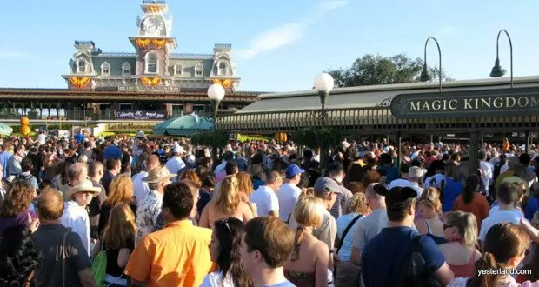
Supply and Demand
SS.2.E.1.2 Recognize that people supply goods and services based on consumer demands.

Slide 2
People who buy things are called consumers.

Slide 3
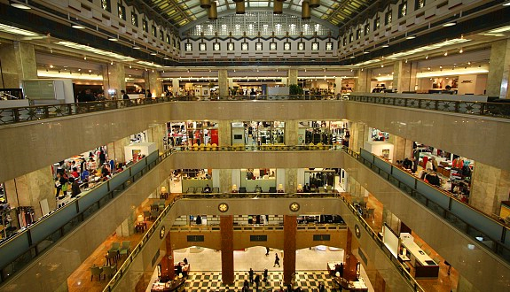
Businesses offer many types of goods and services for consumers to buy.

Slide 4
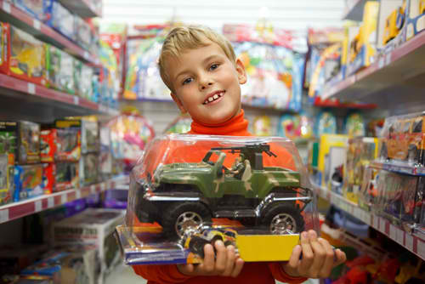
When consumers want a good or service, they will buy it. If they do not want a good or service, they will not buy it.

Slide 5
If consumers want to buy a particular good or service, we say that the good or service is in demand.

Slide 6
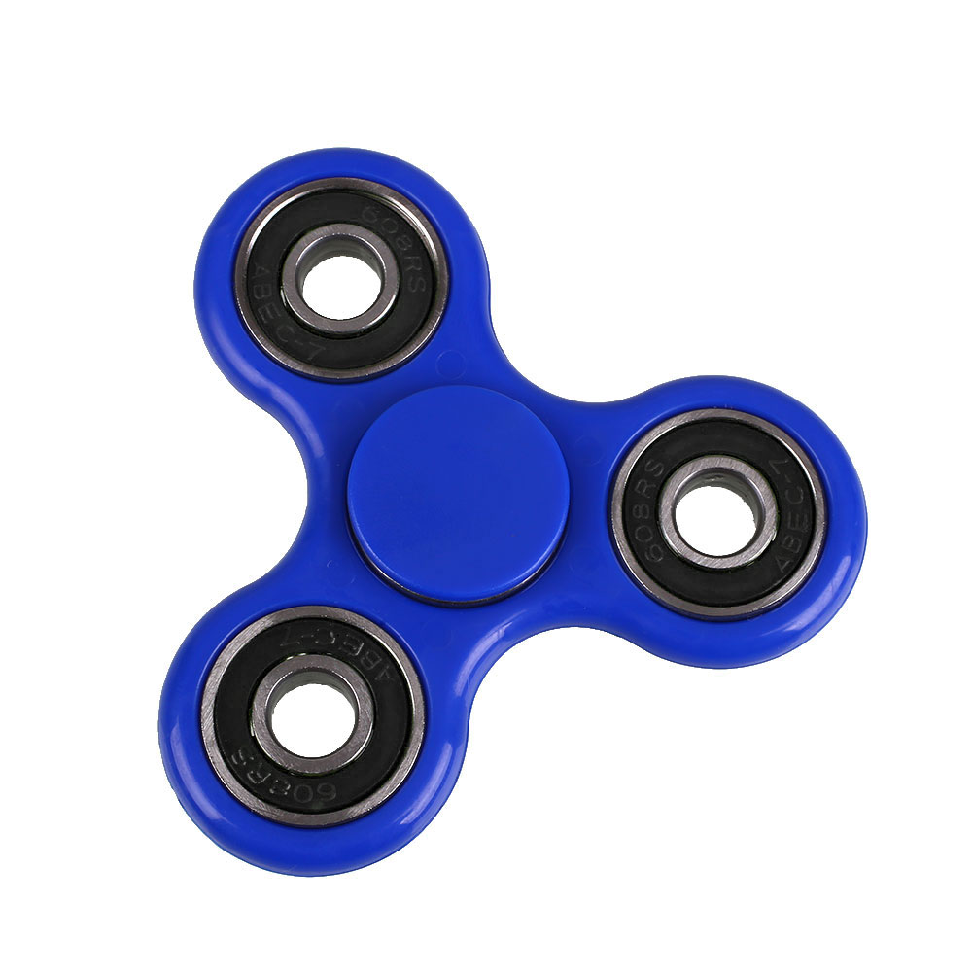
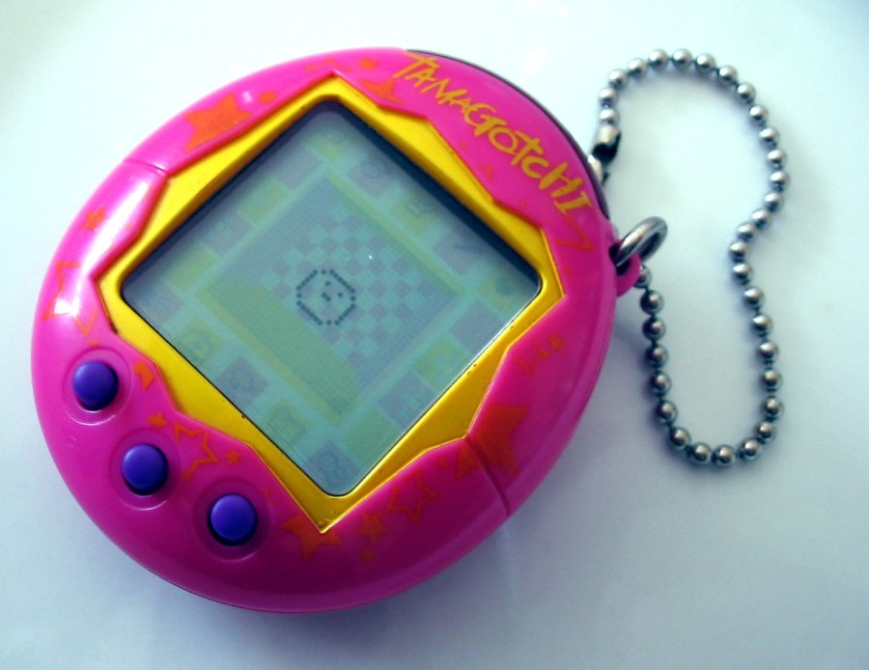
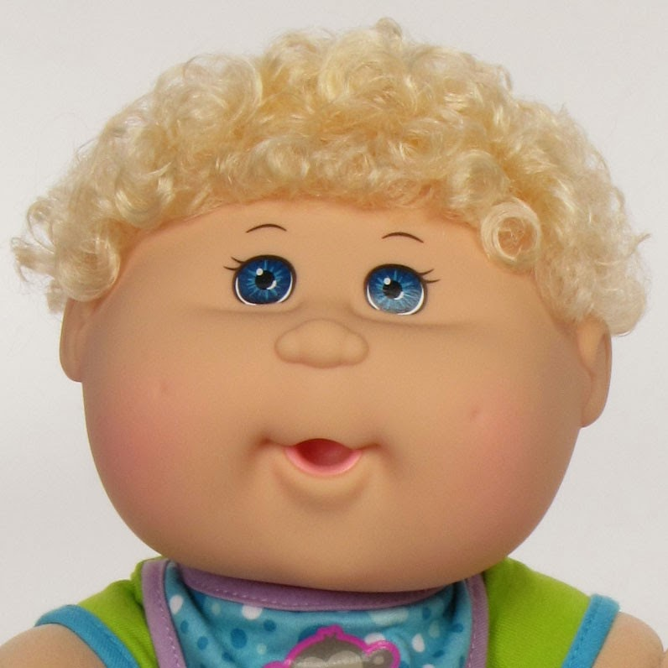
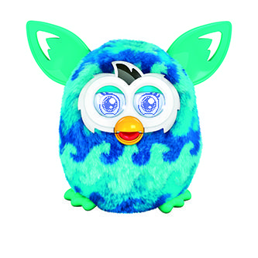
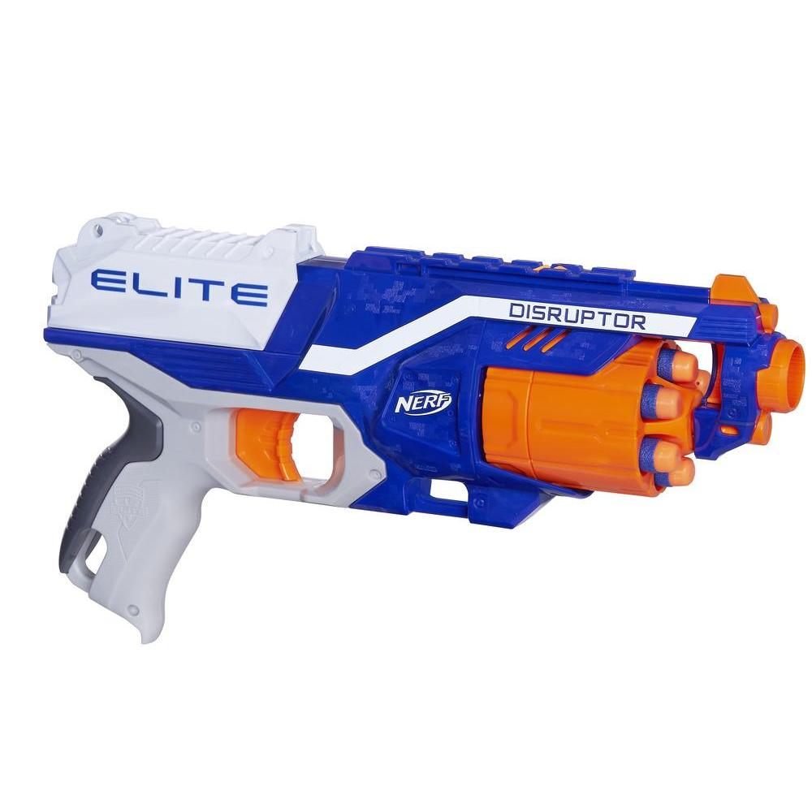
Which of these goods do you think are in demand today? Why or why not?

Slide 7
When goods or services are no longer in demand, business will no longer supply them.

Slide 8
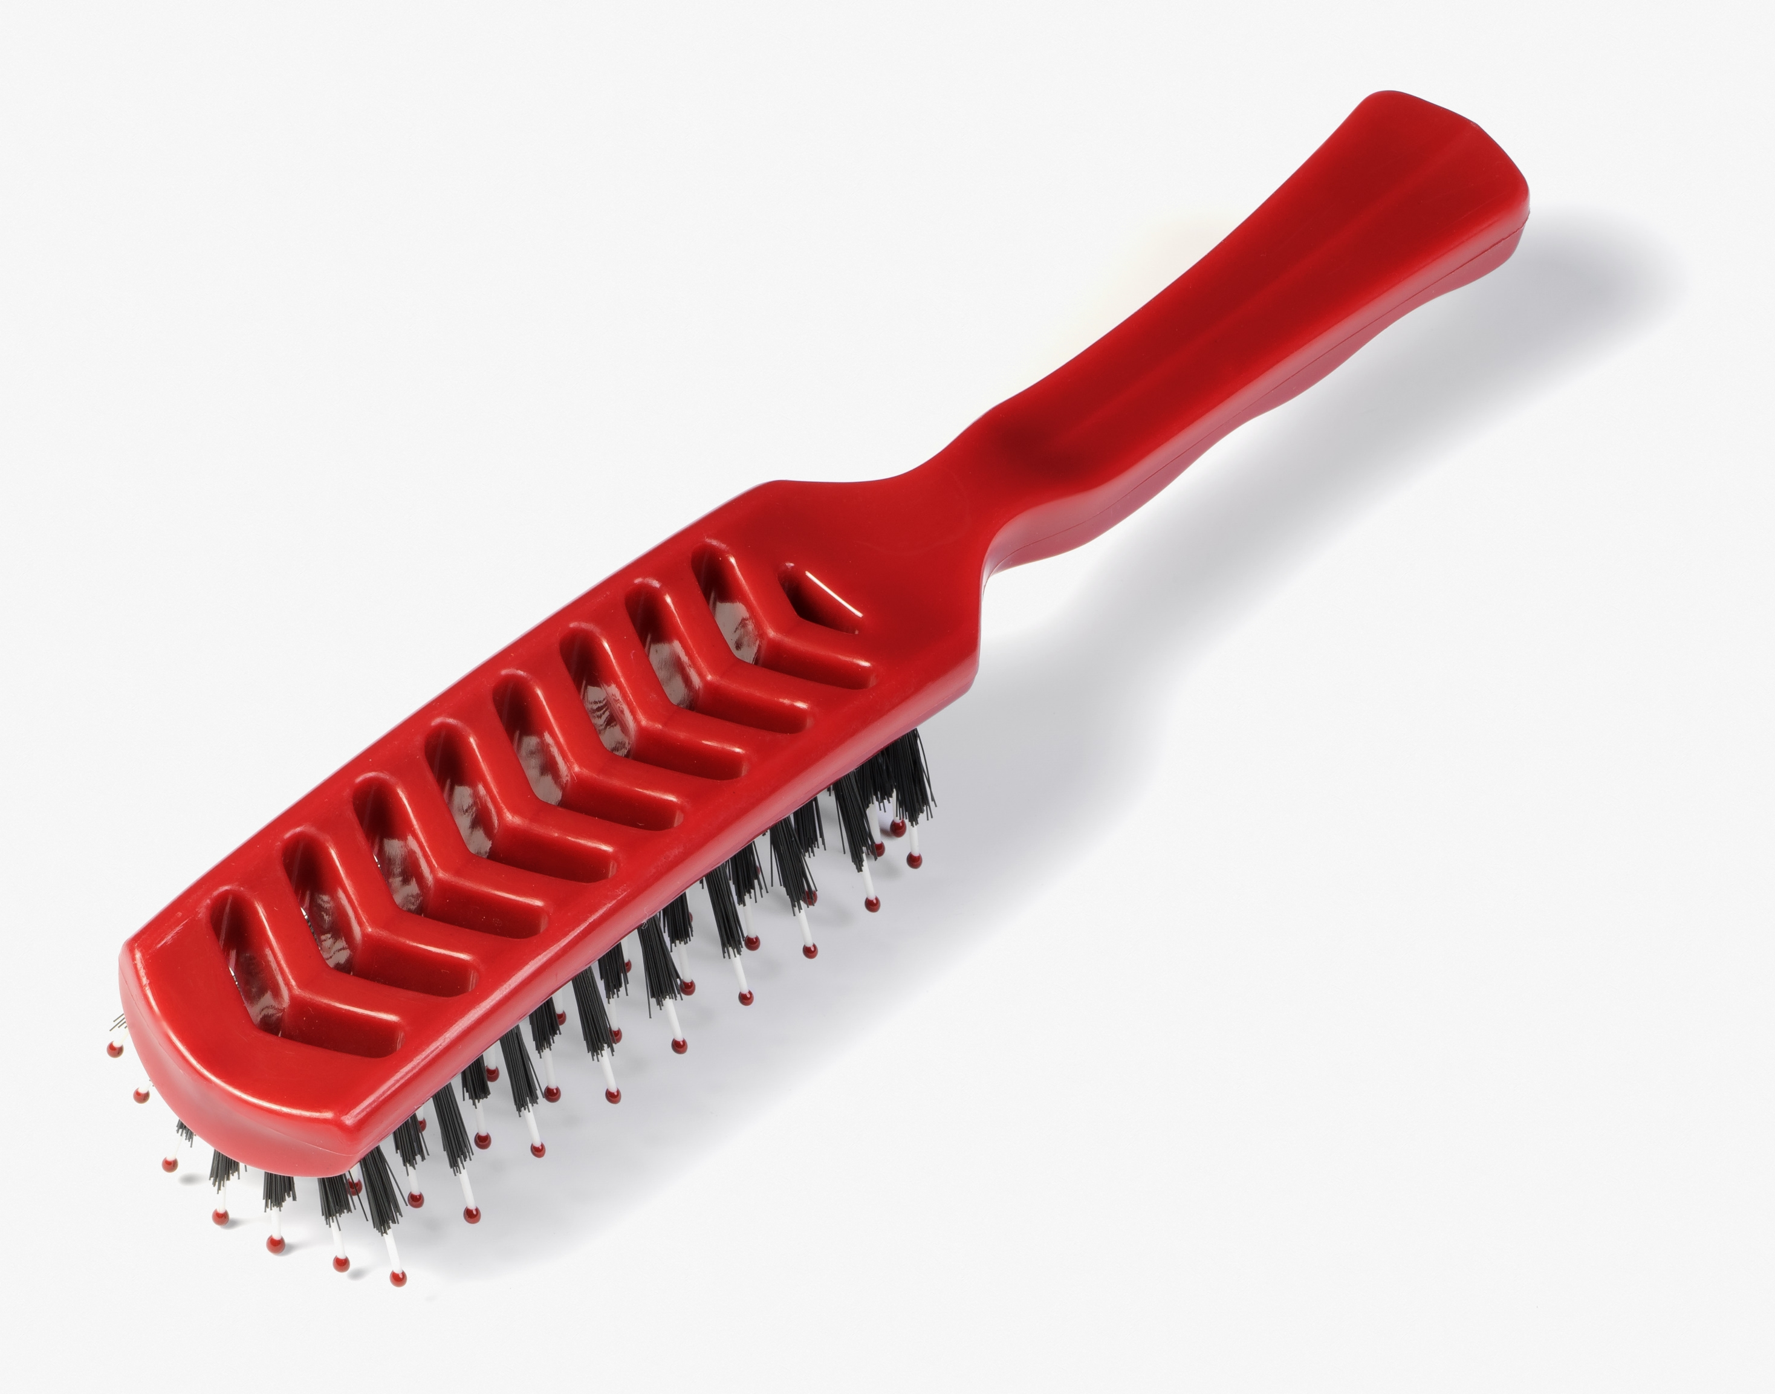
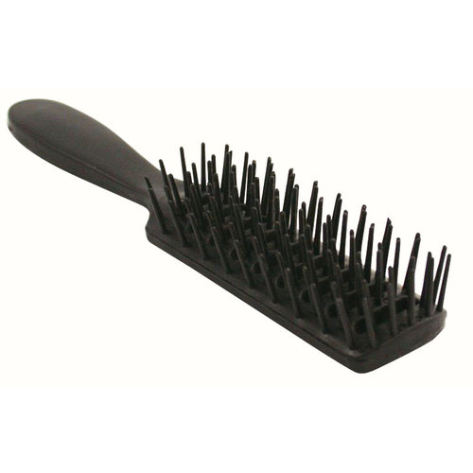
You own a hairbrush business. More consumers want red hairbrushes than black hair brushes. Which color hairbrush is in demand? Why? Which color hairbrush would you probably supply? Why?

Slide 9
Photo Credits
https://www.google.com/search?site=&tbm=isch&source=hp&biw=1280&bih=645&q=red+hairbrush&oq=red+hairbrush&gs_l=img.3..0.1416.4032.0.4367.14.14.0.0.0.0.93.837.13.13.0....0...1.1.64.img..1.13.837.0..0i10i24k1j0i24k1.i3o4AYIP0ko#tbm=isch&q=black+hairbrush&imgrc=8DzC-qAwRUPWtM:
https://www.google.com/search?site=&tbm=isch&source=hp&biw=1280&bih=645&q=department+store&oq=department+store&gs_l=img.3..0l10.5763.15553.0.15777.33.19.14.0.0.0.273.1635.6j7j1.14.0....0...1.1.64.img..5.28.1718.0.BgNIU_sLydk#imgrc=JafQMuA5wQ7VoM:
https://www.google.com/search?site=&tbm=isch&source=hp&biw=1280&bih=645&q=buying+services&oq=buying+services&gs_l=img.3..0i8i30k1j0i24k1l6.4727.10493.0.10653.18.18.0.0.0.0.179.1147.13j2.15.0....0...1.1.64.img..3.15.1143.0..0j0i5i30k1.HGWmy0vb2jM#tbm=isch&q=buying+toys&imgrc=Bra_y3Cy9fI9PM:
https://www.google.com/search?site=&tbm=isch&source=hp&biw=1280&bih=645&q=standing+in+line+at+disney+world&oq=standing+in+line+at+disney+world&gs_l=img.3...1325.6130.0.6291.33.33.0.0.0.0.112.1471.28j3.31.0....0...1.1.64.img..2.20.675.0..0j0i30k1j0i8i30k1j0i10i24k1j0i24k1.pPMArDOGO0k#imgrc=xBsQaKRfwbWwmM:
https://www.google.com/search?site=&tbm=isch&source=hp&biw=1280&bih=645&q=nerf+n+strike+elite&oq=nerf+n+s&gs_l=img.1.1.0l10.1032.3777.0.6309.9.9.0.0.0.0.71.460.8.8.0....0...1.1.64.img..1.8.458.0.WG_5N2oGJI4#imgrc=A2DK8mBzBUqtqM:
https://www.google.com/search?site=&tbm=isch&source=hp&biw=1280&bih=645&q=cabbage+patch+kids&oq=cabbage+&gs_l=img.1.0.0l10.1926.3451.0.5586.9.9.0.0.0.0.178.561.7j1.8.0....0...1.1.64.img..1.8.559.0.dIkMGOhVqh0#imgrc=kRKzdg5HP7wSnM:
https://www.google.com/search?site=&tbm=isch&source=hp&biw=1280&bih=645&q=tomogachi&oq=tomog&gs_l=img.1.2.0l10.2841.3823.0.6797.8.8.0.0.0.0.71.321.5.5.0....0...1.1.64.img..3.5.320.0.ZXeN5VIxCZg#imgrc=RKZMfkWbR8ULhM:
https://www.google.com/search?site=&tbm=isch&source=hp&biw=1280&bih=645&q=lawn+darts&oq=lawn+darts&gs_l=img.3..0l10.1559.3372.0.4036.11.11.0.0.0.0.85.554.9.9.0....0...1.1.64.img..2.9.552.0.F8vEOQ4J0y4#tbm=isch&q=lawn+darts+dangerous+toys&imgrc=gTW8ukF450mavM:

