Slide 1
USF Stavros Center Presents:
Using Artifacts in Trace-Based Cases: Silk Road
Deborah Kozdras, Ph.D.

Slide 2
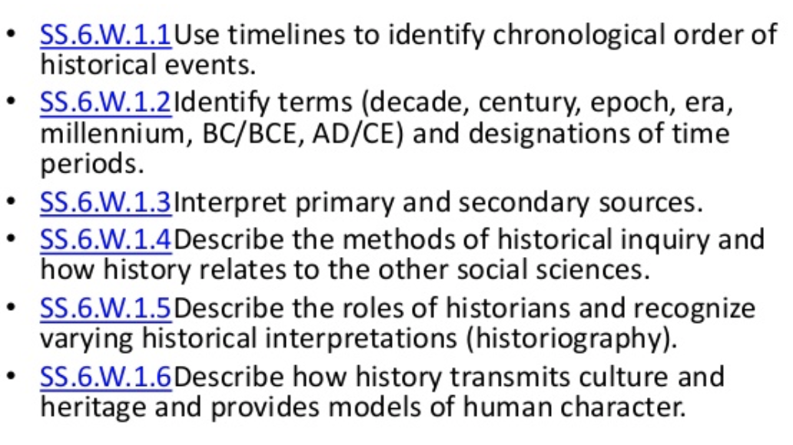
Historical Thinking

Slide 3
Using Place-Based Literacy

Slide 4
Content and Economic Ideas

Slide 5
Economic Questions
What was produced?
How was it produced?
How did what was produced get allocated?
Why was it produced?
How was it used?

Slide 6
Economic vs Economic Historic Thinking
Economics
Economic Historians
Economists practice something few historians do look to the future and predict
Economists isolate independent variables to find regularities that predict
Historians don’t try to predict the future.
Historians feel that isolating variables is unattainable because all variables are interdependent. They consider as many variables as possible.

Slide 7
Trace-Based Cases
Trace as Noun
Trace as Verb
For example, the Merriam-Webster dictionary defines a trace (noun) as a a sign or evidence of some past thing.
As a verb, to trace means to discover signs, evidence, or remains, and to follow or investigate in detail.
​

Slide 8
What do you see? Who? When? Where?
Anonymous
China, Han Dynasty (206 B.C.E.–220 C.E.)
Standing Horse
Earthenware with traces of pigment
Gift of Dr. David and Enid Owens
2007.33
Horses were important to Han rulers and aristocrats, who took representations of them into their elaborate tombs, for service in the afterlife. During Emperor Wu’s reign (141–87 B.C.E.), a superior breed of horse was imported from the Western Region to China’s Central Plains, to counter the onslaught of nomadic tribes from the North. The majestic stance of this tomb sculpture expresses the vitality of these animals known as “celestial horses.” This sculpture may have carried a mounted cavalryman. The tail, which was molded separately is missing.
http://mfastpete.org/obj/standing-horse/

Slide 9
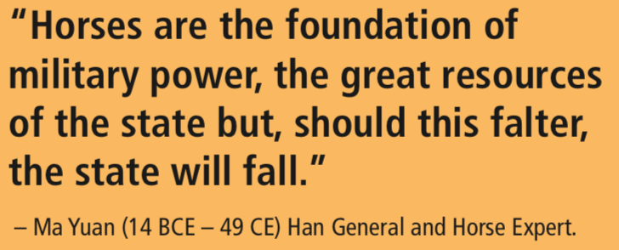
Who?
When?
Where?

Slide 10
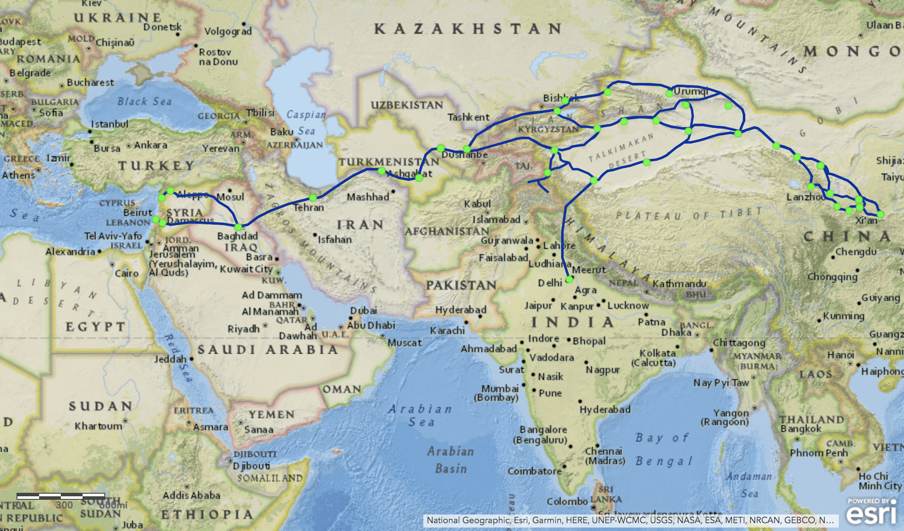
Maphttps://www.arcgis.com/home/webmap/viewer.html?webmap=55399ae83b1f43e1a9d3d7f5e946da23

Slide 11
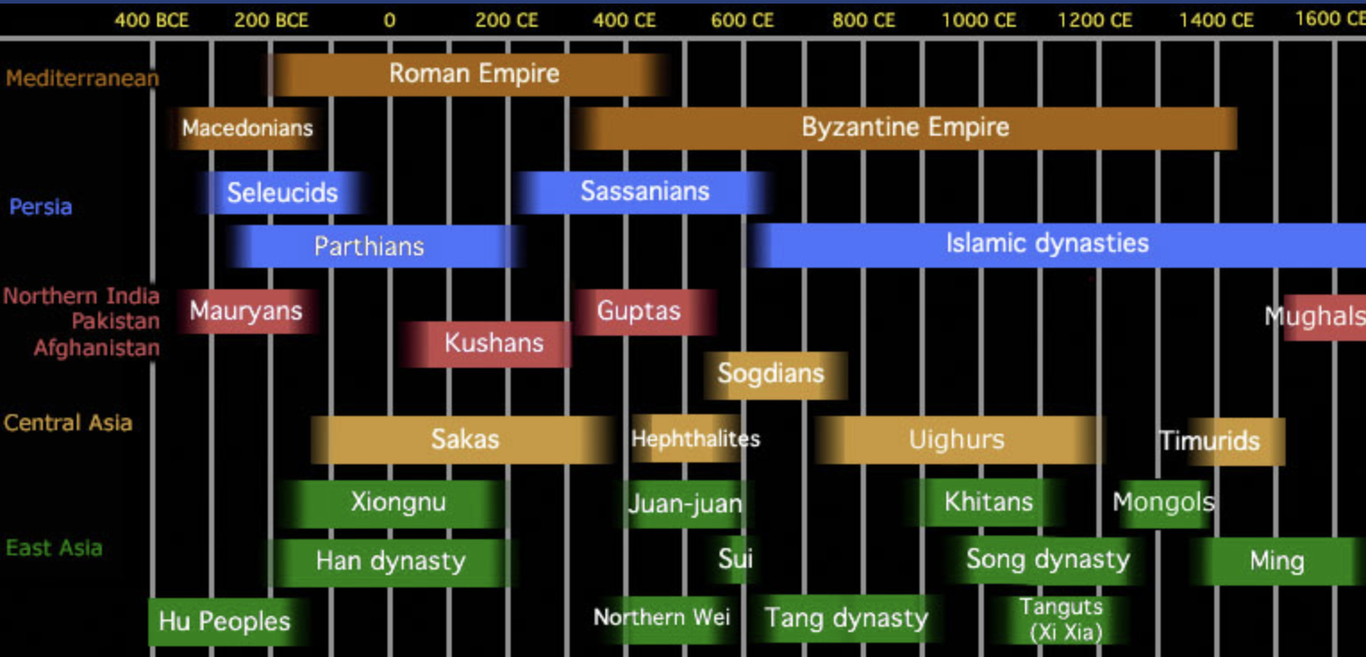
Clickable Timeline with Artifacts
http://depts.washington.edu/silkroad/exhibit/timeline.html

Slide 12
Next, ask:
How?
Why?

Slide 13
Add Other Sources
“The explorer Zhang Qian had told Emperor Wudi that there was a special breed of horses of great stamina in the Fergana Valley, which would equip China with a formidable cavalry. Delighted, the emperor allowed the trading of silk with the inhabitants of the Fergana region, which led to what would become the Silk Road. A first-century B.C. poem, part of the chronicle of China’s history, the Shiji, marks the arrival of the first of these steeds: The heavenly horses arrive from the Western frontier / Having traveled 10,000 li, they come with great virtue. / With loyal spirit, they defeat foreign nations / And crossing the deserts, all barbarians succumb in their wake! Later, during the Tang period, the horse became a status symbol, a kind of sports car of its day. The breed, however, no longer exists, and is preserved only in paintings and sculptures.”
The Shiji http://dsr.nii.ac.jp/rarebook/02/index.html.en
The heavenly horses have arrive from the Western frontier
Having traveled 10,000 li, they arrive with great virtue
With loyal spirit, they defeat foreign nations
And crossing the deserts all barbarians succumb in their wake!
--The Shiji, Chapter 24 (“The Treatise on Music”)
https://www.nationalgeographic.com/archaeology-and-history/magazine/2018/01-02/silk-road-history/

Slide 14
What if they never had heavenly horses?
So What?
What Now?
What Next?

Slide 15
Building an Argument
Main Idea
Here is what I think . . .
Counter
Arguments
Evidence to back up my reasons
Here are my reasons!
___________________________________________________
___________________________________________________
___________________________________________________
You could argue that…
_________________________________________________________________________________________________________
. . .but here is the weakness . . .
_______________________________________________________________
Strong Finish!
__________________________________________________________________________________________________________________________________________
CON
When you weigh all the evidence
you conclude that . . .
PRO

Slide 16
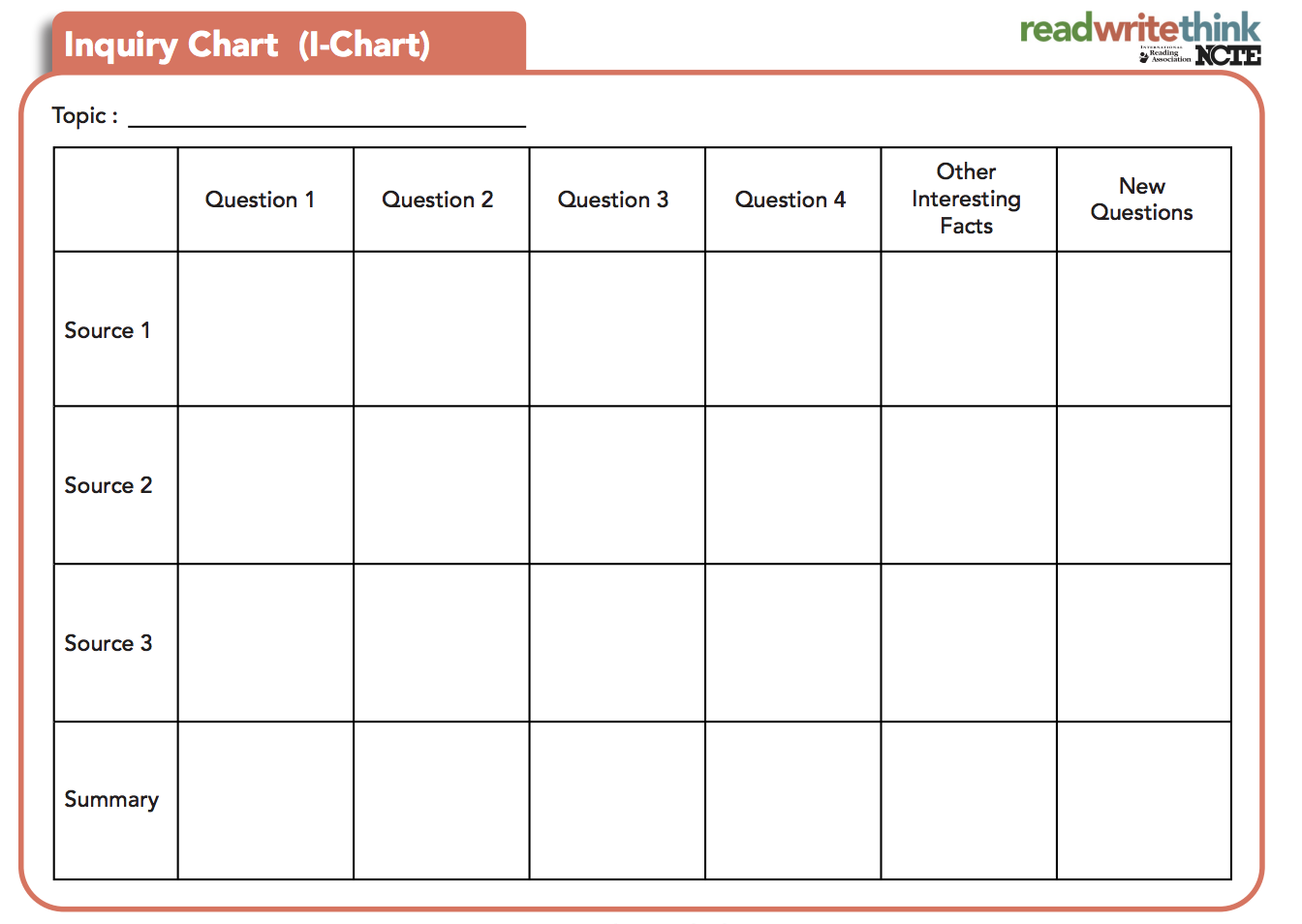
http://www.readwritethink.org/professional-development/strategy-guides/inquiry-charts-charts-30762.html
http://www.readwritethink.org/professional-development/strategy-guides/inquiry-charts-charts-30762.html

