Slide 1
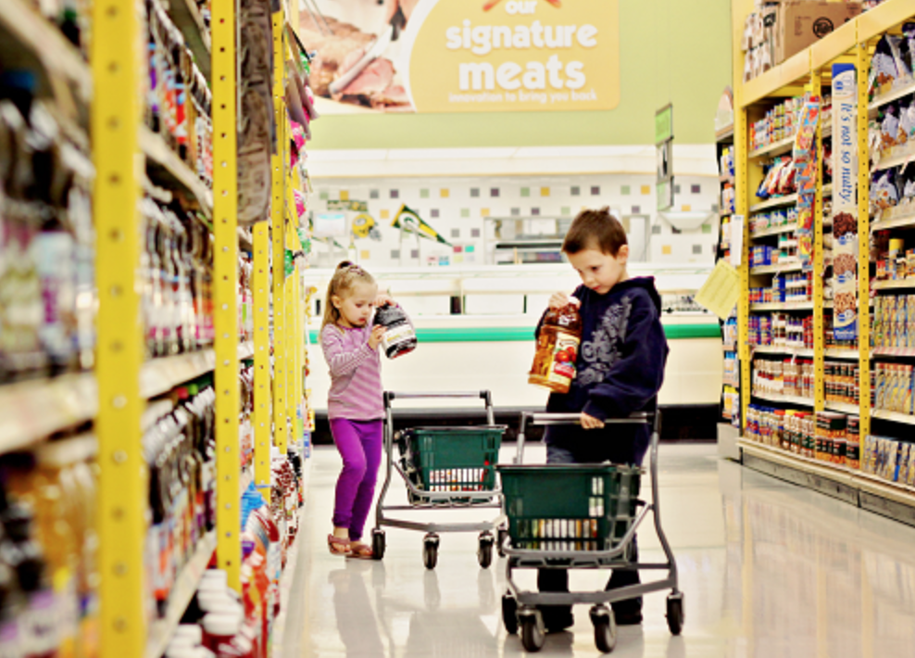
What Can I Buy?
SS.K.E.1.3 Recognize that people work to earn money to buy things they need or want.

Slide 2
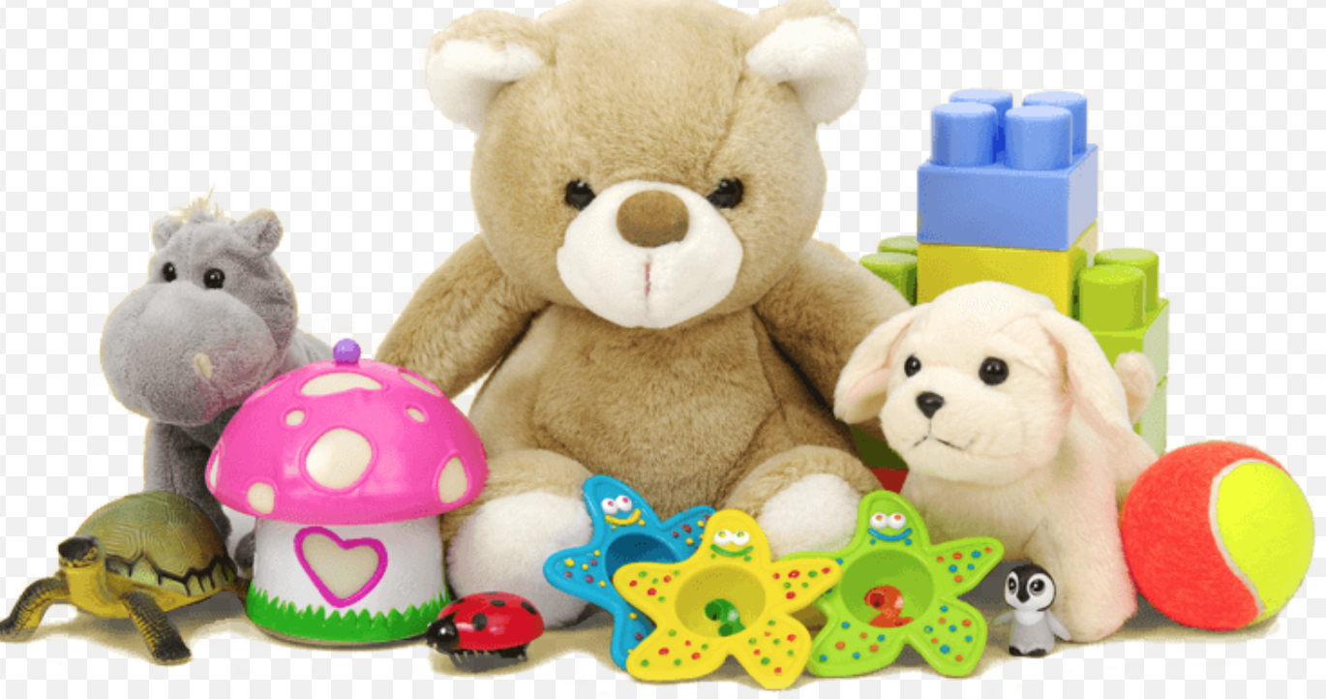
People want things.

Slide 3
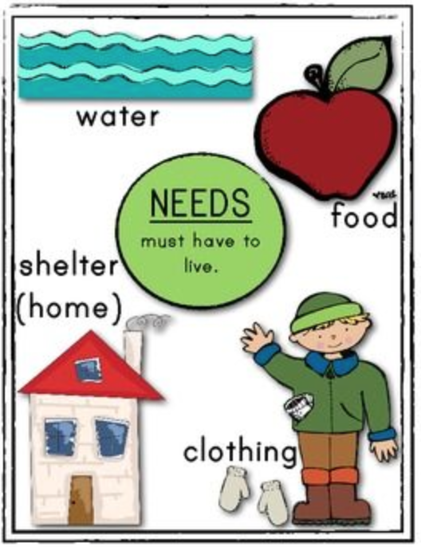
People need things.

Slide 4
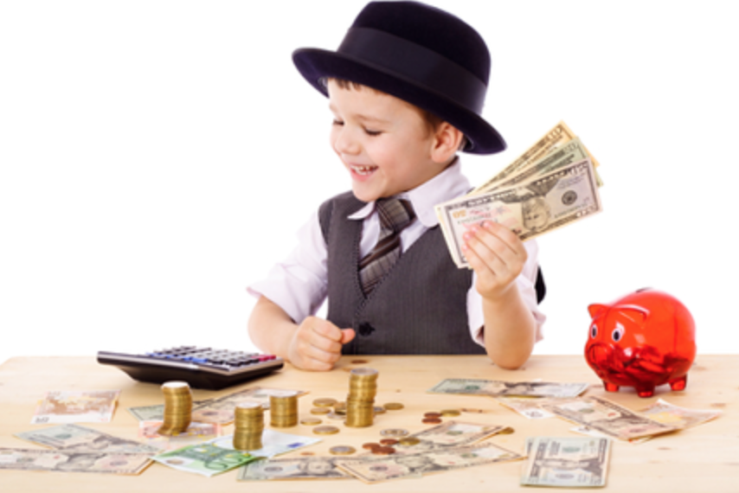
People use money to buy what they want or need.

Slide 5
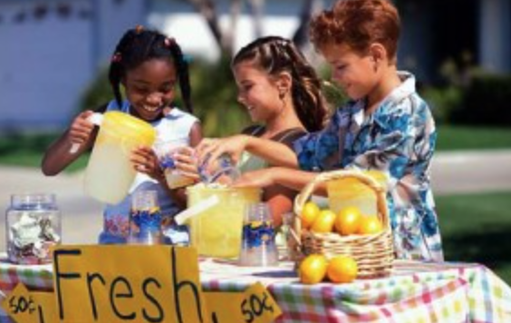
People work to earn money.

Slide 6
People use the money they earn to buy what they want or need.

Slide 7
Photo Credits
http://inspiremedianu.com/tag/online-toys/
http://kidsforsuccess.com/easy-ways-kids-and-teens-can-make-money
http://achildsworldnc.com/teaching-kids-finances/
http://www.coupons.com/thegoodstuff/how-to-get-kids-excited-to-save-money/

