Slide 1
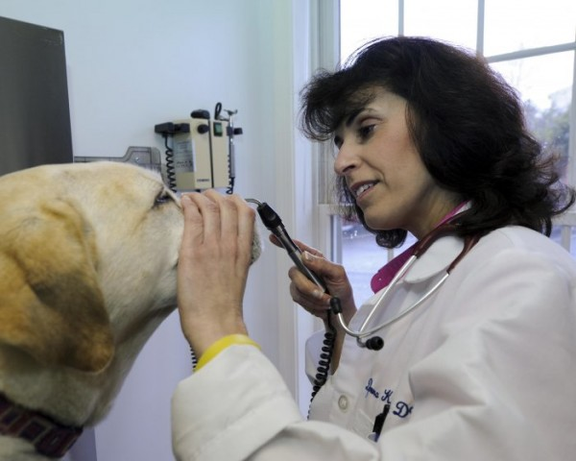
Whose Tools?
SS.K.E.1.1Describe different kinds of jobs that people do and the tools or equipment used.

Slide 2
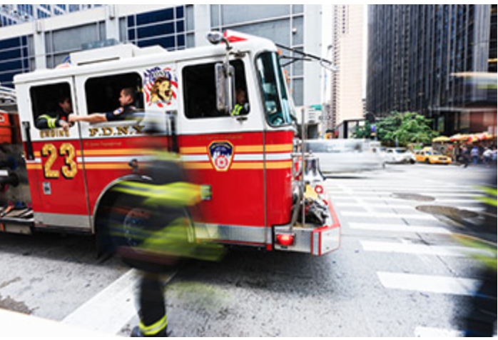
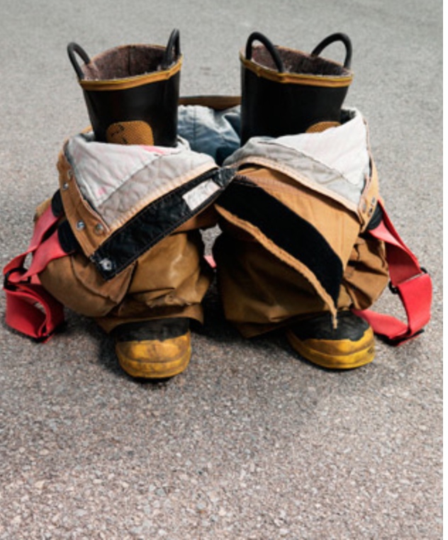
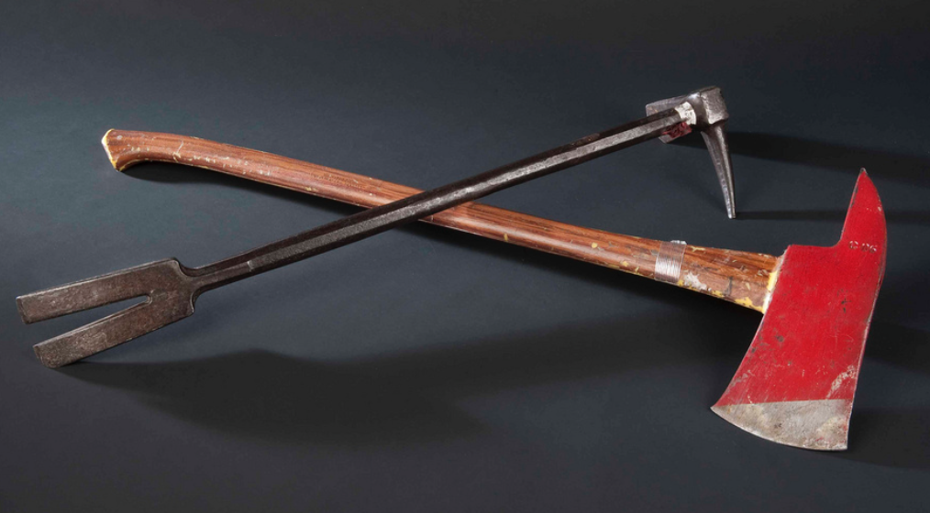
Whose Tools?

Slide 3
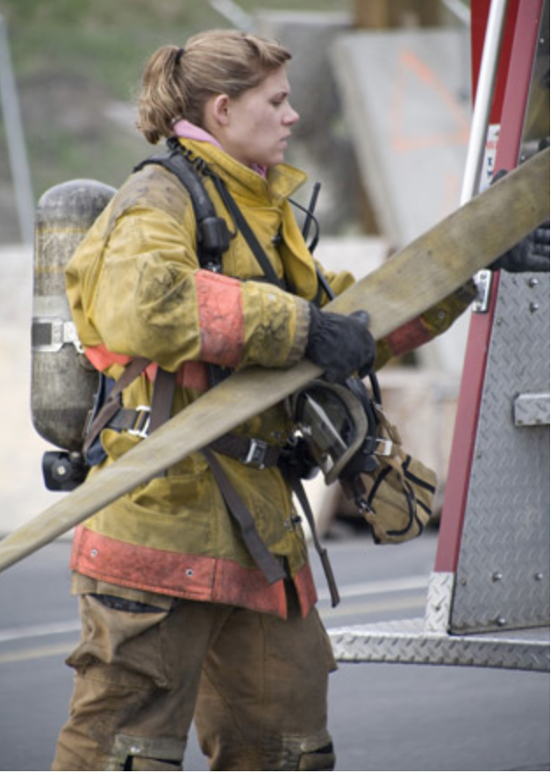
A firefighter uses many tools.

Slide 4
Whose Tools?

Slide 5
A librarian uses many tools.

Slide 6
Whose Tools?

Slide 7
A doctor uses many tools.

Slide 8
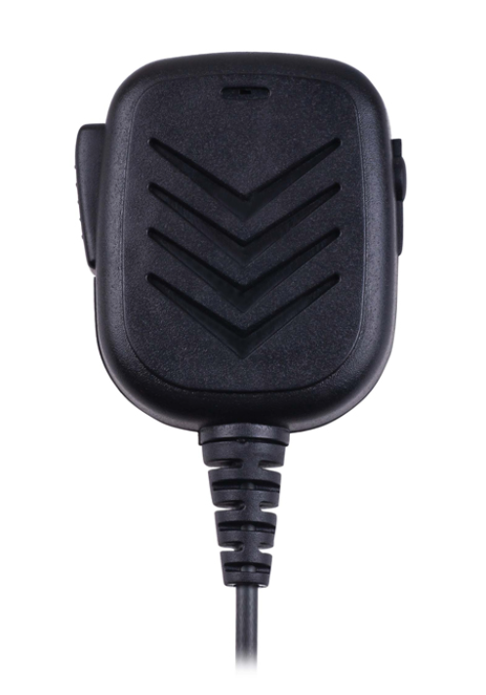
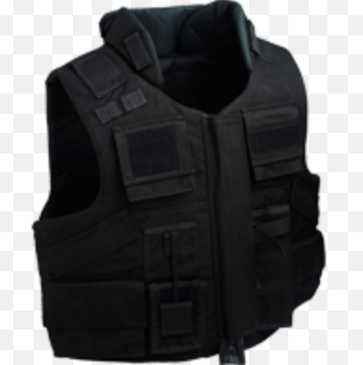
Whose Tools?

Slide 9
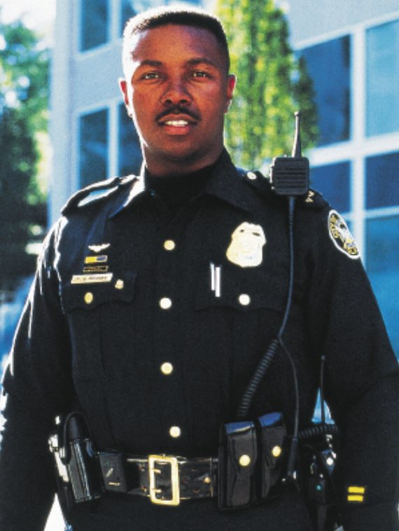
A police officer uses many tools.

Slide 10
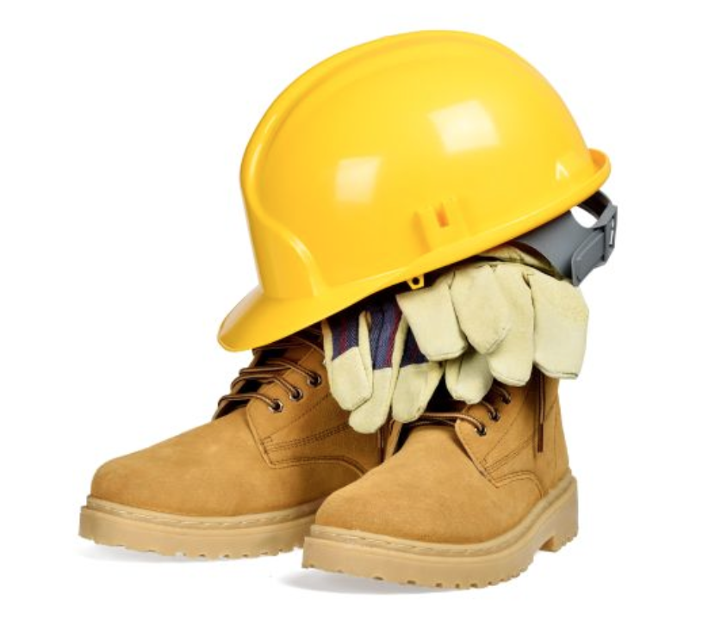
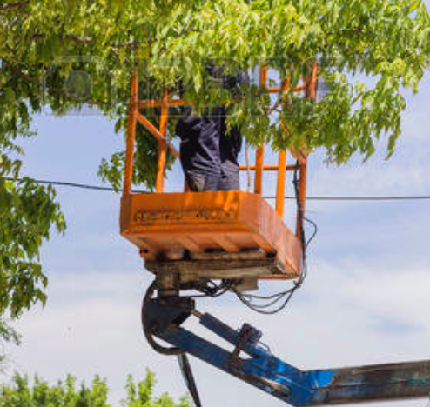
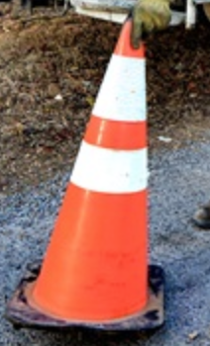
Whose Tools?

Slide 11
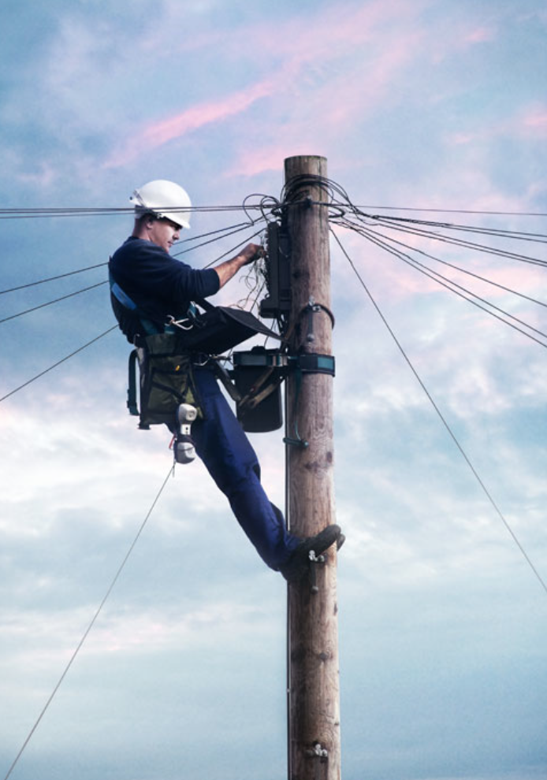
A utility worker uses many tools.

Slide 12
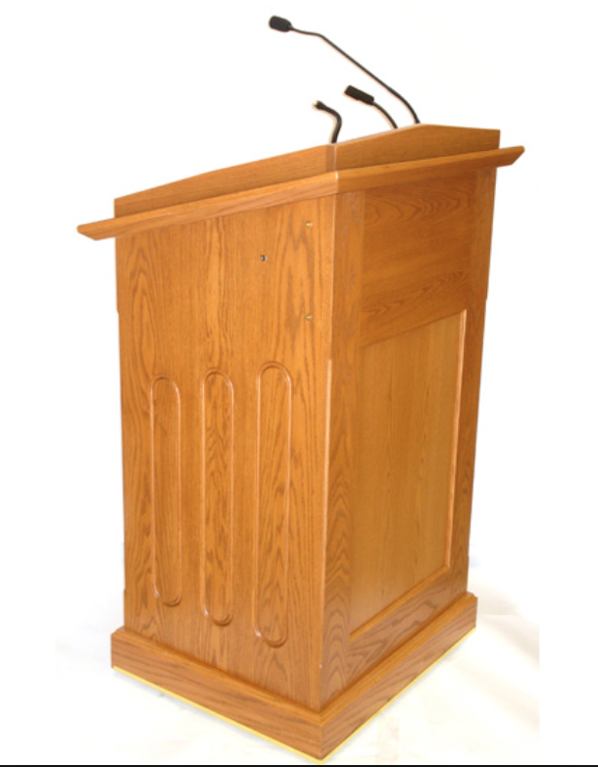
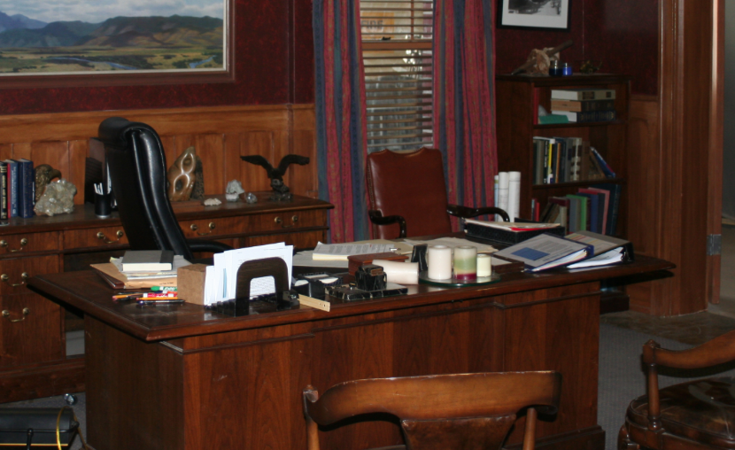
Whose Tools?

Slide 13
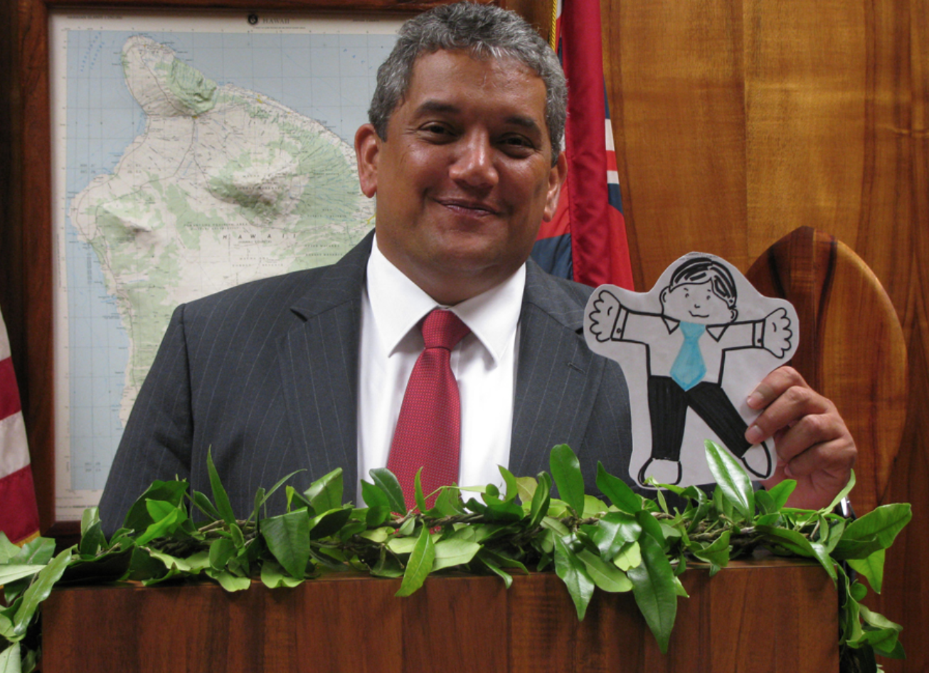
A mayor uses many tools.

Slide 14
Workers use many tools.

Slide 15
Photo Credits
Scholastic Community Club Books:
http://teacher.scholastic.com/commclub/
Through Google Images:
Flicker.com
https://www.flickr.com/photos/nationalmuseumofamericanhistory/5937271889
Clipartkid.com
http://www.clipartkid.com/equiment-doctor-cliparts/
Gaebker,com
http://www.gaebler.com/How-to-Start-a-Police-Equipment-and-Supplies-Business.htm
Elwarmuor.com
http://www.elwarmour.com/product-category/police-armour/
Alibaba.com
https://www.alibaba.com/cache/For-SWAT-security-policeman-walkie-talkie_60385708264.html
Offdutysolutions.com
https://www.offdutysolutions.com/security-jobs-police-officers
Worktruckonline.com
http://www.worktruckonline.com/channel/utility/article/story/2014/11/aerial-device-safety-dos-and-don-ts.aspx
123rf.com
http://www.123rf.com/stock-photo/elevator_equipment.html
Contractortalk.com
http://www.contractortalk.com/articles/2014/09/choosing-the-right-hard-hat/
Commons.wikimedia.org
https://commons.wikimedia.org/wiki/File:Jericho_-_Mayor%27s_Office.jpg
Nydailynews.com
http://www.nydailynews.com/new-york/city-council-32-pay-hike-mayor-signs-bill-article-1.2537503
Hi5publicity.com
http://www.hi5publicity.com/product/podium-wood/

