Slide 1
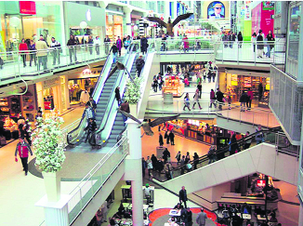
Buyers and Sellers
SS.3.E.1.1 Give examples of how scarcity results in trade.
SS.3.E.1.3 Recognize that buyers and sellers interact to exchange goods and services through the use of trade or money.

Slide 2
Have you ever gone to your refrigerator to get a glass of milk and there was no milk?

Slide 3
When something we want is not available, we call this a scarce resource.

Slide 4
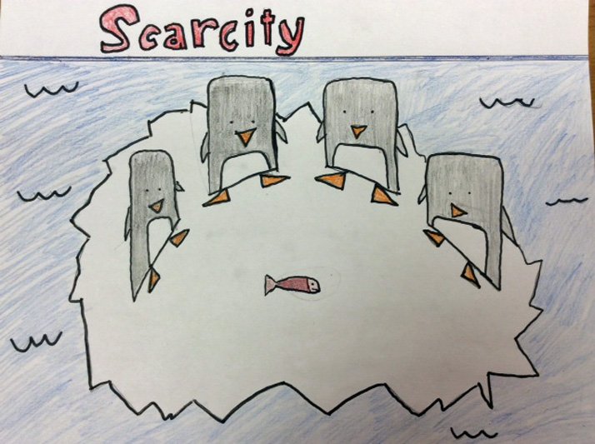
Scarcity results when there is not enough of something that people want or need.

Slide 5
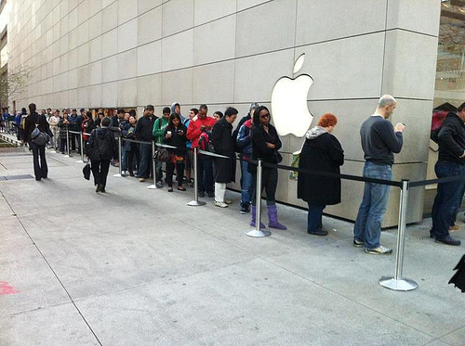
To solve this problem, people will seek to buy a scarce resource. Scarce resources may be either goods or services.

Slide 6
Everyday, people spend money on goods and services that they want or need.

Slide 7
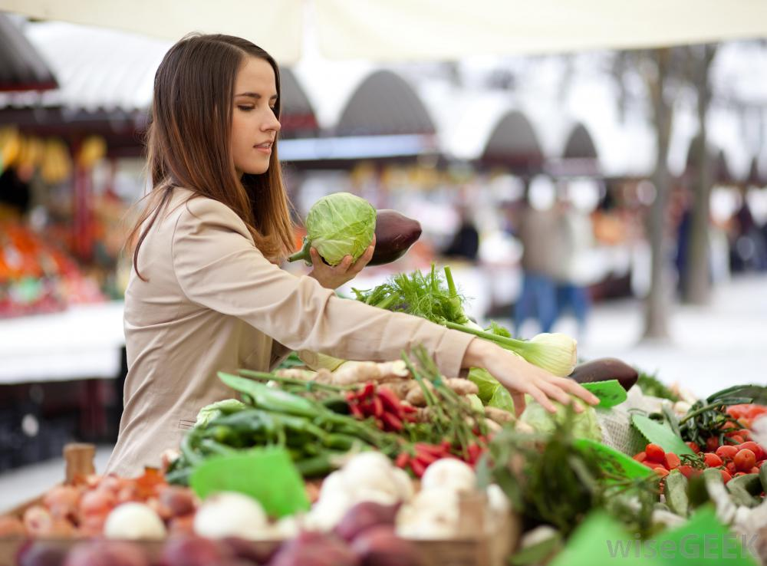
When people spend money for goods and services they become buyers.

Slide 8
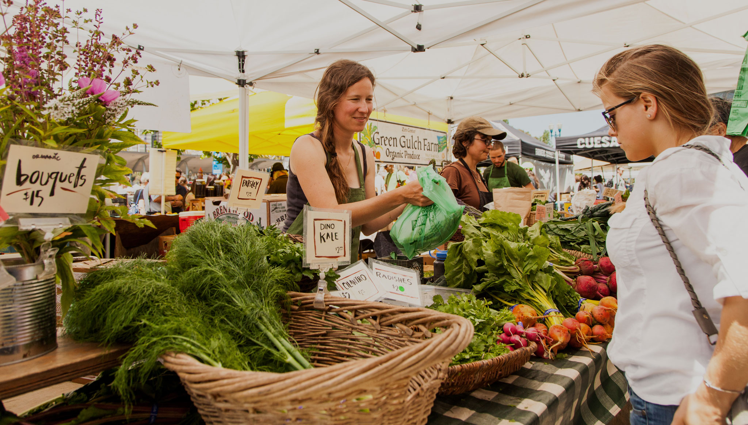
People who offer goods and services for sale are sellers.

Slide 9
There are many ways for buyers to purchase goods and services from sellers.

Slide 10
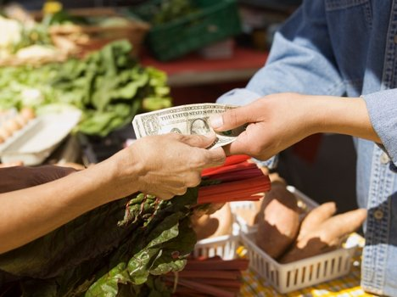
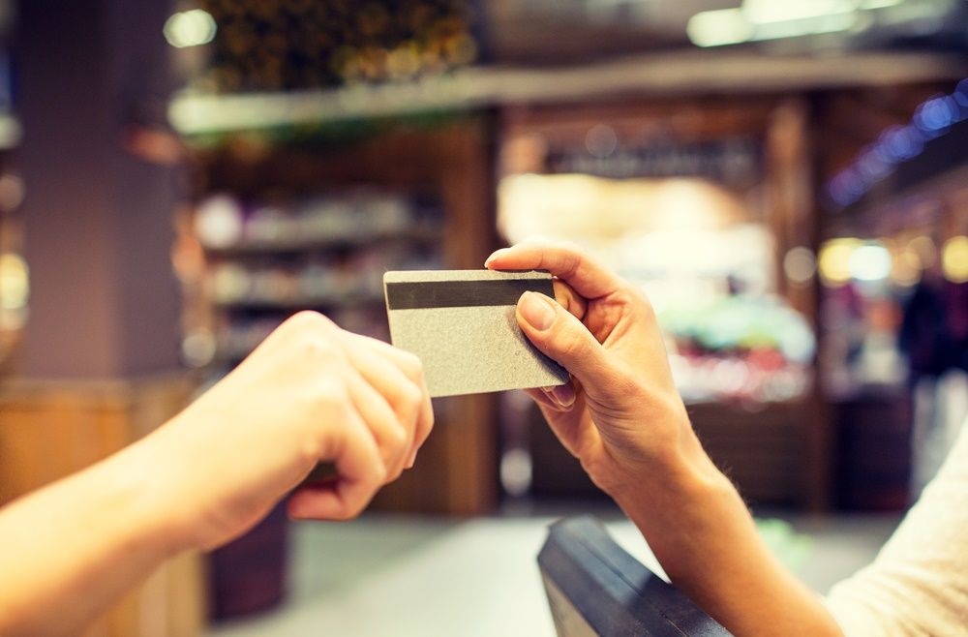
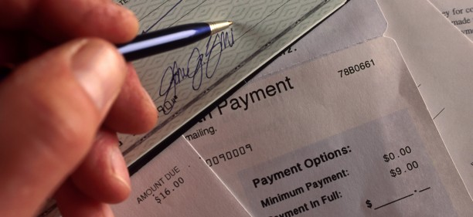
Buyers use cash, checks, and credit cards. Buyers can also trade for goods and services.

Slide 11
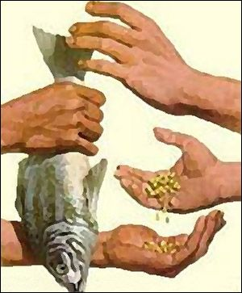
Before people used money, they traded many different items for the goods or services they wanted or needed.

Slide 12
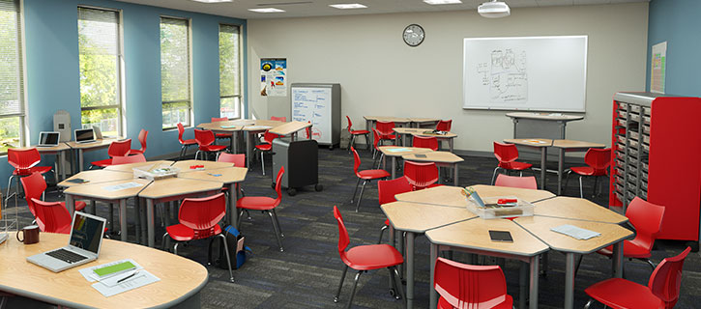
What is a scarce resource in your classroom? Could you buy this resource? Could you trade something for it?

Slide 13
Photo Credits
https://www.google.com/search?site=&tbm=isch&source=hp&biw=1280&bih=645&q=out+of+milk&oq=out+of+mil&gs_l=img.1.0.0l5j0i5i30k1l5.1072.2472.0.5236.10.10.0.0.0.0.144.756.8j2.10.0....0...1.1.64.img..0.10.754.JqpAdEXyJQs#tbm=isch&q=empty+refrigerator+&imgrc=F7Tdr09fZHPgNM:
https://www.google.com/search?site=&tbm=isch&source=hp&biw=1280&bih=645&q=out+of+milk&oq=out+of+mil&gs_l=img.1.0.0l5j0i5i30k1l5.1072.2472.0.5236.10.10.0.0.0.0.144.756.8j2.10.0....0...1.1.64.img..0.10.754.JqpAdEXyJQs#tbm=isch&q=scarcity&imgdii=5uBcHuqpfKwt-M:&imgrc=L43ias6RZ1ZlIM:
https://www.google.com/search?site=&tbm=isch&source=hp&biw=1280&bih=645&q=out+of+milk&oq=out+of+mil&gs_l=img.1.0.0l5j0i5i30k1l5.1072.2472.0.5236.10.10.0.0.0.0.144.756.8j2.10.0....0...1.1.64.img..0.10.754.JqpAdEXyJQs#tbm=isch&q=sold+out+of+milk&imgrc=PqhGkR99x9GhlM:
https://www.google.com/search?site=&tbm=isch&source=hp&biw=1280&bih=645&q=out+of+milk&oq=out+of+mil&gs_l=img.1.0.0l5j0i5i30k1l5.1072.2472.0.5236.10.10.0.0.0.0.144.756.8j2.10.0....0...1.1.64.img..0.10.754.JqpAdEXyJQs#tbm=isch&q=buying+goods+and+services&imgrc=txzNA6LY_q0naM:
https://www.google.com/search?site=&tbm=isch&source=hp&biw=1280&bih=645&q=out+of+milk&oq=out+of+mil&gs_l=img.1.0.0l5j0i5i30k1l5.1072.2472.0.5236.10.10.0.0.0.0.144.756.8j2.10.0....0...1.1.64.img..0.10.754.JqpAdEXyJQs#tbm=isch&q=buying+goods+and+services&imgrc=6amI0YrvpndM4M:
https://www.google.com/search?site=&tbm=isch&source=hp&biw=1280&bih=645&q=out+of+milk&oq=out+of+mil&gs_l=img.1.0.0l5j0i5i30k1l5.1072.2472.0.5236.10.10.0.0.0.0.144.756.8j2.10.0....0...1.1.64.img..0.10.754.JqpAdEXyJQs#tbm=isch&q=buying+goods+and+services&imgrc=I9T0iriz7BGC_M:
https://www.google.com/search?site=&tbm=isch&source=hp&biw=1280&bih=645&q=out+of+milk&oq=out+of+mil&gs_l=img.1.0.0l5j0i5i30k1l5.1072.2472.0.5236.10.10.0.0.0.0.144.756.8j2.10.0....0...1.1.64.img..0.10.754.JqpAdEXyJQs#tbm=isch&q=farmer's+market&imgrc=TSLcXfz3i07nxM:
https://www.google.com/search?site=&tbm=isch&source=hp&biw=1280&bih=645&q=out+of+milk&oq=out+of+mil&gs_l=img.1.0.0l5j0i5i30k1l5.1072.2472.0.5236.10.10.0.0.0.0.144.756.8j2.10.0....0...1.1.64.img..0.10.754.JqpAdEXyJQs#tbm=isch&q=buying+goods+and+services&imgrc=1EjRJfnHvH9B1M:
https://www.google.com/search?site=&tbm=isch&source=hp&biw=1280&bih=645&q=out+of+milk&oq=out+of+mil&gs_l=img.1.0.0l5j0i5i30k1l5.1072.2472.0.5236.10.10.0.0.0.0.144.756.8j2.10.0....0...1.1.64.img..0.10.754.JqpAdEXyJQs#tbm=isch&q=paying+with+a+check&imgrc=UdDjYx01Tc3jSM:
https://www.google.com/search?site=&tbm=isch&source=hp&biw=1280&bih=645&q=out+of+milk&oq=out+of+mil&gs_l=img.1.0.0l5j0i5i30k1l5.1072.2472.0.5236.10.10.0.0.0.0.144.756.8j2.10.0....0...1.1.64.img..0.10.754.JqpAdEXyJQs#tbm=isch&q=classroom&imgrc=dGpSRnjHHBRD_M:

