Slide 1
Buying and Saving
SS.1.E.1.5 Recognize the importance of saving money for future purchases.
SS.1.E.1.6 Identify that people need to make choices because of scarce resources.

Slide 2
People make choices everyday. Sometimes a choice is made because there is not enough of what we want.

Slide 3
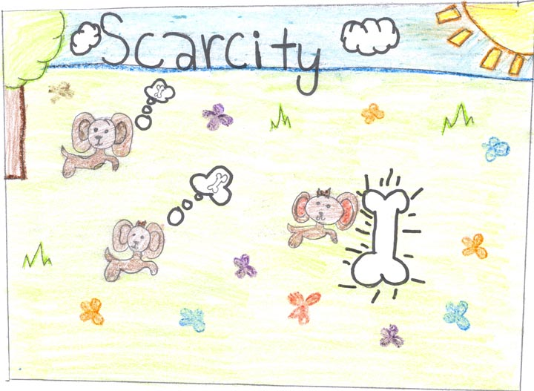
When we do not have enough of a resource that we want, we say that the resource is scarce.

Slide 4
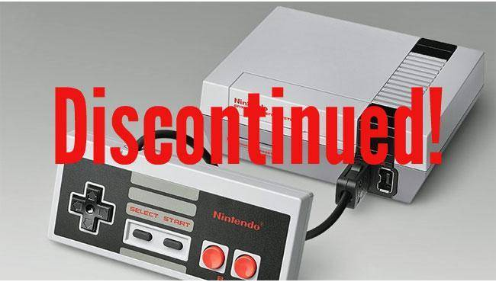
Scarcity can also mean that what we want is no longer available.

Slide 5
Sometimes we can buy what we want right away. Sometimes we need to save money to buy what we want.

Slide 6
We can save money at home. When we have saved enough money to buy what we want, we can go shopping!

Slide 7
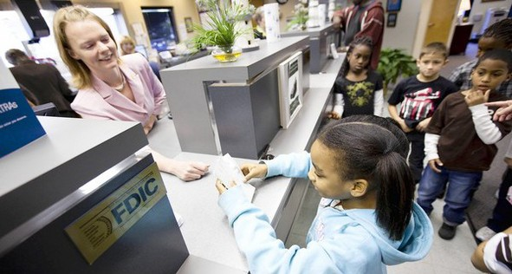
We can also save money in a bank. Banks pay us a little extra money called interest for letting them use our money until we need it.

Slide 8
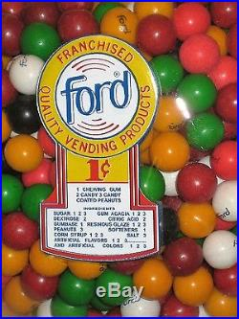
Can we buy this right away or do we need to save?

Slide 9
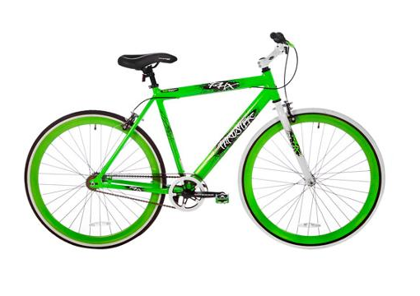
Can we buy this right away or do we need to save?
$200

Slide 10
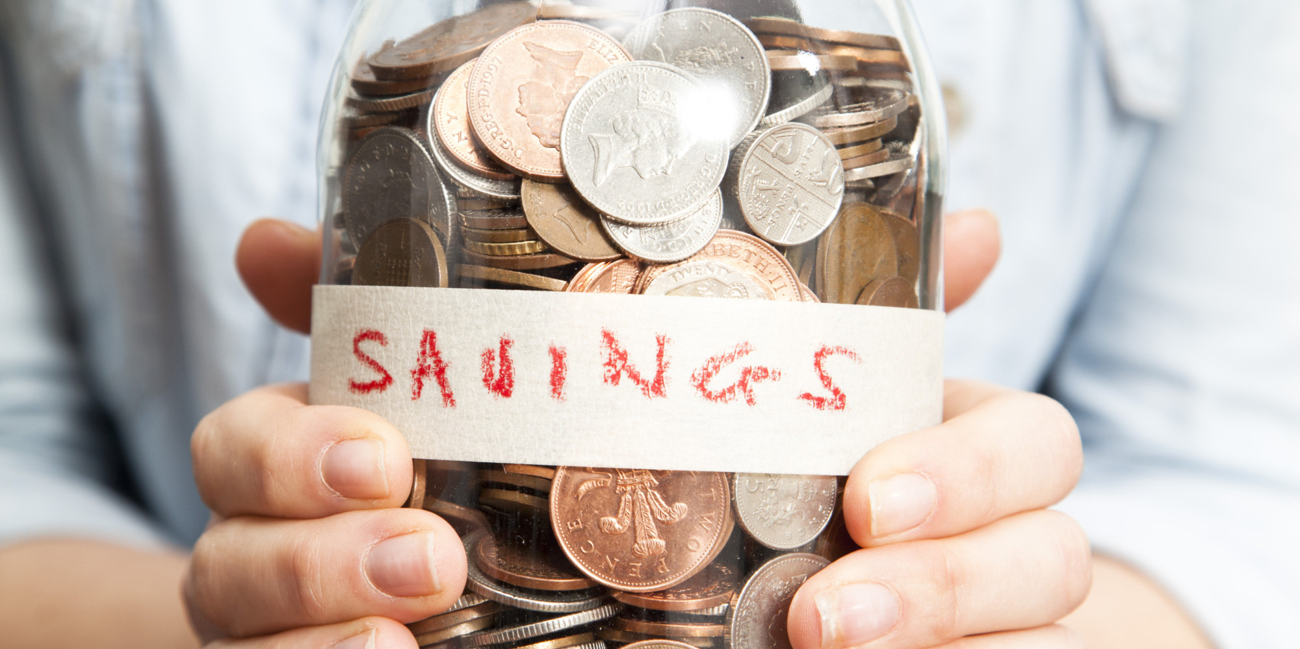
What would you like to save money to buy?

Slide 11
Photo Credits
http://davidewart.typepad.com/.a/6a00d8345310da69e2019b04b89526970d-popup
https://www.google.com/search?site=&tbm=isch&source=hp&biw=1280&bih=645&q=decision+making&oq=decision+making&gs_l=img.3..0l10.138202.140967.0.141144.17.13.0.4.4.0.98.685.9.9.0....0...1ac.1.64.img..4.13.711.0.WsGVudQs7lo#tbm=isch&q=scarce+resources+for+kids&imgdii=RtXe1GYhwfk-2M:&imgrc=L43ias6RZ1ZlIM:
http://www.qualitywaterservicecompany.com/2011/10/03/save/
https://www.financialsecuritybank.com/community-kids-links.htm
https://www.dreamstime.com/photos-images/piggy-bank-pile-coins.html
http://www.keywordsuggests.com/p3y6iS4Ayn4TJ6lUGZ%7Cha3PaeGAxGBHhR6FHIAFcyII/
https://www.google.com/search?q=one+cent+gum&source=lnms&tbm=isch&sa=X&ved=0ahUKEwiYxKe9xOjTAhXPaCYKHY_4DgcQ_AUICygC&biw=1280&bih=645#imgrc=rrlxD-iOGxAtKM:
https://www.google.com/search?site=&tbm=isch&source=hp&biw=1280&bih=645&q=saving+money&oq=saving+money&gs_l=img.3..0l10.2634.4867.0.5404.13.9.0.4.4.0.164.686.7j1.8.0....0...1ac.1.64.img..1.12.707.0.gaaeIuiVPCE#imgrc=HWU7qtDL1A0jCM:

