Slide 1
Choices, Choices!
SS.1.E.1.2 Define opportunity costs as giving up one thing for another.

Slide 2
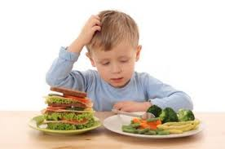
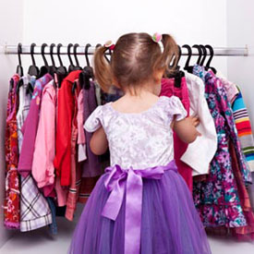
We make choices every day.

Slide 3
Sometimes it is easy to choose, but sometimes it is difficult.

Slide 4
When we make a choice, we have to give something up.
You can only pick one pet!

Slide 5
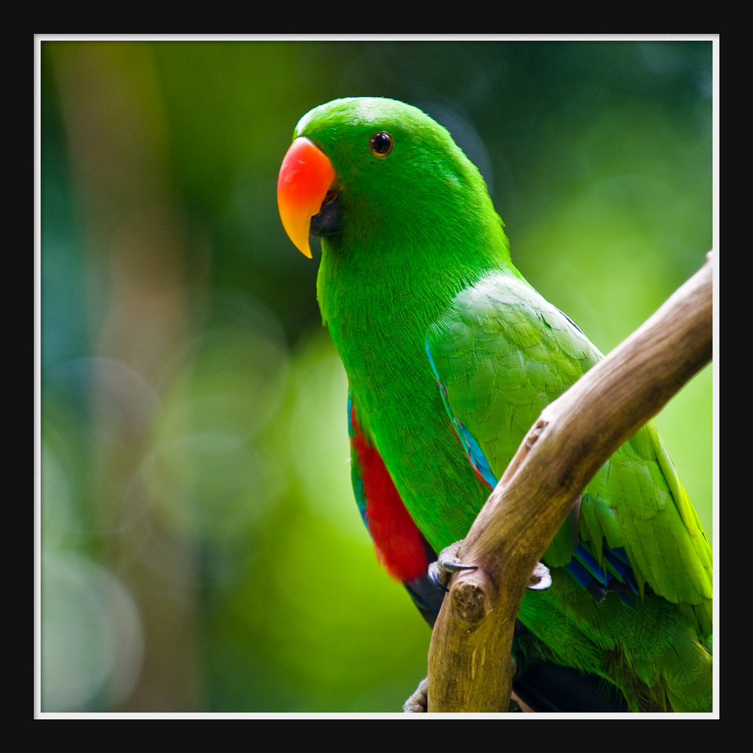
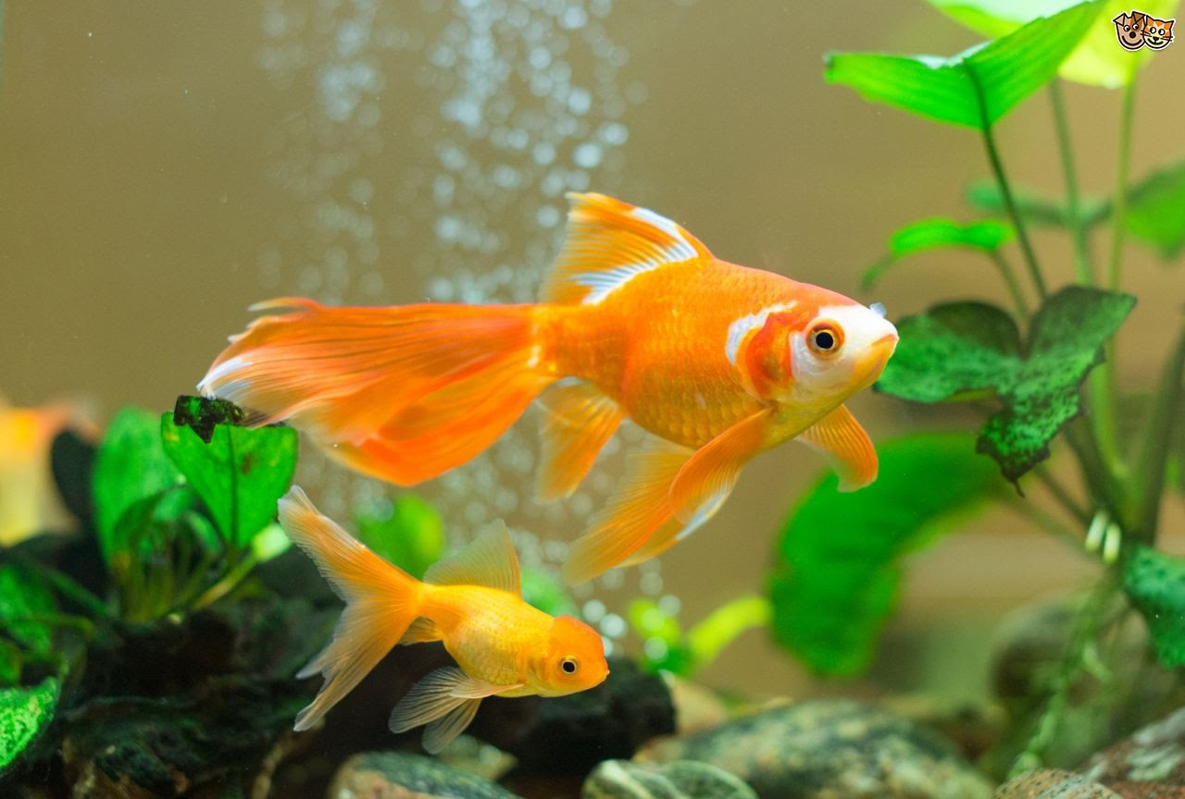
What we give up when we make a choice is called an opportunity cost.
The goldfish was my second choice. This is my opportunity cost.
I picked a parrot!

Slide 6
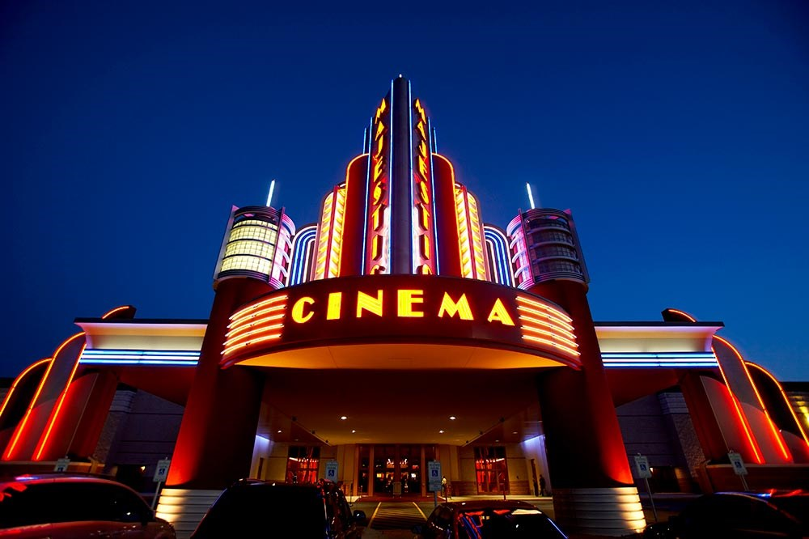
Should we go to the beach or to a movie? What would you choose? What would be the opportunity cost?

Slide 7
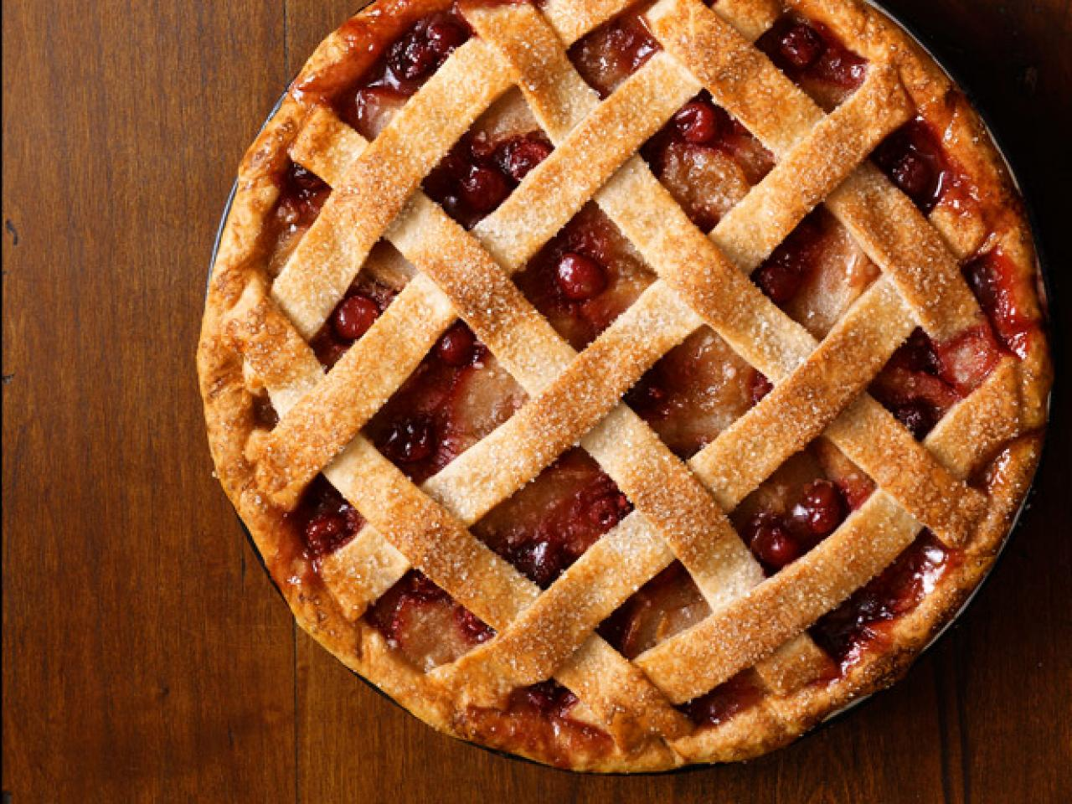
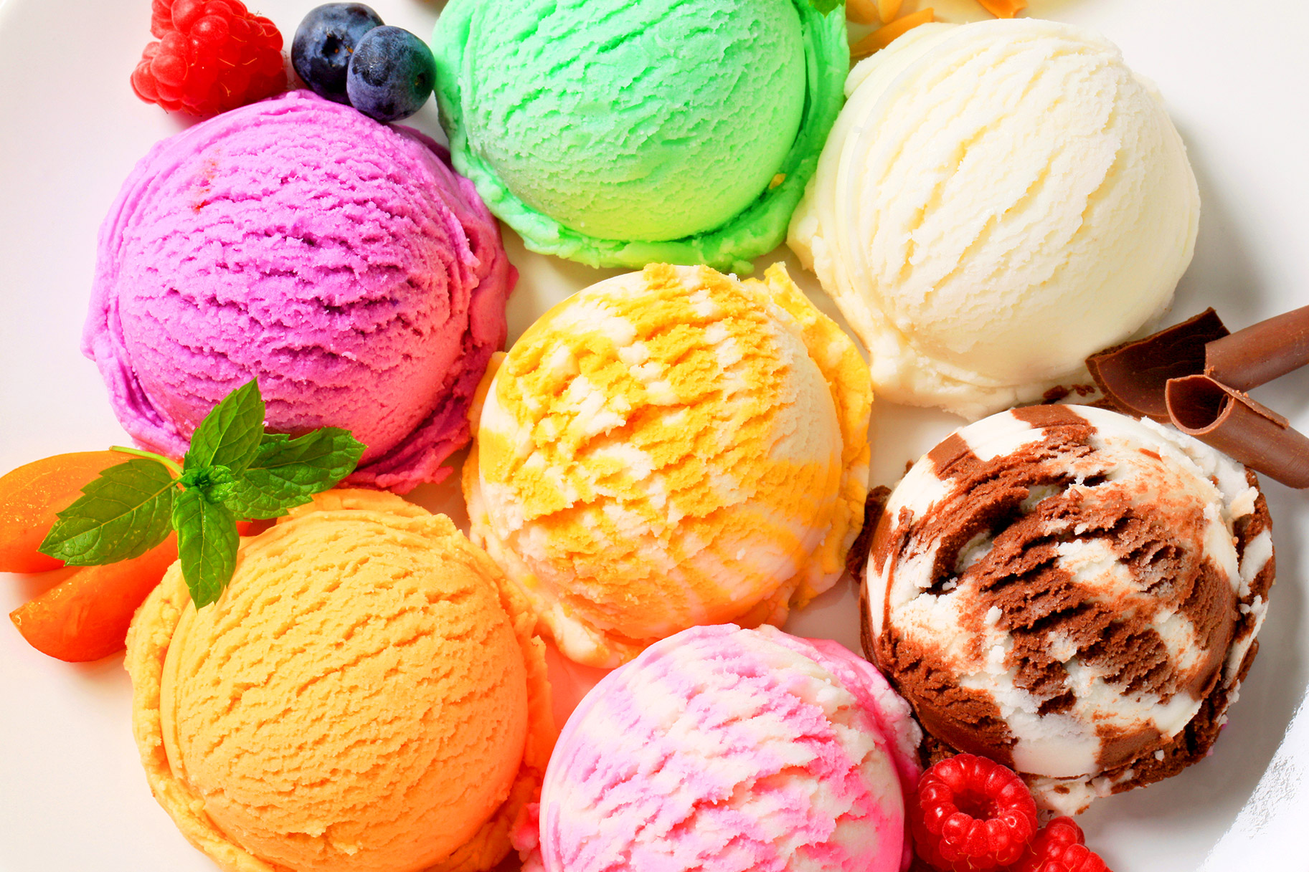
Should we pick pie or ice cream for dessert? What would you choose? What would be the opportunity cost?

Slide 8
When we make a choice, the thing we give up is the opportunity cost. What choices have you made today? What were the opportunity costs?

Slide 9
Photo Credits
https://www.google.com/search?site=&tbm=isch&source=hp&biw=1147&bih=601&q=kids+making+choices&oq=kids+making+choices&gs_l=img.3..0j0i8i30k1l4.1303.3712.0.4424.20.17.0.3.3.0.145.1539.10j6.16.0....0...1ac.1.64.img..1.19.1553.0..0i30k1.k-5s6t0l_1o#imgrc=cYWdlVCDbULQ0M:
https://www.google.com/search?site=&tbm=isch&source=hp&biw=1147&bih=601&q=kids+making+choices&oq=kids+making+choices&gs_l=img.3..0j0i8i30k1l4.1303.3712.0.4424.20.17.0.3.3.0.145.1539.10j6.16.0....0...1ac.1.64.img..1.19.1553.0..0i30k1.k-5s6t0l_1o#imgrc=RbAeB23Bwqr13M:
https://www.google.com/search?site=&tbm=isch&source=hp&biw=1147&bih=601&q=kids+making+choices&oq=kids+making+choices&gs_l=img.3..0j0i8i30k1l4.1303.3712.0.4424.20.17.0.3.3.0.145.1539.10j6.16.0....0...1ac.1.64.img..1.19.1553.0..0i30k1.k-5s6t0l_1o#imgrc=VdGAoGA_ehfOWM:
https://www.google.com/search?site=&tbm=isch&source=hp&biw=1147&bih=601&q=kids+making+choices&oq=kids+making+choices&gs_l=img.3..0j0i8i30k1l4.1303.3712.0.4424.20.17.0.3.3.0.145.1539.10j6.16.0....0...1ac.1.64.img..1.19.1553.0..0i30k1.k-5s6t0l_1o#imgrc=Urps8rFWHsOQ3M:
https://www.google.com/search?site=&tbm=isch&source=hp&biw=1147&bih=601&q=kids+making+choices&oq=kids+making+choices&gs_l=img.3..0j0i8i30k1l4.1303.3712.0.4424.20.17.0.3.3.0.145.1539.10j6.16.0....0...1ac.1.64.img..1.19.1553.0..0i30k1.k-5s6t0l_1o#tbm=isch&q=beach&imgrc=1QGsPyRrAjpebM:
https://www.google.com/search?site=&tbm=isch&source=hp&biw=1147&bih=601&q=kids+making+choices&oq=kids+making+choices&gs_l=img.3..0j0i8i30k1l4.1303.3712.0.4424.20.17.0.3.3.0.145.1539.10j6.16.0....0...1ac.1.64.img..1.19.1553.0..0i30k1.k-5s6t0l_1o#tbm=isch&q=movie+theater&imgrc=zgEKuwGFeum-1M:

Slide 10
Photo Credits
https://www.google.com/search?site=&tbm=isch&source=hp&biw=1147&bih=601&q=kids+making+choices&oq=kids+making+choices&gs_l=img.3..0j0i8i30k1l4.1303.3712.0.4424.20.17.0.3.3.0.145.1539.10j6.16.0....0...1ac.1.64.img..1.19.1553.0..0i30k1.k-5s6t0l_1o#tbm=isch&q=gold+fish&imgrc=qvjItnxvWJlHuM:
https://www.google.com/search?site=&tbm=isch&source=hp&biw=1147&bih=601&q=kids+making+choices&oq=kids+making+choices&gs_l=img.3..0j0i8i30k1l4.1303.3712.0.4424.20.17.0.3.3.0.145.1539.10j6.16.0....0...1ac.1.64.img..1.19.1553.0..0i30k1.k-5s6t0l_1o#tbm=isch&q=green+parrot&imgrc=pyHijdoBHo6AIM:
https://www.google.com/search?site=&tbm=isch&source=hp&biw=1147&bih=601&q=kids+making+choices&oq=kids+making+choices&gs_l=img.3..0j0i8i30k1l4.1303.3712.0.4424.20.17.0.3.3.0.145.1539.10j6.16.0....0...1ac.1.64.img..1.19.1553.0..0i30k1.k-5s6t0l_1o#tbm=isch&q=which+pet+should+i+get&imgrc=4tvbkH4Ox6SB4M:
https://www.google.com/search?site=&tbm=isch&source=hp&biw=1147&bih=601&q=kids+making+choices&oq=kids+making+choices&gs_l=img.3..0j0i8i30k1l4.1303.3712.0.4424.20.17.0.3.3.0.145.1539.10j6.16.0....0...1ac.1.64.img..1.19.1553.0..0i30k1.k-5s6t0l_1o#tbm=isch&q=pie&imgrc=x5cTfkmVnEoANM:
https://www.google.com/search?site=&tbm=isch&source=hp&biw=1147&bih=601&q=kids+making+choices&oq=kids+making+choices&gs_l=img.3..0j0i8i30k1l4.1303.3712.0.4424.20.17.0.3.3.0.145.1539.10j6.16.0....0...1ac.1.64.img..1.19.1553.0..0i30k1.k-5s6t0l_1o#tbm=isch&q=ice+cream&imgrc=xJxGqUrJcSu41M:
https://www.google.com/search?site=&tbm=isch&source=hp&biw=1147&bih=601&q=kids+making+choices&oq=kids+making+choices&gs_l=img.3..0j0i8i30k1l4.1303.3712.0.4424.20.17.0.3.3.0.145.1539.10j6.16.0....0...1ac.1.64.img..1.19.1553.0..0i30k1.k-5s6t0l_1o#tbm=isch&q=opportunity+cost&imgrc=E-t54nE5kvKIwM:

