Slide 1
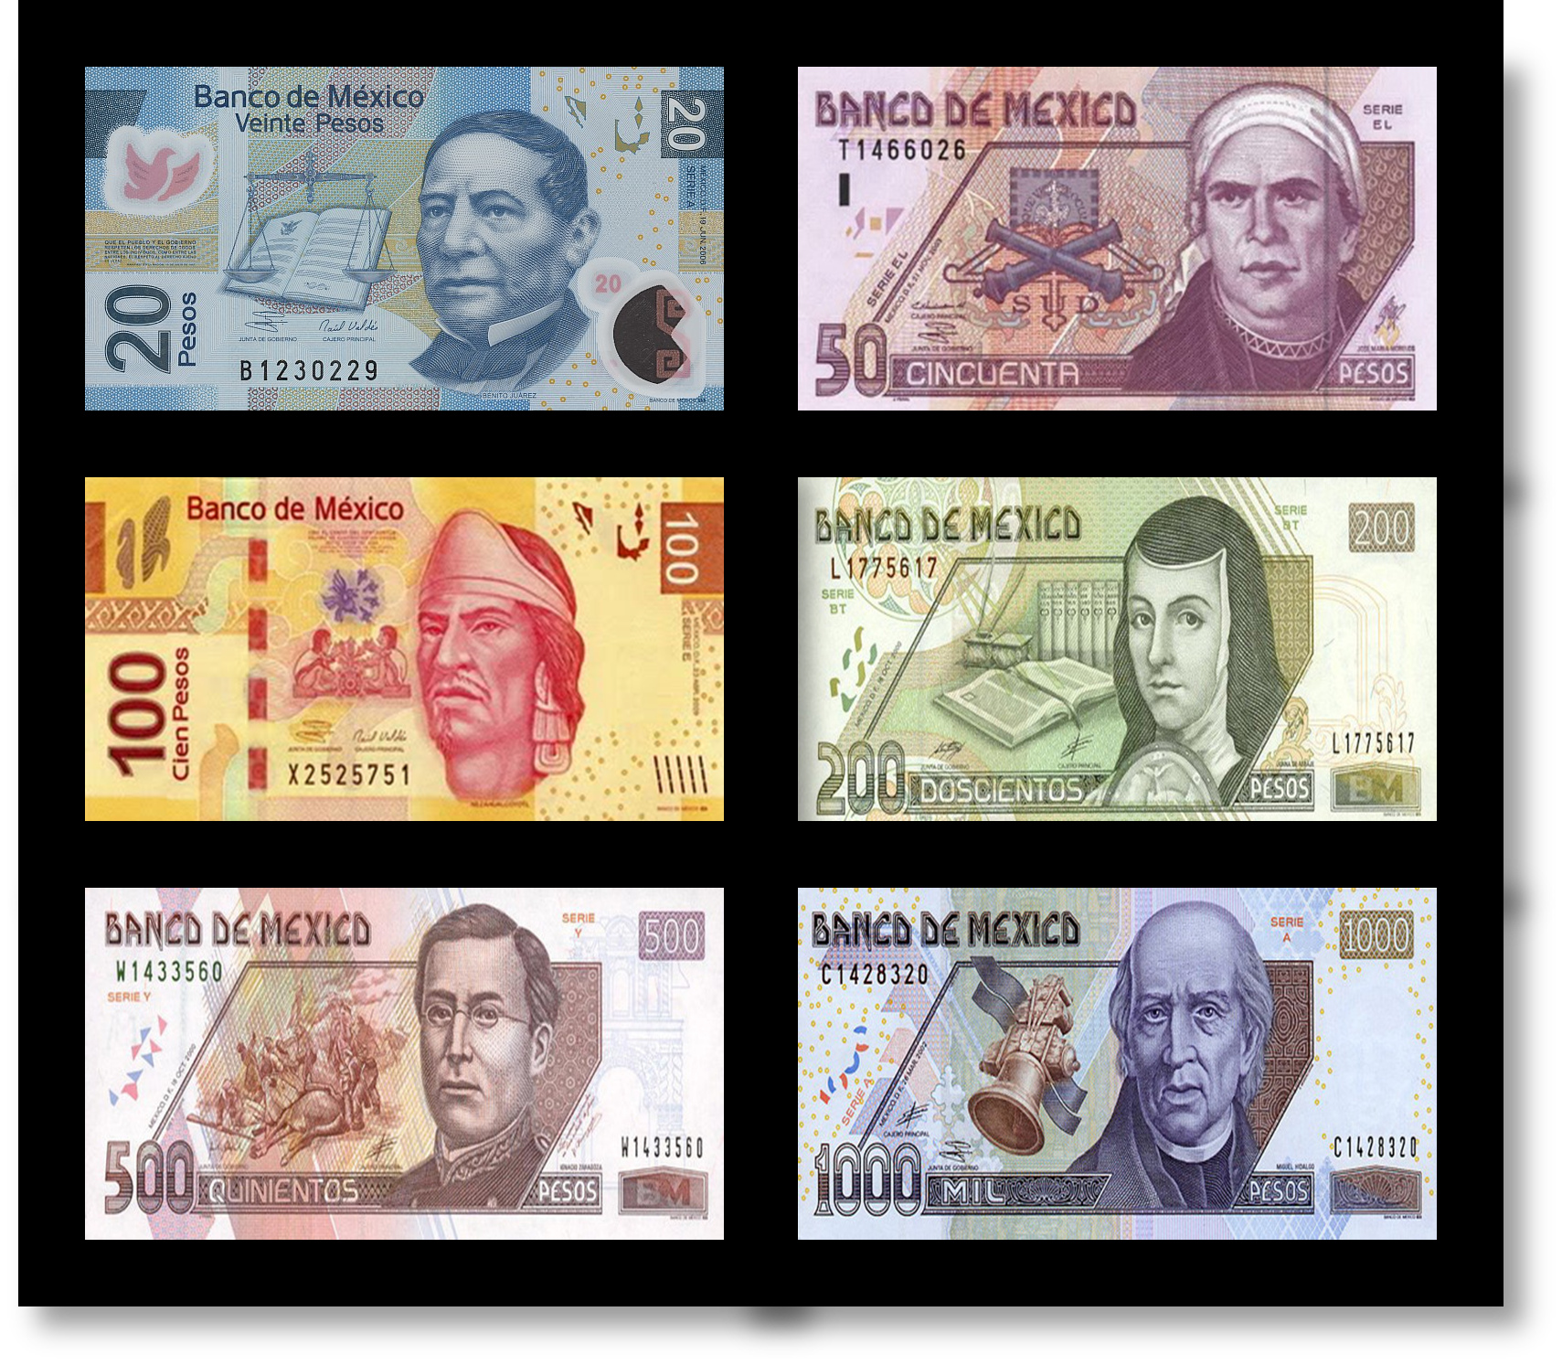
Currencies of the United States, Canada, Mexico, and the Caribbean
SS.3.E.1.4 Distinguish between currencies used in the United States, Canada, Mexico, and the Caribbean.

Slide 2
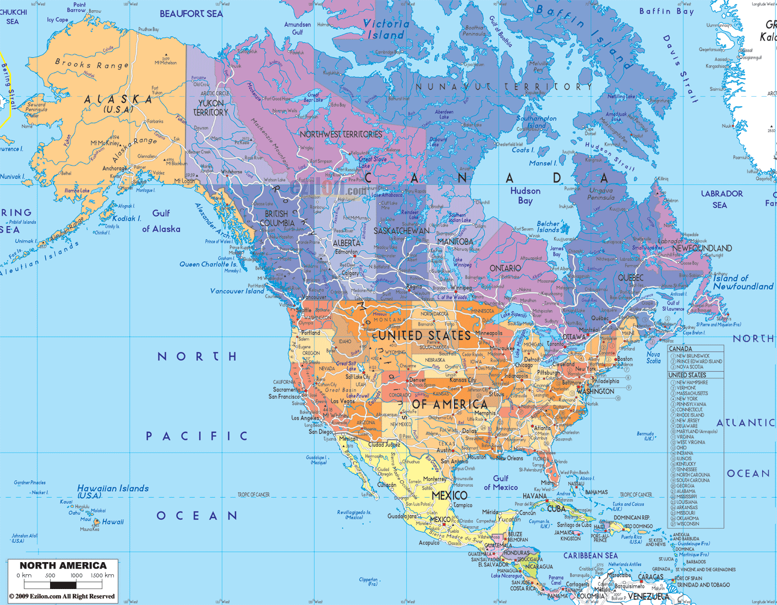
Different countries use different forms of money, or currency.

Slide 3
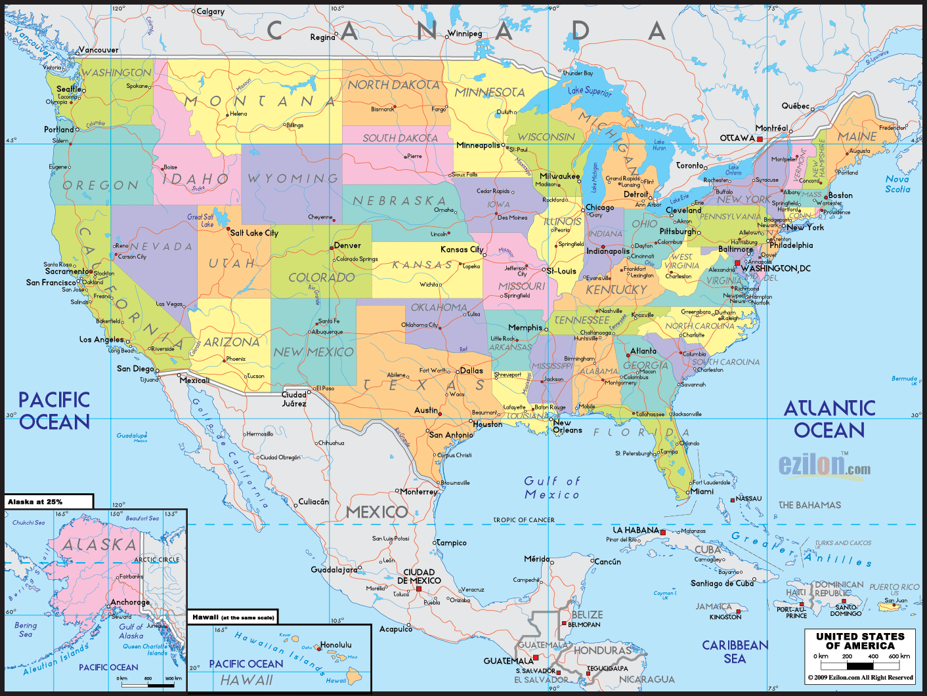
The United States of America

Slide 4
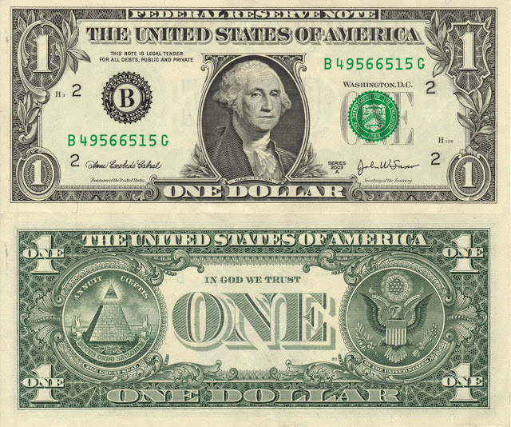
The currency of the United States is the United States Dollar

Slide 5
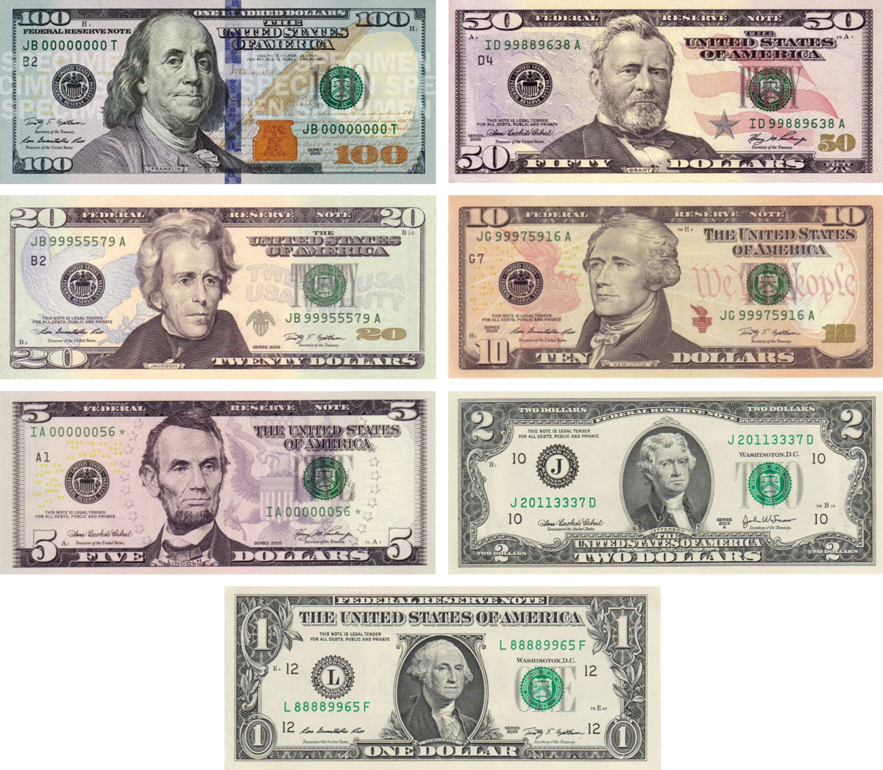
American paper currency is issued in several denominations: $1, $2, $5, $10, $20, $50, and $100.

Slide 6
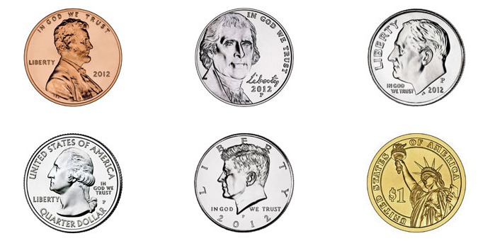
American coin currency is issued in several denominations: 1¢, 5¢, 10¢, 25¢, 50¢, and $1.

Slide 7
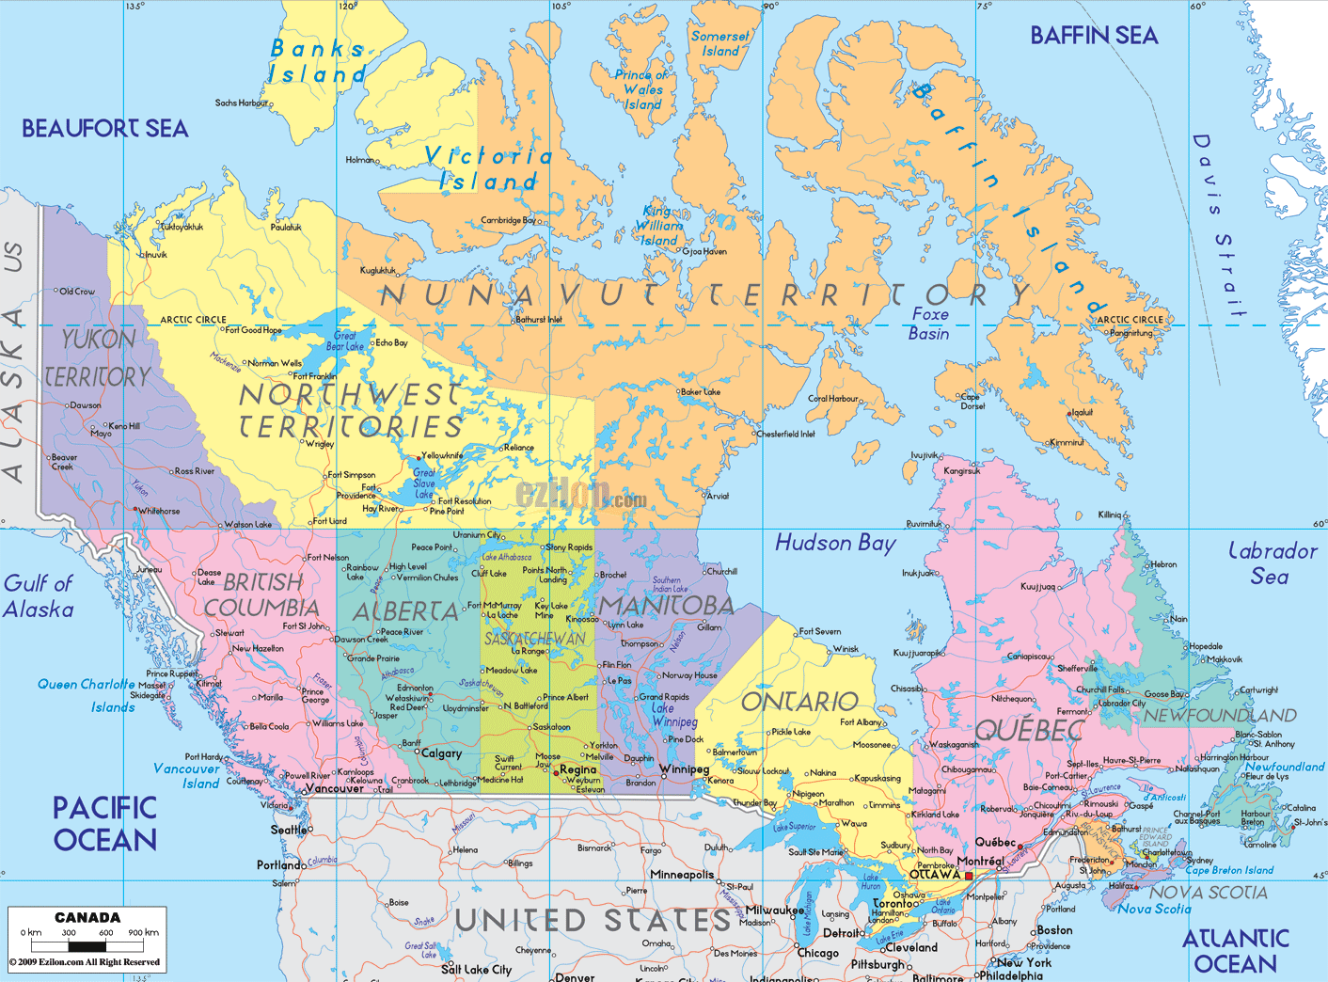
Canada

Slide 8
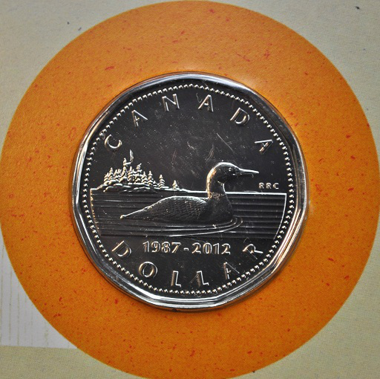
The currency of Canada is the Canadian Dollar.

Slide 9
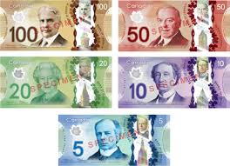
Canadian paper currency is issued in several denominations: $5, $10, $20, $50, and $100.

Slide 10
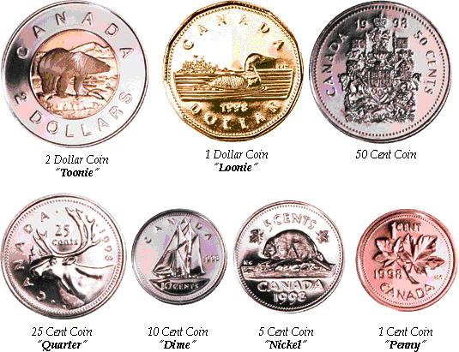
Canadian coin currency is issued in several denominations: 1¢, 5¢, 10¢, 25¢, 50¢, $1, and $2.
Notes:
The Canadian penny is being taken out of circulation.

Slide 11
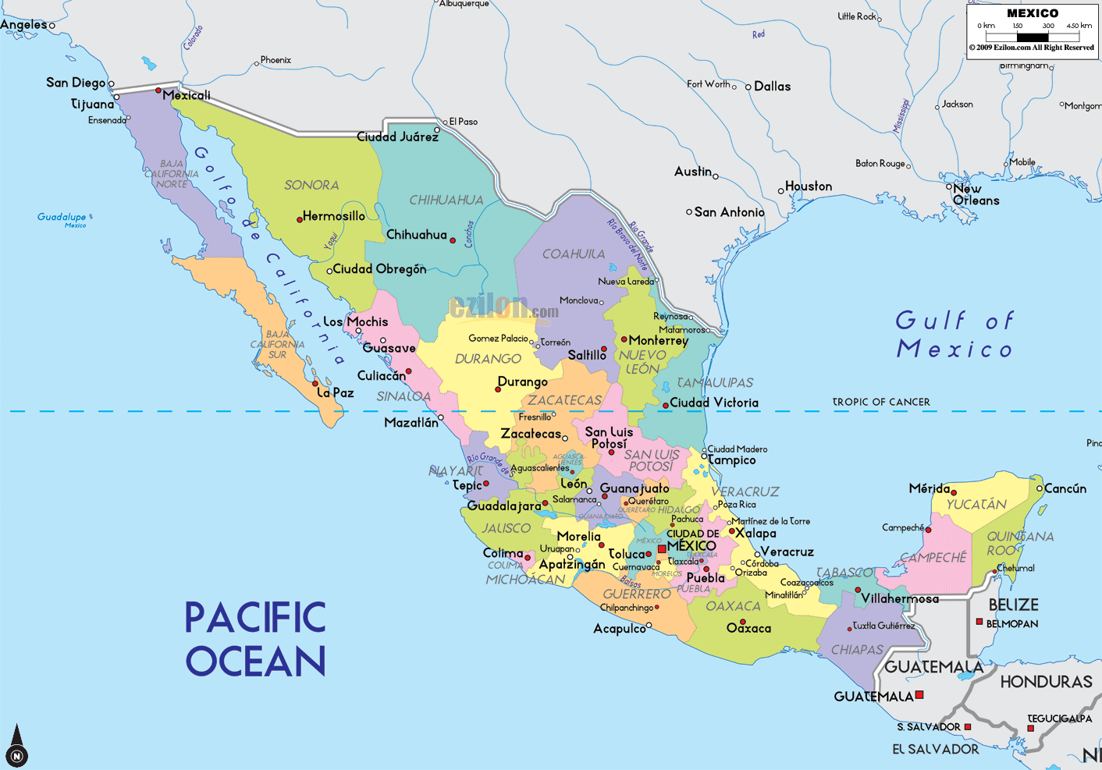
Mexico

Slide 12
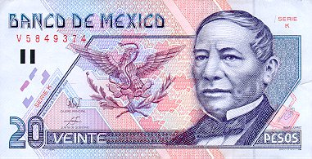
The currency of the Mexico is the Mexican Peso.
Notes:
Benito Juarez is on the 20 peso bill.

Slide 13
Mexican paper currency is issued in several denominations: 20, 50, 100, 200, 500, and 1000 pesos.

Slide 14
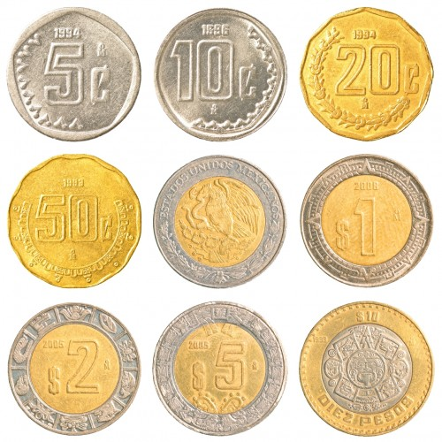
Mexican coin currency is issued in several denominations.
Centavos: 5¢, 10¢, 20¢, and 50¢
Pesos: $1, $2, $5, and $10

Slide 15
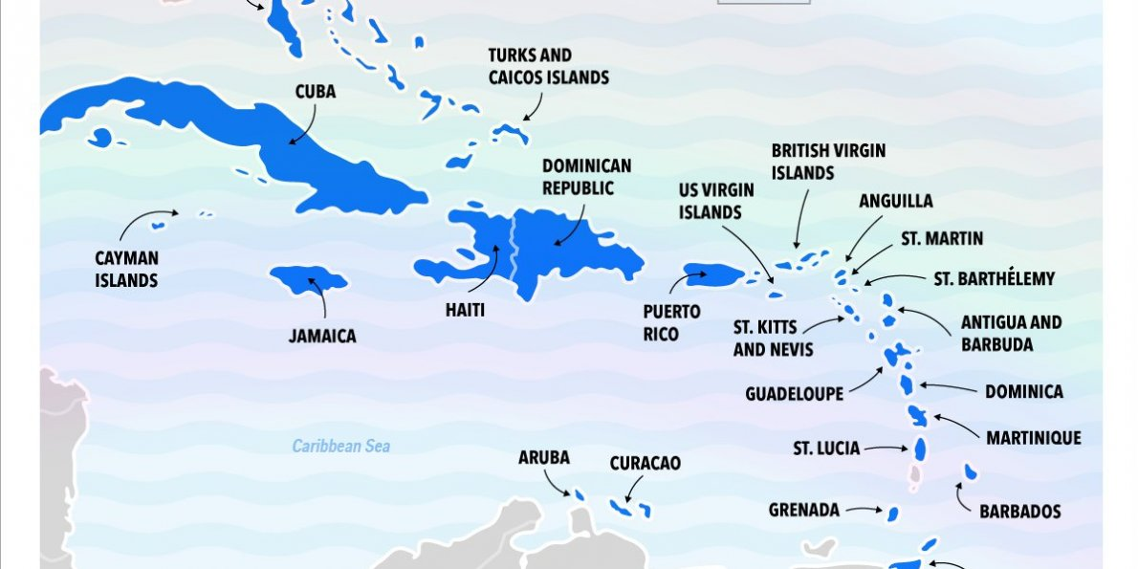
There are many different currencies in the Caribbean Islands.
https://en.wikipedia.org/wiki/Central_banks_and_currencies_of_the_Caribbean

Slide 16
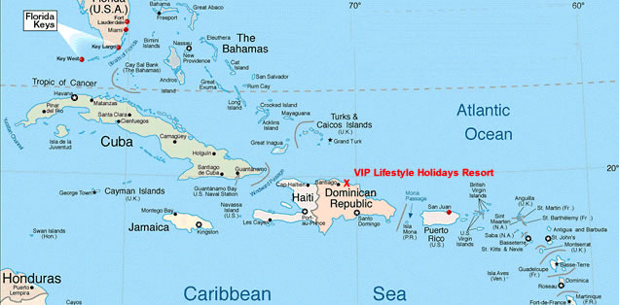
Cuba

Slide 17
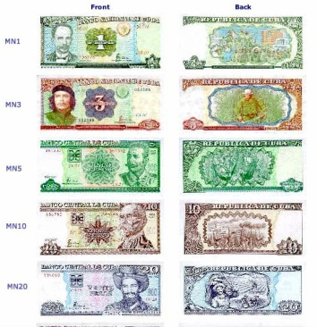
Cuban paper currency is issued in several denominations: $1, $3, $5, $10, $20, $50, and $100 pesos .

Slide 18
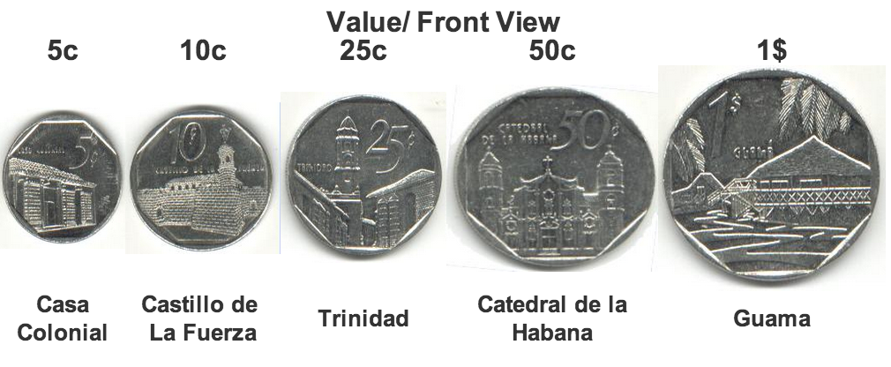
Cuban coin currency is issued in several denominations: $0.05, $0.10, $0.25, $0.50, $1.00.

Slide 19
Haiti

Slide 20
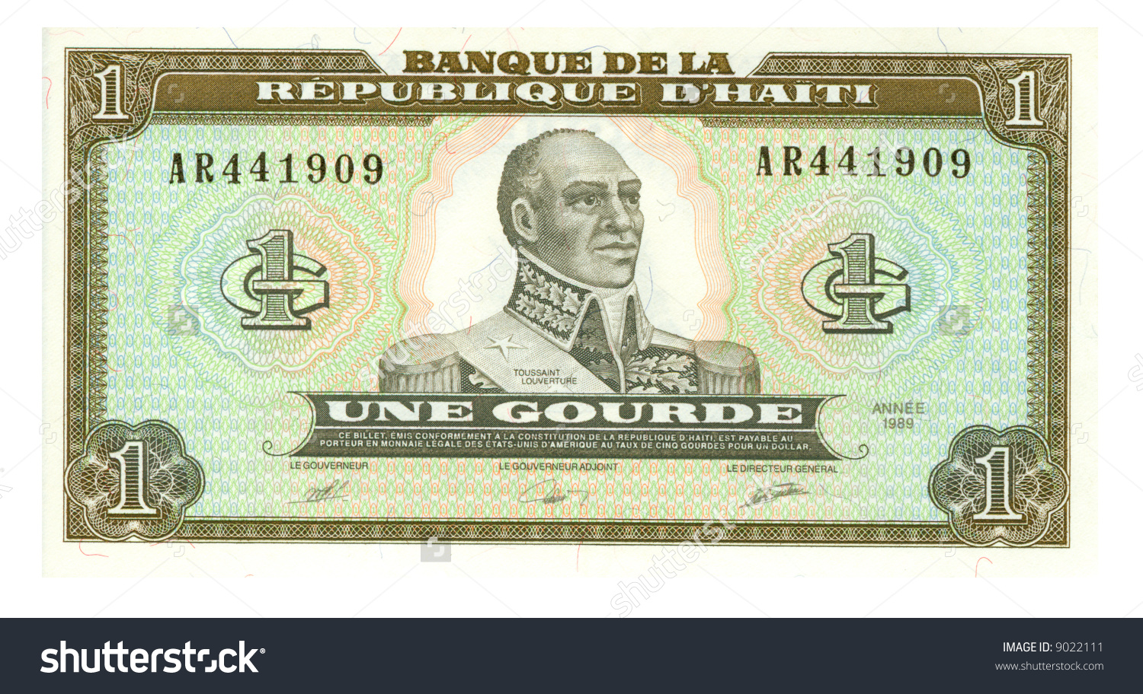
The currency of the Haiti is the Haitian Gourde.

Slide 21
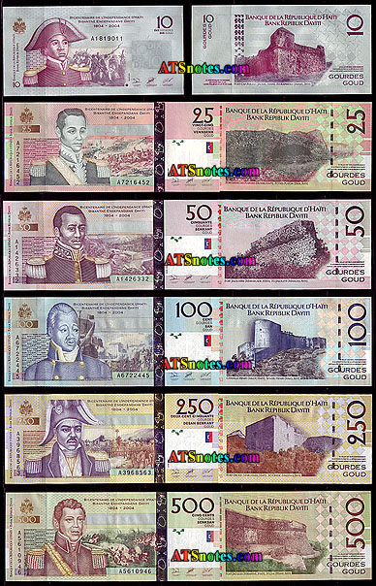
Haitian paper currency is issued in several denominations: 1, 2, 5, 10, 20, 25, 50, 100, 500, and 1,000 gourdes.

Slide 22
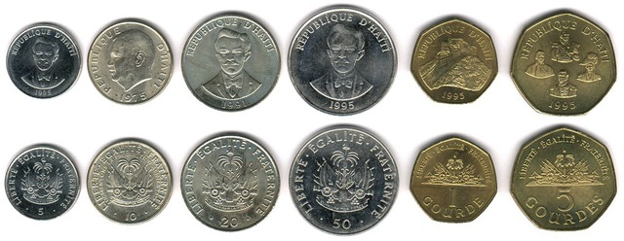
Haitian coin currency is issued in several denominations: 6, 12, 25, 50, and 100 centimes as well as 1, 5, and 25 gourdes.

Slide 23
Puerto Rico

Slide 24
The currency of the Puerto Rico is the United States Dollar.

Slide 25
Puerto Rico is a United States Territory. It uses the same coins and bills as the United States.

Slide 26
How much is a dollar worth in other countries?
1 United States Dollar =
1.32 Canadian Dollars (1.32 times more)
17.96 Mexican Pesos (17.96 times more)
87 Cuban centavos (.13 times less)*
62.88 Haitian Gourde (62.88 times more)

Slide 27
Photo Credits
https://www.google.com/search?site=&tbm=isch&source=hp&biw=1280&bih=645&q=map+of+north+america%2C+canada%2C+and+caribbean&oq=map+of+north+america%2C+canada%2C+and+caribbean&gs_l=img.3...2245.18352.0.18552.56.51.5.0.0.0.193.3320.44j5.49.0....0...1.1.64.img..2.36.2322.0..0j0i30k1j0i8i30k1.lKNDiKwoMu0#imgrc=vutLdbBu0k-WvM:
https://www.google.com/search?site=&tbm=isch&source=hp&biw=1280&bih=645&q=map+of+north+america%2C+canada%2C+and+caribbean&oq=map+of+north+america%2C+canada%2C+and+caribbean&gs_l=img.3...2245.18352.0.18552.56.51.5.0.0.0.193.3320.44j5.49.0....0...1.1.64.img..2.36.2322.0..0j0i30k1j0i8i30k1.lKNDiKwoMu0#tbm=isch&q=current+dollar+bill&imgrc=lK08f2cDJH3qrM:
https://www.google.com/search?site=&tbm=isch&source=hp&biw=1280&bih=645&q=map+of+north+america%2C+canada%2C+and+caribbean&oq=map+of+north+america%2C+canada%2C+and+caribbean&gs_l=img.3...2245.18352.0.18552.56.51.5.0.0.0.193.3320.44j5.49.0....0...1.1.64.img..2.36.2322.0..0j0i30k1j0i8i30k1.lKNDiKwoMu0#tbm=isch&q=american+coin+currency&imgdii=hgnrC3ORuXOm4M:&imgrc=p3vbIcTIvHoF6M:
https://jeroja6.wordpress.com/2011/12/05/canada-cartera-25-anos-dolar-loonie-1987-2012/
https://www.google.com/search?site=&tbm=isch&source=hp&biw=1280&bih=645&q=map+of+north+america%2C+canada%2C+and+caribbean&oq=map+of+north+america%2C+canada%2C+and+caribbean&gs_l=img.3...2245.18352.0.18552.56.51.5.0.0.0.193.3320.44j5.49.0....0...1.1.64.img..2.36.2322.0..0j0i30k1j0i8i30k1.lKNDiKwoMu0#tbm=isch&q=current+canadian+coins&imgrc=iA_9nXnjO_82jM:
https://www.google.com/search?q=http://visit-vallarta.com/wp-content/uploads/2014/03/MXN-Currency.png&source=lnms&tbm=isch&sa=X&ved=0ahUKEwiOwIne-L3UAhXG6SYKHeKdBdgQ_AUICigB&biw=1280&bih=645#tbm=isch&q=current+mexican+peso&imgrc=6u0471JkyUVIIM:
https://www.mexperience.com/lifestyle/mexico-essentials/money-in-mexico/
https://www.google.com/search?q=http://visit-vallarta.com/wp-content/uploads/2014/03/MXN-Currency.png&source=lnms&tbm=isch&sa=X&ved=0ahUKEwiOwIne-L3UAhXG6SYKHeKdBdgQ_AUICigB&biw=1280&bih=645#tbm=isch&q=map+of+caribbean+islands&imgrc=xufIXbWk72BVfM:
http://www.webhavana.com/en/cuba_currency.html
https://www.google.com/search?q=http://visit-vallarta.com/wp-content/uploads/2014/03/MXN-Currency.png&source=lnms&tbm=isch&sa=X&ved=0ahUKEwiOwIne-L3UAhXG6SYKHeKdBdgQ_AUICigB&biw=1280&bih=645#tbm=isch&q=haitian+coins&imgrc=LD1Wcj_quXz92M:

