Slide 1
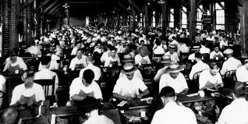
Entrepreneurs in Florida
SS.4.E.1.1 Identify entrepreneurs from various social and ethnic backgrounds who have influenced Florida and local economy.

Slide 2
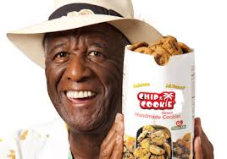
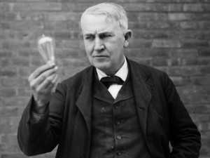
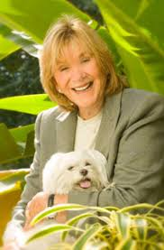
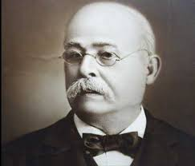
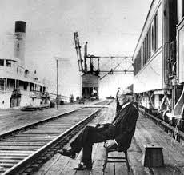
What is an entrepreneur? An entrepreneur is a person who starts a business and is willing to risk losing money in order to make money.

Slide 3
Henry Morrison Flagler was born on January 2, 1830 in Hopewell, New York. After a visit to Florida in 1878, Flagler believed that Florida had the potential to attract large numbers of tourists. In 1885, Flagler purchased the Jacksonville, St. Augustine & Halifax Railroad, the first railroad in what would eventually become the Florida East Coast Railway system.

Slide 4
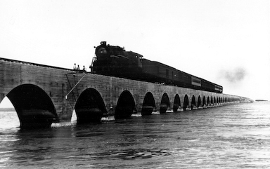
He built hotels along the train route, providing a way for tourists from the north to vacation in Florida. He was the first person to build a railroad system that went all the way to Key West, Florida.

Slide 5
Wally Amos was born in 1936 in Tallahassee, Florida. He later moved to New York to live with his aunt where he attended Food Trades Vocational High School. He and his aunt enjoyed cooking together. He improved her cookie recipe by using many ingredients not usually found in chocolate chip cookies.

Slide 6
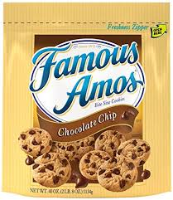
He served in the Air Force, and later became the William Morris Agency’s first African-American talent agent. In 1975, he started the Famous Amos Cookie business. Eventually his cookies could be found in grocery stores across the United States.

Slide 7
Phyllis Apple was born in 1922 in Miami, Florida. She became a reporter, wife, and mother, and was actively involved in her daughter’s school. At the age of 57, she started a public relations firm in her home. People in public relations help companies make good impressions so that other people will do business with them.

Slide 8
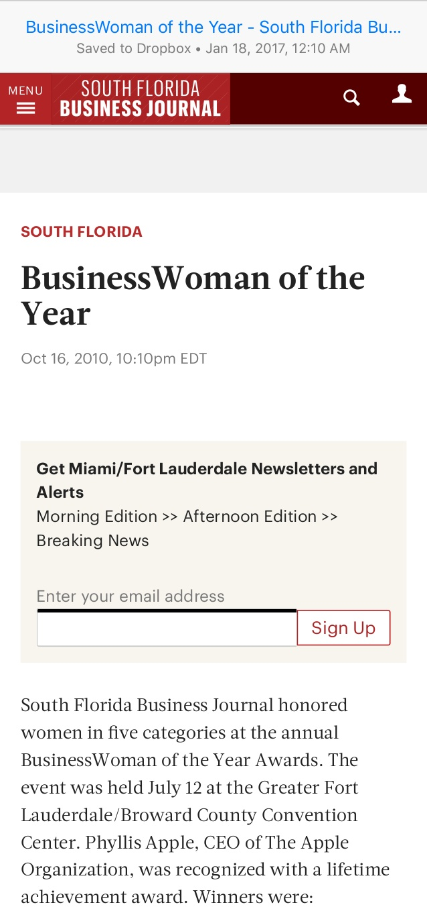
By 2007, her company, The Apple Organization, was worth $2.5 million dollars, and in 2010 she received the South Florida Business Journal’s Lifetime Achievement Award. Even though she retired in 2009, she continues to work to earn money for charities.

Slide 9
Vincente Ybor was born in Spain in 1819. He immigrated to Cuba, then to Florida in 1868. He started a cigar-making business in Key West, then moved his business to Tampa in 1885. He bought a large amount of land for his business and named the area Ybor City.

Slide 10
He employed many Cuban workers, so Ybor City became the center of Cuban culture in Florida. Many other cigar-makers came to Ybor City to build their own factories. Ybor City became known as the Cigar Capital of the World.

Slide 11
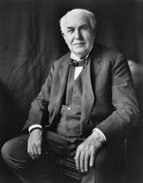
Thomas Edison was born in 1847 in Milan, Ohio. He became a businessman and inventor, best known for the development of the phonograph, motion picture camera, and the light bulb. He held 1,093 patents in the United States and others in The United Kingdom, France, and Germany.

Slide 12
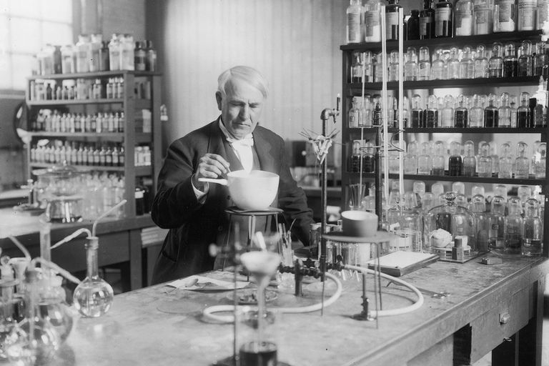
Known as The Wizard of Menlo Park, Edison moved from New Jersey to Ft. Myers, Florida, in 1885. His work led to technologies that we use every day: electric light, sound recording, the battery for the electric car, and motion pictures.

Slide 13
Maybe one day you will become an entrepreneur. What kind of business might you start?

Slide 14
Photo Credits
https://www.google.com/search?site=&tbm=isch&source=hp&biw=1271&bih=646&q=henry+flagler+railroad&oq=henry+flagler&gs_l=img.1.0.0l10.4830.7026.0.9047.14.14.0.0.0.0.95.876.13.13.0....0...1.1.64.img..1.13.872.0.I_IFgYiTQFc
https://www.google.com/search?site=&tbm=isch&source=hp&biw=1271&bih=646&q=thomas+edison&oq=thomas+edison&gs_l=img.3..0l10.1878.3645.0.4669.16.15.0.0.0.0.209.1374.6j5j1.12.0....0...1.1.64.img..4.12.1370.0.DzmnV68EaLQ#imgrc=BaAhzsvPwsosaM:
https://www.google.com/search?site=&tbm=isch&source=hp&biw=1271&bih=646&q=wally+amos&oq=wally+amos&gs_l=img.1.0.0l10.2304.4935.0.6472.13.12.0.0.0.0.239.782.5j2j1.8.0....0...1.1.64.img..5.8.780.0.1QmxdleuZuI
https://www.google.com/search?site=&tbm=isch&source=hp&biw=1354&bih=646&q=vincente+ybor&oq=vincente+ybor&gs_l=img.3..0i10i24k1.1395.4460.0.4677.14.14.0.0.0.0.89.791.13.13.0....0...1.1.64.img..1.13.788.0..0j0i10k1j0i8i30k1.ZPM-RY1ChKE#imgrc=5tgxBEycw2hZKM:
https://www.google.com/search?site=&tbm=isch&source=hp&biw=1354&bih=646&q=vincente+ybor&oq=vincente+ybor&gs_l=img.3..0i10i24k1.1395.4460.0.4677.14.14.0.0.0.0.89.791.13.13.0....0...1.1.64.img..1.13.788.0..0j0i10k1j0i8i30k1.ZPM-RY1ChKE#imgrc=6hj5MOp4iLdw5M:
https://www.google.com/search?biw=1083&bih=516&tbm=isch&sa=1&q=thomas+edison%27s+inventions&oq=thomas+edison%27s+inventions&gs_l=psy-ab.3..0l2j0i30k1l2.7982.8958.0.10033.5.5.0.0.0.0.81.271.5.5.0....0...1.1.64.psy-ab..0.5.265.AAlDa0pnfwU#imgrc=vHRZ5xd8e_yIEM:
https://www.google.com/search?site=&tbm=isch&source=hp&biw=1354&bih=646&q=new+business&oq=new+business&gs_l=img.3..0l10.2309.9750.0.10182.42.30.12.0.0.0.239.3088.3j21j2.26.0....0...1.1.64.img..5.37.3040.0.-cN4CYvAL_s#imgrc=Z43LpbYBNA4vJM:

