Slide 1
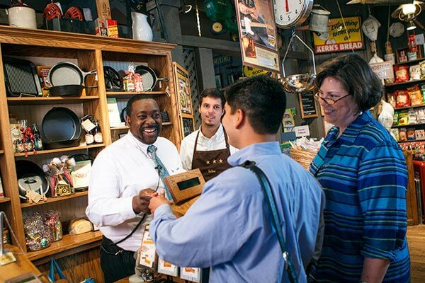
Goods and Services
SS.1.E.1.1 Recognize that money is a method of exchanging goods and services.
SS.1.E.1.3 Distinguish between examples of goods and services.
SS.1.E.1.4 Distinguish people as buyers, sellers, and producers of goods and services.

Slide 2
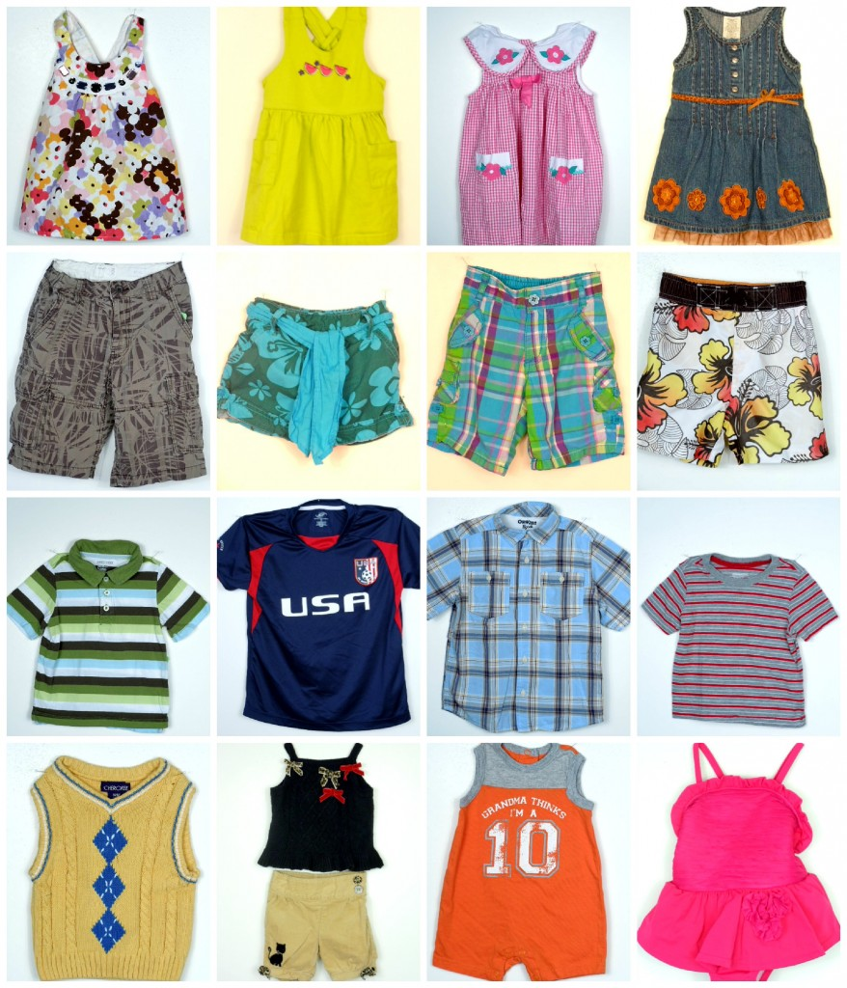
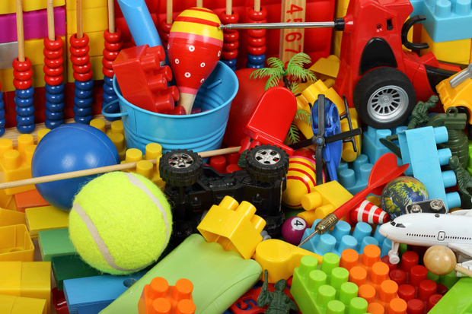
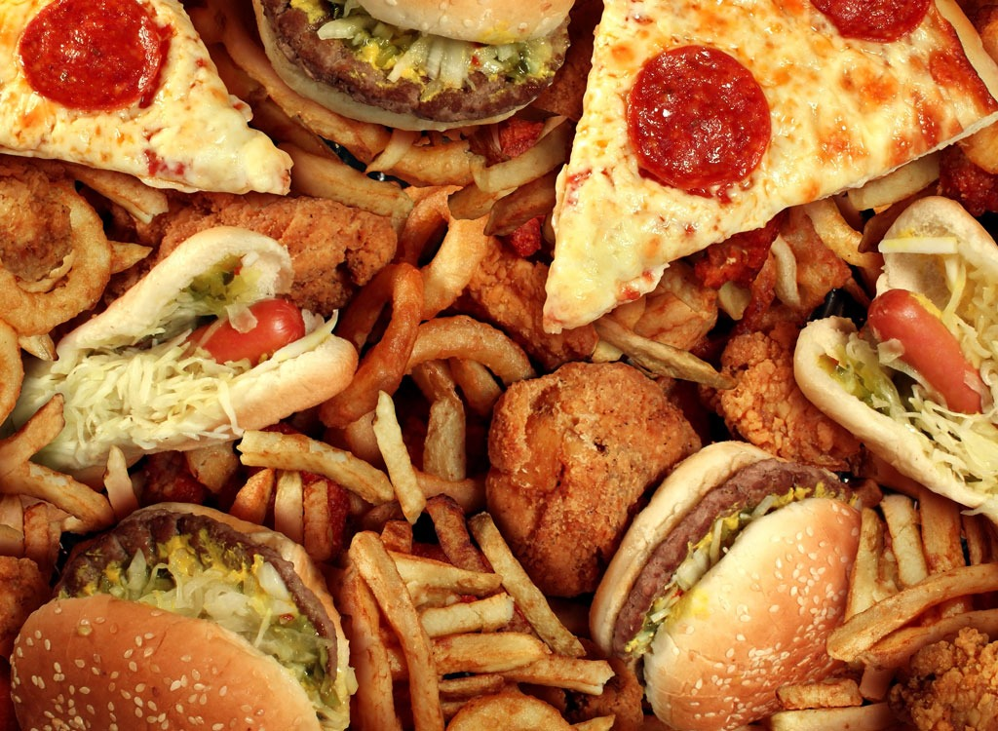
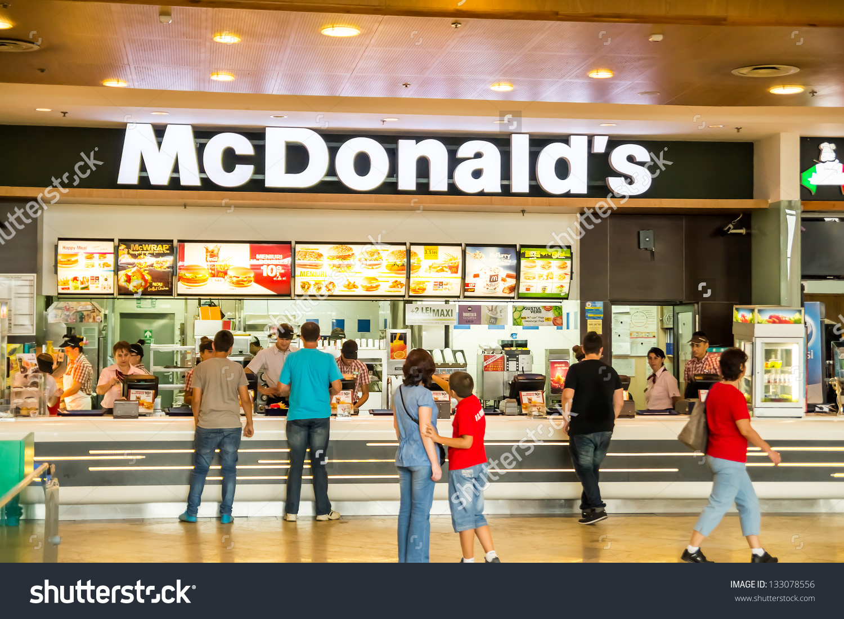
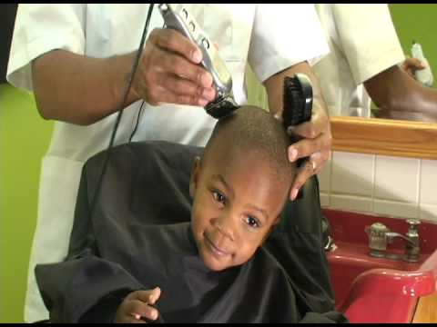
We use money to buy things.

Slide 3
Sometimes we buy goods. Goods are items that we buy.

Slide 4
Sometimes we buy services. Services are actions we pay other people to do.

Slide 5
Some places offer both goods and services.

Slide 6
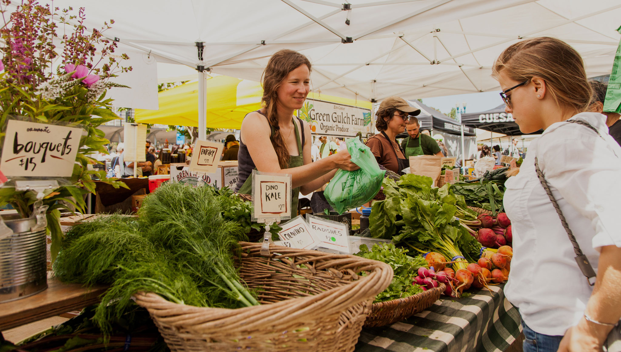
People can be buyers or sellers.

Slide 7
Buyers purchase goods or services. Sellers supply goods or services.

Slide 8
People can produce many kinds of good and services.

Slide 9
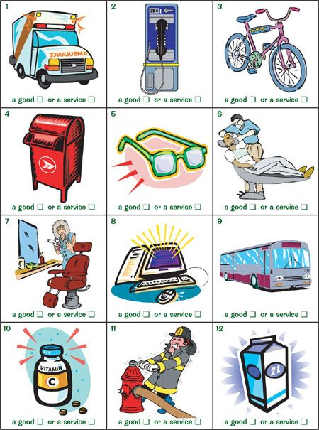
What goods and services can you buy in your town?

Slide 10
Photo Credits
https://www.google.com/search?site=&tbm=isch&source=hp&biw=1147&bih=602&q=food&oq=food&gs_l=img.3..0l10.1558.1925.0.2750.5.5.0.0.0.0.91.335.4.4.0....0...1ac.1.64.img..1.4.335.0.ogfK1Fi1Ids#imgrc=7s4IvWKirC0p_M
https://www.google.com/search?site=&tbm=isch&source=hp&biw=1147&bih=602&q=food&oq=food&gs_l=img.3..0l10.1558.1925.0.2750.5.5.0.0.0.0.91.335.4.4.0....0...1ac.1.64.img..1.4.335.0.ogfK1Fi1Ids#tbm=isch&q=children's+clothing&imgrc=ALDNZpBVPSZhpM:
https://www.google.com/search?site=&tbm=isch&source=hp&biw=1147&bih=602&q=food&oq=food&gs_l=img.3..0l10.1558.1925.0.2750.5.5.0.0.0.0.91.335.4.4.0....0...1ac.1.64.img..1.4.335.0.ogfK1Fi1Ids#tbm=isch&q=black+child's+haircut&imgrc=5VZZG-PFNalrIM:
https://www.google.com/search?site=&tbm=isch&source=hp&biw=1147&bih=602&q=food&oq=food&gs_l=img.3..0l10.1558.1925.0.2750.5.5.0.0.0.0.91.335.4.4.0....0...1ac.1.64.img..1.4.335.0.ogfK1Fi1Ids#tbm=isch&q=mechanic&imgrc=cuxtLbH8jzIgDM:
https://www.google.com/search?site=&tbm=isch&source=hp&biw=1147&bih=602&q=food&oq=food&gs_l=img.3..0l10.1558.1925.0.2750.5.5.0.0.0.0.91.335.4.4.0....0...1ac.1.64.img..1.4.335.0.ogfK1Fi1Ids#tbm=isch&q=flight+attendant&imgrc=4KygW6UIO5bfaM:
https://www.google.com/search?site=&tbm=isch&source=hp&biw=1147&bih=602&q=food&oq=food&gs_l=img.3..0l10.1558.1925.0.2750.5.5.0.0.0.0.91.335.4.4.0....0...1ac.1.64.img..1.4.335.0.ogfK1Fi1Ids#tbm=isch&q=toys&imgrc=0RdyaPnc9outKM:
https://www.google.com/search?site=&tbm=isch&source=hp&biw=1147&bih=602&q=food&oq=food&gs_l=img.3..0l10.1558.1925.0.2750.5.5.0.0.0.0.91.335.4.4.0....0...1ac.1.64.img..1.4.335.0.ogfK1Fi1Ids#tbm=isch&q=mcdonalds+restaurant&imgdii=E1695b45ipibGM:&imgrc=eRO8nB9wxGUfmM:
https://www.google.com/search?site=&tbm=isch&source=hp&biw=1147&bih=602&q=food&oq=food&gs_l=img.3..0l10.1558.1925.0.2750.5.5.0.0.0.0.91.335.4.4.0....0...1ac.1.64.img..1.4.335.0.ogfK1Fi1Ids#tbm=isch&q=farmers+market&imgrc=TSLcXfz3i07nxM:
https://www.google.com/search?site=&tbm=isch&source=hp&biw=1147&bih=602&q=food&oq=food&gs_l=img.3..0l10.1558.1925.0.2750.5.5.0.0.0.0.91.335.4.4.0....0...1ac.1.64.img..1.4.335.0.ogfK1Fi1Ids#tbm=isch&q=checking+out+at+cracker+barrel&imgrc=XVzZoQzEz7JGiM:
https://www.google.com/search?site=&tbm=isch&source=hp&biw=1147&bih=602&q=food&oq=food&gs_l=img.3..0l10.1558.1925.0.2750.5.5.0.0.0.0.91.335.4.4.0....0...1ac.1.64.img..1.4.335.0.ogfK1Fi1Ids#tbm=isch&q=goods+and+services+for+kids&imgrc=HSQvguLUtnVnBM:

