Slide 1
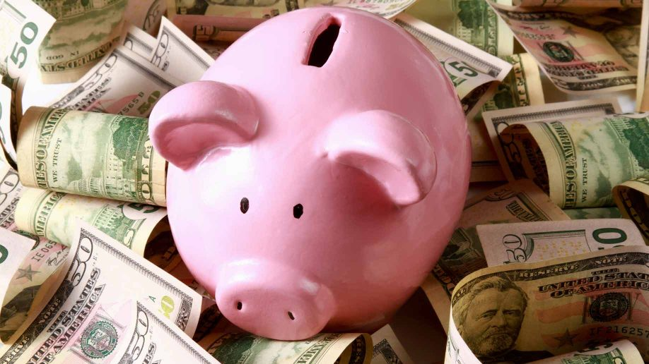
Saving and Spending
SS.2.E.1.4 Explain the personal benefits and costs involved in saving and spending.

Slide 2
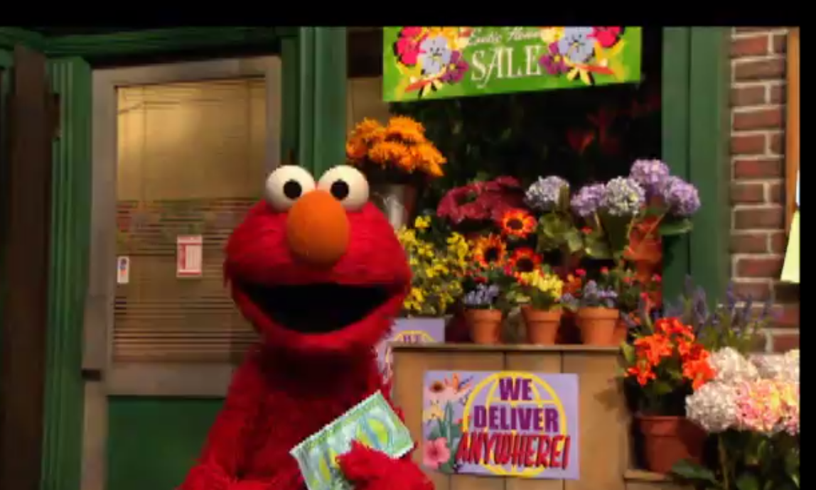
When we have money, we have to make decisions about what to do with it.
https://www.sesamestreet.org/toolkits/save
Elmo Makes a Choice

Slide 3
We can spend our money on wants and needs. What would you want to buy right now with your money?

Slide 4
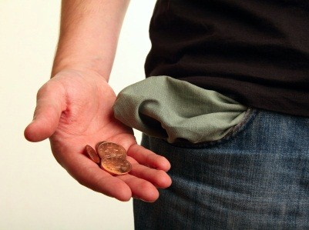
Spending money can be fun, but once you spend it you cannot buy anything else.

Slide 5
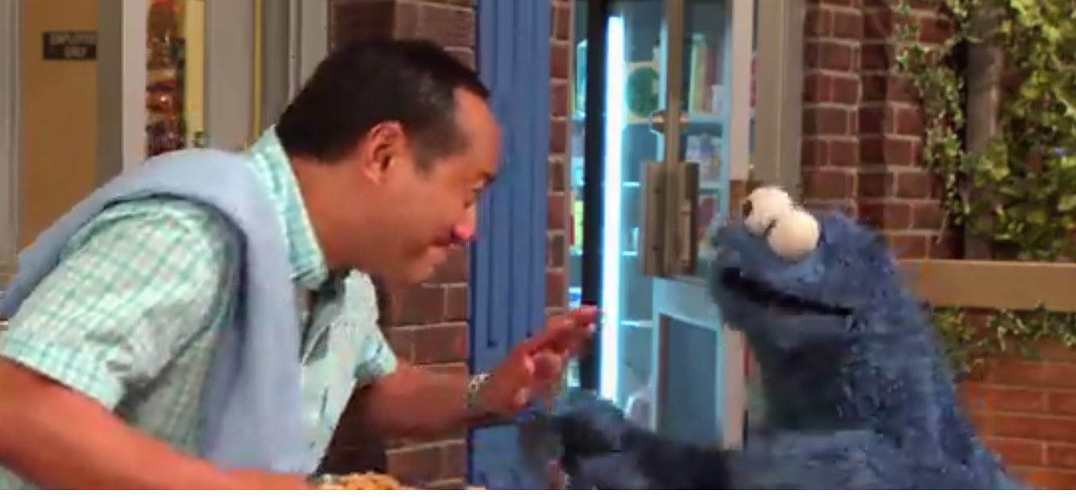
We can save our money. When we save our money, we have decided to wait to spend it later.
https://www.sesamestreet.org/toolkits/save
Learning to Wait

Slide 6
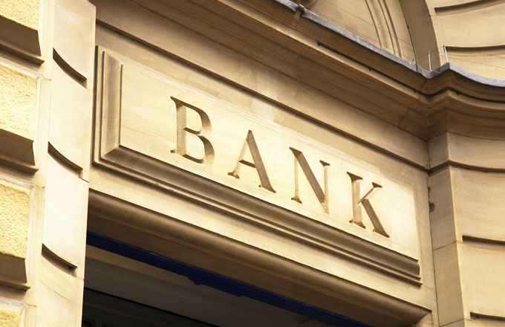
We can save our money at home, or we can save it in a bank. If we save it in a bank, we get paid a little extra money called interest.

Slide 7
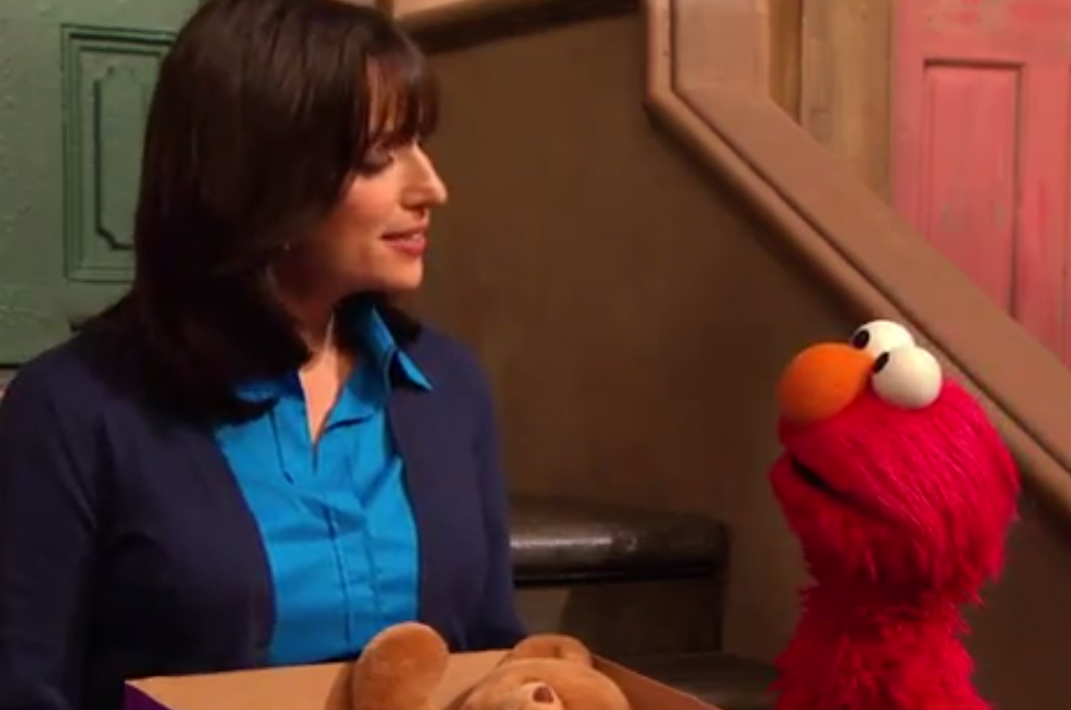
We can also choose to share or donate our money to other people who need help.
https://www.sesamestreet.org/toolkits/save
Helping Others

Slide 8
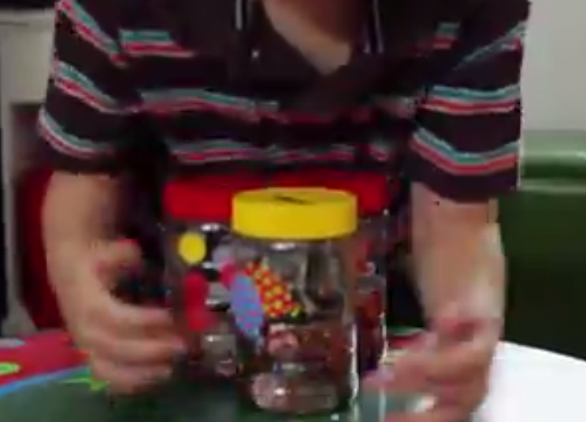
Think carefully before you spend your money. You want to make sure that you make the right decision and get the best use of your money.
https://www.sesamestreet.org/toolkits/save
Three Jars

Slide 9
Photo Credits
https://www.google.com/search?site=&tbm=isch&source=hp&biw=1280&bih=601&q=spending+money&oq=spending+money&gs_l=img.3..0l10.1584.5865.0.6241.16.15.1.0.0.0.332.1372.7j2j1j1.11.0....0...1.1.64.img..4.12.1375.tz7i51CvfrQ#tbm=isch&q=spending+money+kids&imgrc=cLSgQyoZabSSWM:
https://www.google.com/search?site=&tbm=isch&source=hp&biw=1280&bih=601&q=spending+money&oq=spending+money&gs_l=img.3..0l10.1584.5865.0.6241.16.15.1.0.0.0.332.1372.7j2j1j1.11.0....0...1.1.64.img..4.12.1375.tz7i51CvfrQ#tbm=isch&q=saving+money+in+a+bank+&imgrc=fvTgltpGfS04CM:
https://www.google.com/search?site=&tbm=isch&source=hp&biw=1280&bih=601&q=spending+money&oq=spending+money&gs_l=img.3..0l10.1584.5865.0.6241.16.15.1.0.0.0.332.1372.7j2j1j1.11.0....0...1.1.64.img..4.12.1375.tz7i51CvfrQ#tbm=isch&q=bank&imgrc=nO_SFNNtHd6BSM:

