Slide 1
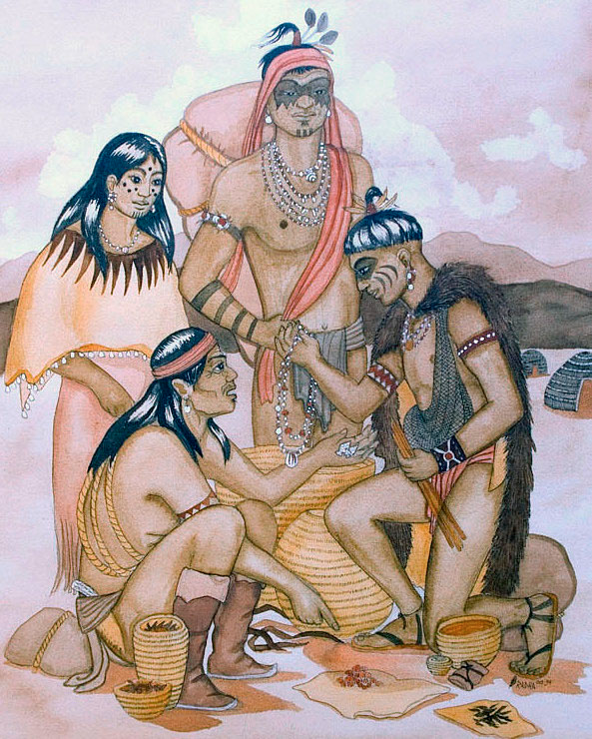
Trade and the Economic Growth of North America
SS.5.E.1.1 Identify how trade promoted economic growth in North America from pre-Columbian times to 1850.
SS.5.E.2.1 Recognize the positive and negative effects of voluntary trade among Native Americans, European explorers, and colonists.

Slide 2
The United States trades with many countries to import and export goods and services.

Slide 3
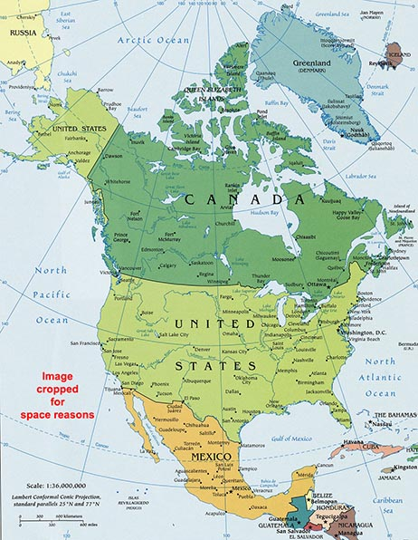
Trade has been an important part of the economic growth of North America since the time of its earliest inhabitants.

Slide 4
Hunters and gatherers traded weapons and tools to other native people in North America, Mexico, and South America.

Slide 5
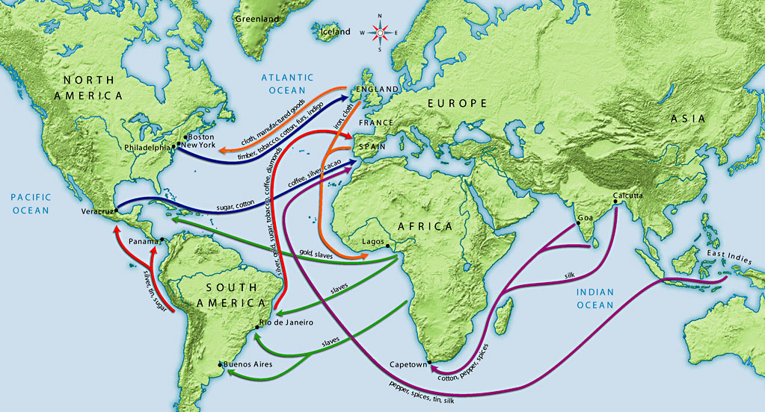
The search for new trade routes led European explorers to the New World.

Slide 6
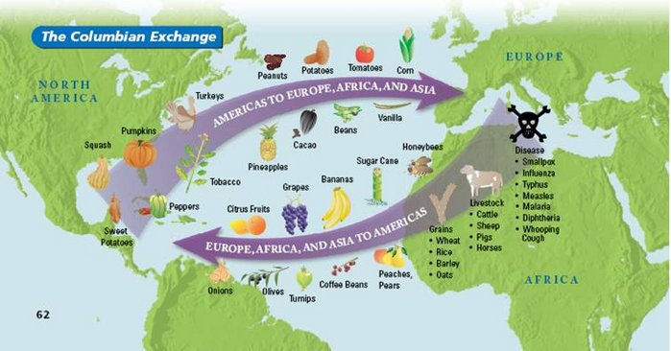
After Christopher Columbus’ journey to the New World in 1492, the Columbian Exchange began as a process for trading goods, and transporting people, to and from Europe.

Slide 7
The Columbian Exchange also brought diseases to the New World. Native Americans did not have the ability to fight off these diseases, resulting in many deaths.

Slide 8
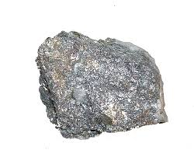
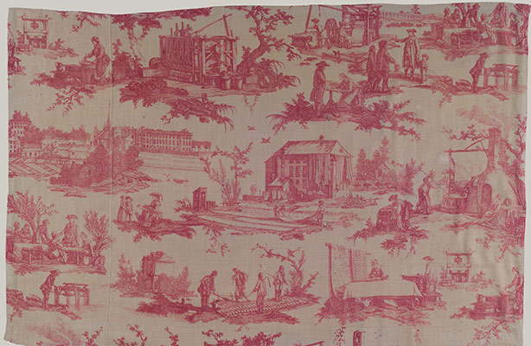
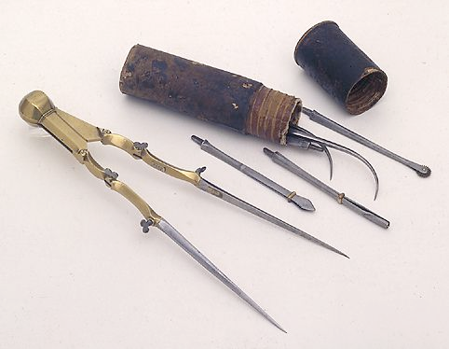
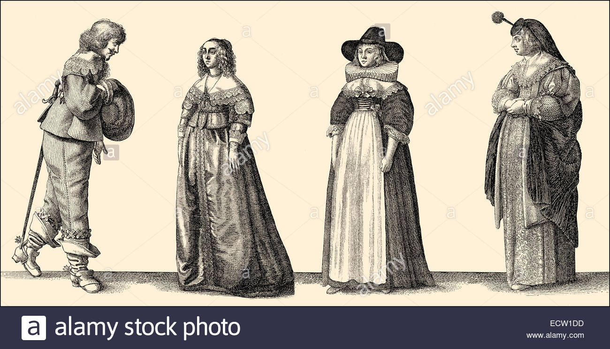
European countries controlled trade with the New World colonies. Raw materials such as tobacco, sugar, silver, and potatoes were traded for finished materials such as textiles, tools, and clothing between Europe and the colonies.

Slide 9
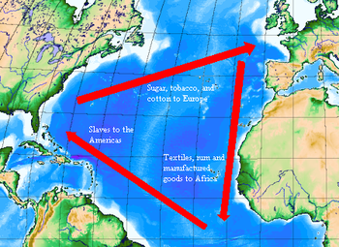
Triangular Trade began as a way to trade goods, including slaves, between Europe, Africa, and the colonies.

Slide 10
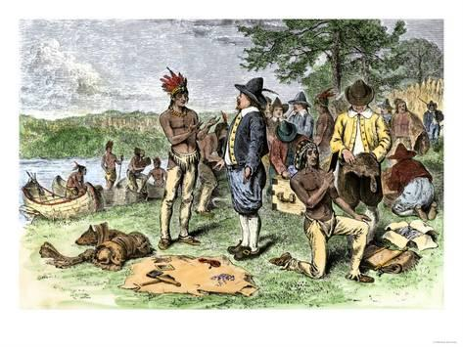
French and Dutch exploration of the colonies in the 1500s and 1600s increased the trade of furs, gold and silver with Europe.

Slide 11
England began exploration and colonization in the New World in the early 1600s. England wanted to capitalize on the profitable trading efforts with Native Americans established by France. Private companies, such as the East India Company, found investors who financed voyages to the colonies in order to make a profit on the raw materials found there.

Slide 12
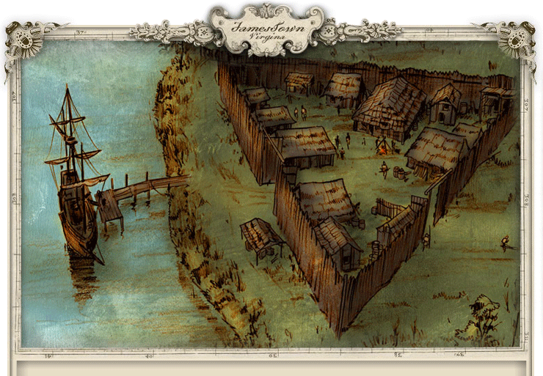
After a failed attempt at establishing a formal colony in Roanoke (now part of North Carolina), England established the colony of Jamestown in 1607.

Slide 13
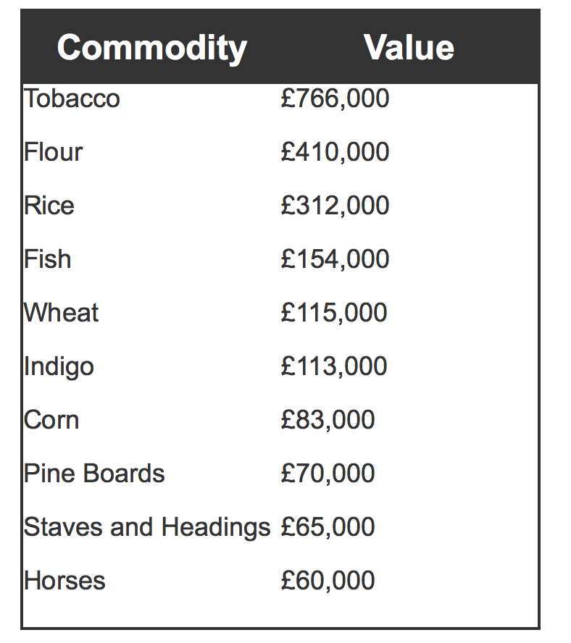
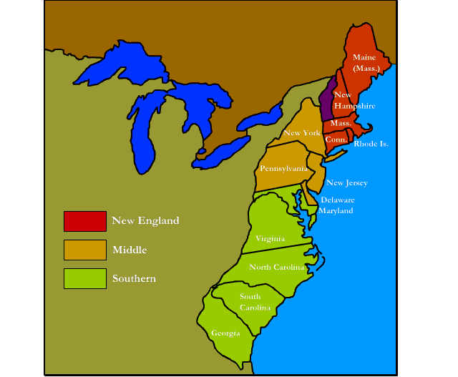
Trade and the English Colonies
https://www.landofthebrave.info/trade-in-the-colonies.htm

Slide 14
Trade Issues That Led to War
England wanted to control growing trade between the Colonies and other countries in order to capitalize on money made from the goods produced there. The Navigation Acts imposed by England prevented the Colonies from trading with other countries.

Slide 15
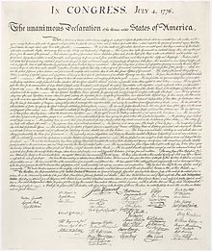
Revolution
The Navigation Acts angered many Colonists and led to negative feelings toward England. The Stamp Act and The Townsend Acts imposed additional taxes on the Colonies. These economic issues, along with other events that continued to anger Colonists, eventually led to the Revolutionary War.

Slide 16
Trade and the New Nation
Trade continued to be an important consideration as the new United States of America began building its nation. Trade issues resulted in the War of 1812 with England. Since the United States was no longer trading with England, the country invested in its own factories.

Slide 17
The Market Revolution
In the first half of the 1800s there were many new inventions in factory work, transportation, and communication. These inventions allowed the United States to produce more finished goods from its raw materials and increase its ability to trade with other countries.

