Slide 1
Trace-Based Cases
Notes:
Pasco County Schools has a mission that hopefully you have heard before … We exist to provide a World Class Education for all students … this is our WHY. The mission is further reinforced in our vision of ensuring all our students achieve success in college, career and life … this is WHAT we do every day. And while these statements are very important, they are not enough to communicate HOW we will actualize these promises to our students and our community.
For that reason, we have planned out three key priorities that we believe, with focus and effort, will help us deliver on our mission and vision. These are High Impact Instruction, Data Driven Decisions, and Collaborative Culture. We have a big goal for each of these priorities – and we monitor our progress towards each of the big goals in our Success Plan each year. You don’t get to big goals by accident, though, and these are too important to leave to chance, so we developed a Theory of Action, as a plan to help us as we pursue our mission:
We believe that if we create a unifying vision of instructional excellence for our schools, define the behaviors we believe will lead to success in schools and provide the necessary supports from our teams, then, staff efficacy and student achievement will increase.

Slide 2
Notes:
While we have a great mission of providing a world class education, we cannot just hand that statement to each teacher and leader and expect everyone to know what that means. These five statements were developed by principals and other school and district leaders in efforts to more clearly define what a world-class education looks and sounds like in classrooms. This common vision of instructional excellence, part of our theory of action, brings us closer to actualizing the mission and vision of Pasco County Schools.
… this graphic, which I hope you have seen around the district or in some schools, is meant to illustrate what a World Class Learning Moment looks and feels like for every student, every day.
We want students to:
Build strong content knowledge and apply learning to new contexts
Think critically to understand and solve real world problems
Collaborate and communicate to learn within and outside of their school community
Utilize a variety of tools and resources enhance their learning … AND…
Take ownership for their learning and reflect on their learning progress
These are not graduate outcomes, they are everyday outcomes, for every student in every classroom … what every teacher should be striving for and every leader should be supporting.

Slide 3
Notes:
While the Common Vision of Instructional Excellence helps us visualize the student world class learning experience, we also have to get clear about what the adults are doing as we deliver on that experience.
These actions here, which align to our priorities, help build a system and shared vision for our teacher and leader action related to academic success. All of our work, including the learning you will engage in today is connected to one or more of these levers, and all are needed to ensure that adults can actualize our Common Vision of Instructional Excellence for every student. It is the combination and intentional focus on Providing Rigorous Instruction and Building Compassionate Schools and Ensuring Equitable Instructional Practices that will ultimately make our district stand out as world class.

Slide 4
Notes:
Together, these actions define who we are as a district. In Pasco County Schools, we educate the whole child. Our students learn to think critically and solve complex problems while also becoming compassionate human beings. We ensure that all students have the skills they need to become responsible and contributing members of our community.
We develop the best conditions in our world class learning opportunities for our students when we balance their needs. The balance of creating a compassionate school environment that integrates social emotional skills and the consideration of our students’ experience with trauma. And in that environment delivering engaging instruction anchored in rigorous standards that help to prepare our students for college and careers. But none of this matters without ensuring that all of our students have equitable access to these opportunities. And as we move closer to realizing our vision as a system, we must invest time and effort into all three of these realms to create the balance needed for our students to succeed.

Slide 5
Today’s Training is Focused on…
Engage students in problem solving and real world learning
Build strong content knowledge and apply learning to new contexts
Think critically to understand and solve real world problems
Collaborate and communicate to learn within and outside of their school community
Utilize a variety of tools and resources enhance their learning
Take ownership for their learning and reflect on their learning progress
How can you take every opportunity to be a world changer for your students?
Notes:
Today’s training is focused on XXXXXX (add the connection to the one/or more of the five student learning outcomes or one/or more of the three adult levers in shaping academic success. Make this connection explicitly).
During this training, we want you to focus on how the content and experience can help you, as a critical adult in our system, provide our students every opportunity to be a world class learner. How can you take every opportunity to be a world changer for your students?
Don’t forget the last slide at the end, focused on reflecting on using the learning from this session.

Slide 6
Notes:
Direct participants to the Together We Learn SharePoint site where all of the resources for your session is stored.
There are two ways to access the materials. Either by going to the OLL SharePoint site from Office 365 OR by adding the Together We Learn app to the Launchpad in myPascoConnect.
The first directions are for those who want to navigate to the resources from the Office for Leading and Learning SharePoint site.
The set of directions will show participants how to add an app to their launchpad in myPascoConnect for a direct link to the Together We Learn SharePoint site so they have it easily accessible.
Then direct participants to select the appropriate category (Elementary, Secondary, of All) for your session to get to the folder titled for your session.

Slide 7
USF Stavros Center Presents:
Using Artifacts in Trace-Based Cases
Deborah Kozdras
Tinyurl.com/usfstavrosresources

Slide 8
Standards
SS.6.E.1.3 Describe the following economic concepts as they relate to early civilization: scarcity, opportunity cost, supply and demand, barter, trade, productive resources (land, labor, capital, entrepreneurship).
SS.6.W.1.1 Use timelines to identify chronological order of historical events.
SS.6.W.1.2 Identify terms (decade, century, epoch, era, millennium, BC/BCE, AD/CE) and designations of time periods.
SS.6.W.1.3 Interpret primary and secondary sources.
SS.6.W.1.4 Describe the methods of historical inquiry and how history relates to the other social sciences.
SS.6.W.1.5 Describe the roles of historians and recognize varying historical interpretations (historiography).
SS.6.W.1.6 Describe how history transmits culture and heritage and provides models of human character.
SS.6.W.2.1 Compare the lifestyles of hunter-gatherers with those of settlers of early agricultural communities.
SS.6.W.2.2 Describe how the developments of agriculture and metallurgy related to settlement, population growth, and the emergence of civilization.
SS.6.W.2.3 Identify the characteristics of civilization.

Slide 9
Economic Questions
What was produced?
How was it produced?
How did what was produced get allocated?
Why was it produced?
How was it used?

Slide 10
Economic vs Economic Historic Thinking
Economics
Economic Historians
Economists practice something few historians do look to the future and predict
Economists isolate independent variables to find regularities that predict
Historians don’t try to predict the future.
Historians feel that isolating variables is unattainable because all variables are interdependent. They consider as many variables as possible.

Slide 11
We the Economy – Cave-o-nomics
https://wetheeconomy.com/films/cave-o-nomics/

Slide 12
Trace-Based Cases
Trace as Noun
Trace as Verb
For example, the Merriam-Webster dictionary defines a trace (noun) as a a sign or evidence of some past thing.
As a verb, to trace means to discover signs, evidence, or remains, and to follow or investigate in detail.
​

Slide 13
What do you see?
Trace-Based Cases begin with a trace of something from the past, like an artifact, photo, painting, or other visual source. During initial cases, utilize teacher-generated questions. Then, gradually release the responsibility to the students, so they can eventually ask their own questions.

Slide 14
Step 1: Descriptive Questions What? Who? When? Where?
Until the nineteenth century, most people believed humans had been living on Earth for only a few thousand years. This axe, discovered in 1859, was the first strong evidence that we have been here for much longer. It is thought to be around 400,000 years old and, since then, even older stone tools have been found in Africa providing further evidence of early human habitation. The axe was discovered along with mammoth and rhino remains, and was probably used to prepare meat and skins. It was found in northern France by workers mining gravel. It was photographed before it was removed from the ground, giving scientists information about its position, the type of rock it was found in and the presence of other artefacts and fossils close by. This was the first time photography was used to provide precise evidence of location within the context of an archaeological discovery. The axe was donated to the Natural History Museum in 1896. It lay unheralded in the collections for over one hundred years but was uncovered again last year by Robert Kruszynski and Clive Gamble.
http://www.bbc.co.uk/ahistoryoftheworld/objects/dHcuPrLwRnWZOpD36U_MKA

Slide 15
Step 2: Analysis Questions How? Why?
Until the nineteenth century, most people believed humans had been living on Earth for only a few thousand years. This axe, discovered in 1859, was the first strong evidence that we have been here for much longer. It is thought to be around 400,000 years old and, since then, even older stone tools have been found in Africa providing further evidence of early human habitation. The axe was discovered along with mammoth and rhino remains, and was probably used to prepare meat and skins. It was found in northern France by workers mining gravel. It was photographed before it was removed from the ground, giving scientists information about its position, the type of rock it was found in and the presence of other artefacts and fossils close by. This was the first time photography was used to provide precise evidence of location within the context of an archaeological discovery. The axe was donated to the Natural History Museum in 1896. It lay unheralded in the collections for over one hundred years but was uncovered again last year by Robert Kruszynski and Clive Gamble.
http://www.bbc.co.uk/ahistoryoftheworld/objects/dHcuPrLwRnWZOpD36U_MKA

Slide 16
Step 3: Evaluative Questions What if? So what? What next? What now?
Until the nineteenth century, most people believed humans had been living on Earth for only a few thousand years. This axe, discovered in 1859, was the first strong evidence that we have been here for much longer. It is thought to be around 400,000 years old and, since then, even older stone tools have been found in Africa providing further evidence of early human habitation. The axe was discovered along with mammoth and rhino remains, and was probably used to prepare meat and skins. It was found in northern France by workers mining gravel. It was photographed before it was removed from the ground, giving scientists information about its position, the type of rock it was found in and the presence of other artefacts and fossils close by. This was the first time photography was used to provide precise evidence of location within the context of an archaeological discovery. The axe was donated to the Natural History Museum in 1896. It lay unheralded in the collections for over one hundred years but was uncovered again last year by Robert Kruszynski and Clive Gamble.
http://www.bbc.co.uk/ahistoryoftheworld/objects/dHcuPrLwRnWZOpD36U_MKA

Slide 17
C3
http://www.c3teachers.org/inquiries/nomadic-life/

Slide 18
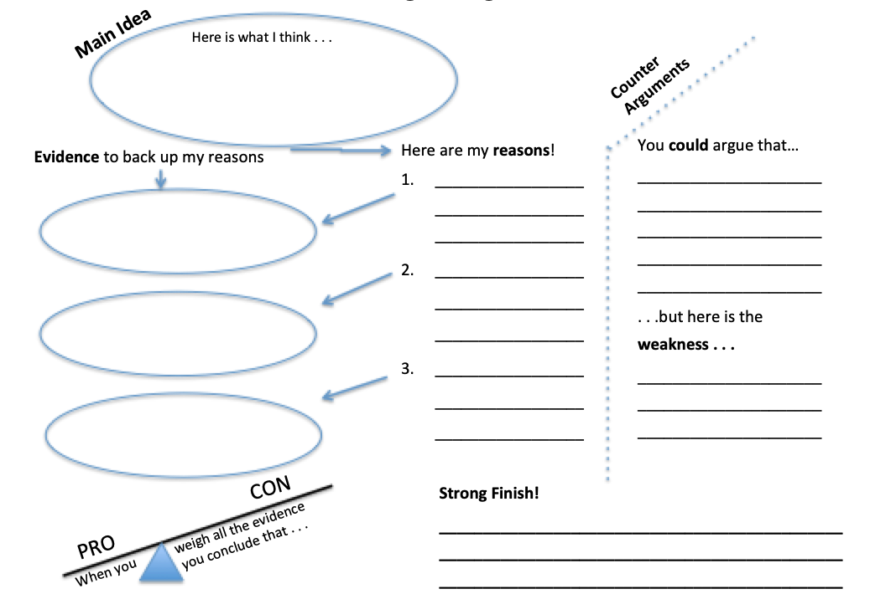
Building an Argument

Slide 19
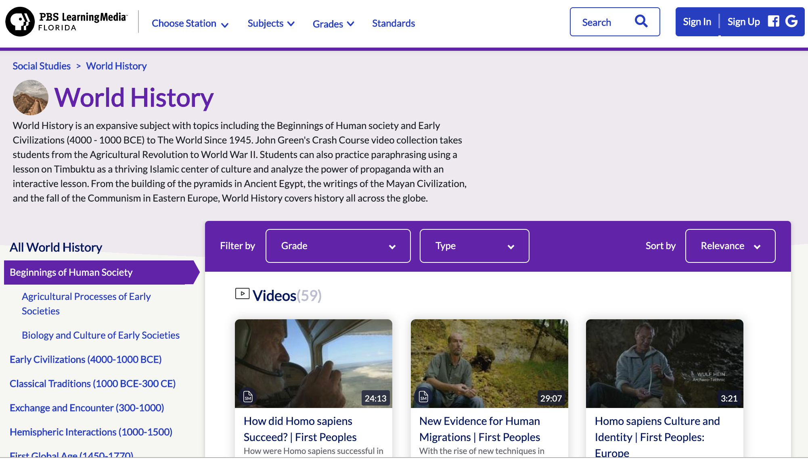
https://florida.pbslearningmedia.org/subjects/social-studies/world-history/beginnings-of-human-society/

Slide 20
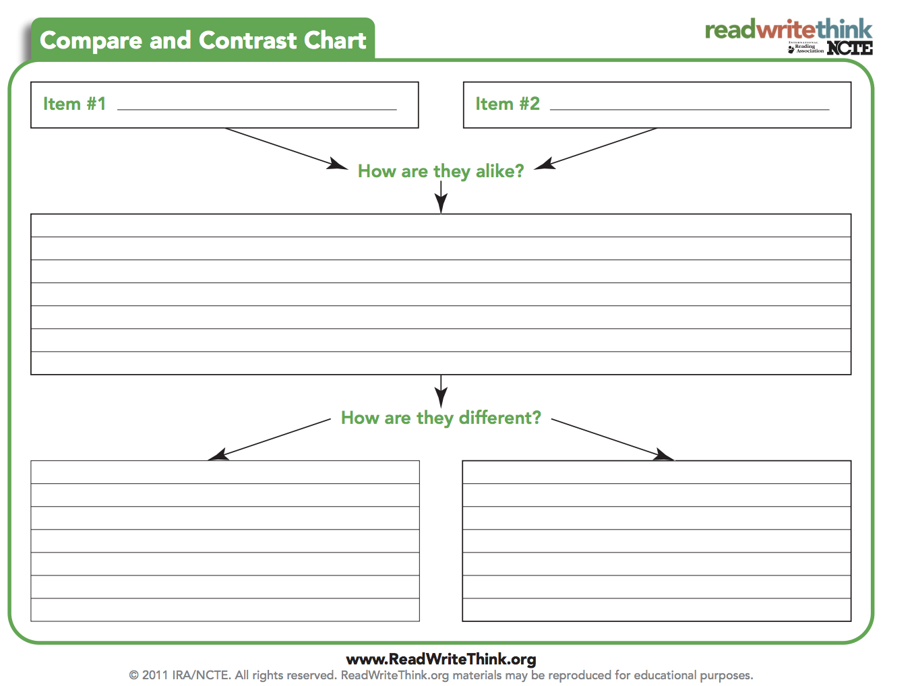
How did agriculture change from 1800’s to 1920?
Oliver plow, 1877
Fordson tractor, 1918

Slide 21
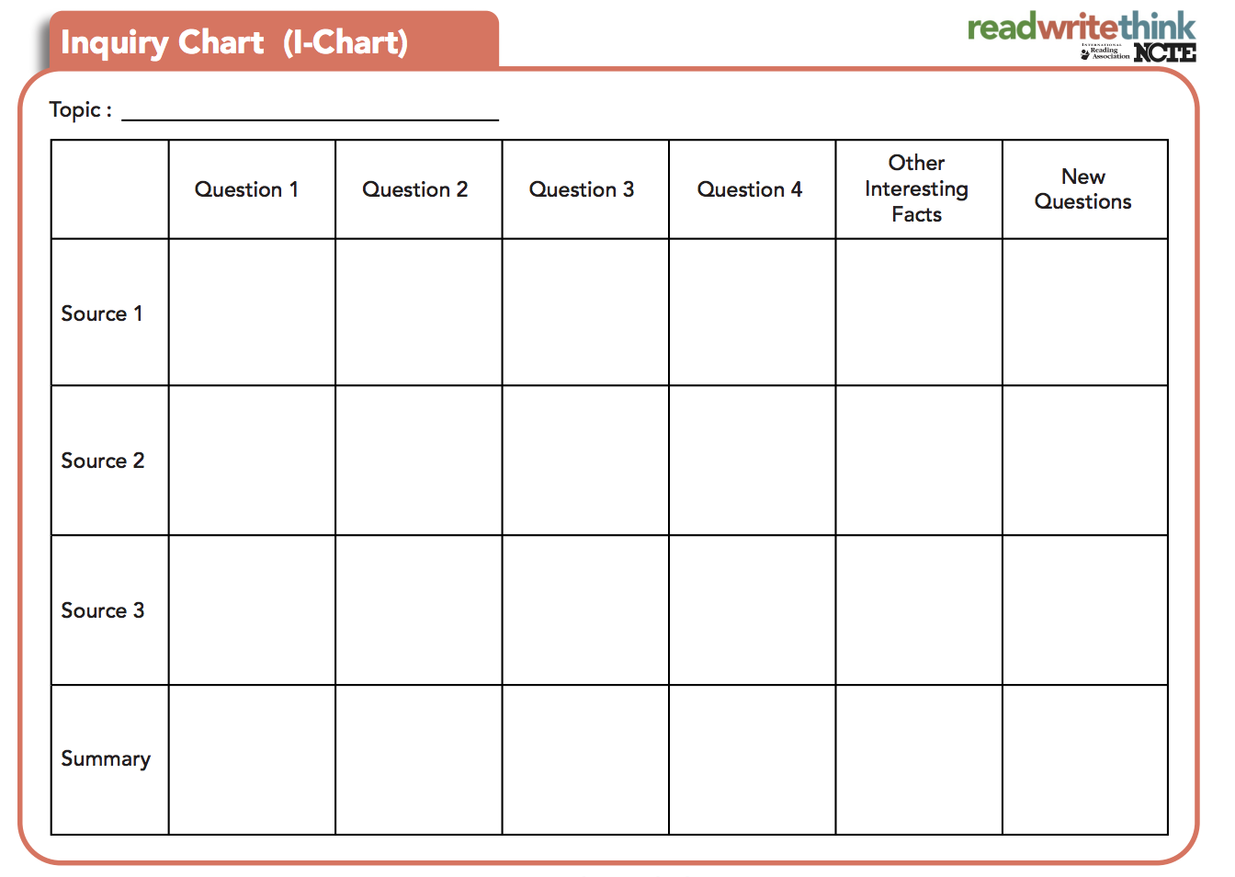
http://www.readwritethink.org/professional-development/strategy-guides/inquiry-charts-charts-30762.html
http://www.readwritethink.org/professional-development/strategy-guides/inquiry-charts-charts-30762.html

Slide 22
Notes:
Please be sure that you end every session with an opportunity for participants to reflect on their learning for application during the 19-20 school year.

