Slide 1
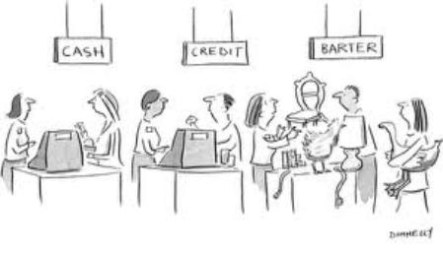
Trade
SS.2.E.1.3 Recognize that the United States trades with other nations to exchange goods and services.

Slide 2
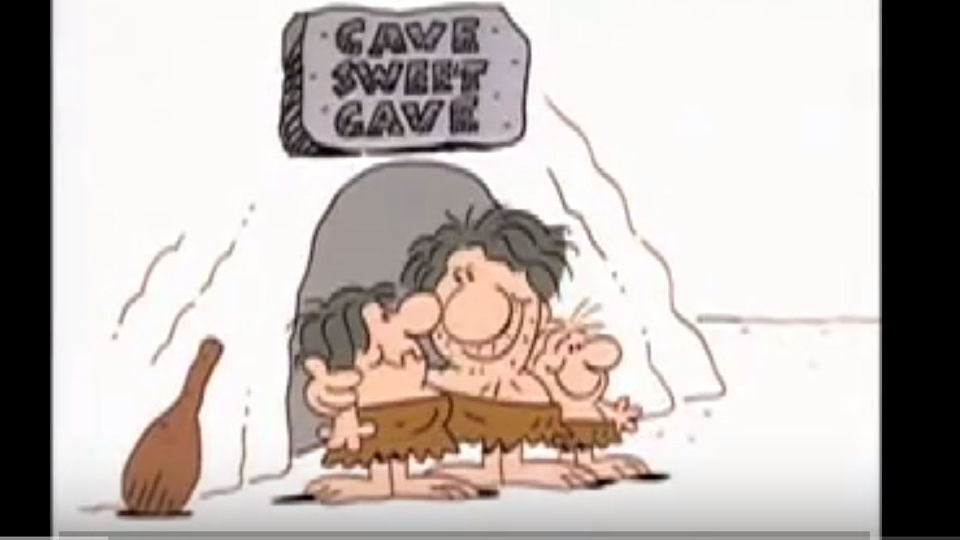
Barter and Trade
https://www.youtube.com/watch?v=wHY5cdExNa8

Slide 3
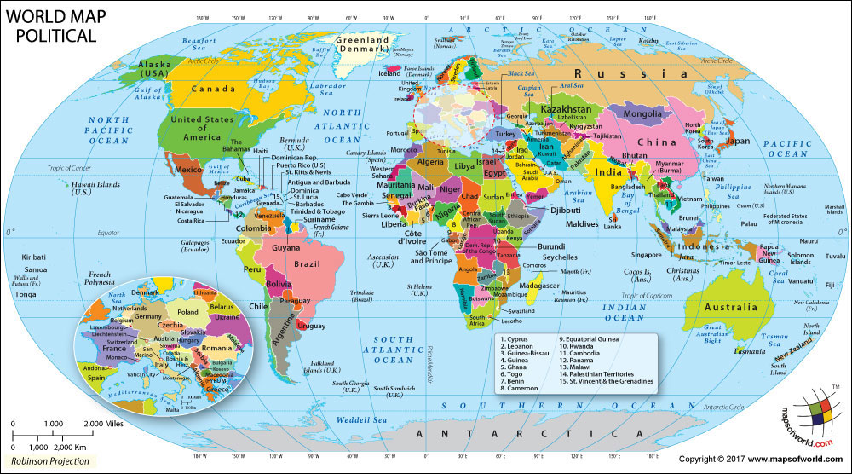
The United States produces many goods and services for its citizens. The Unites States also sells, or exports, goods and services to other countries.

Slide 4
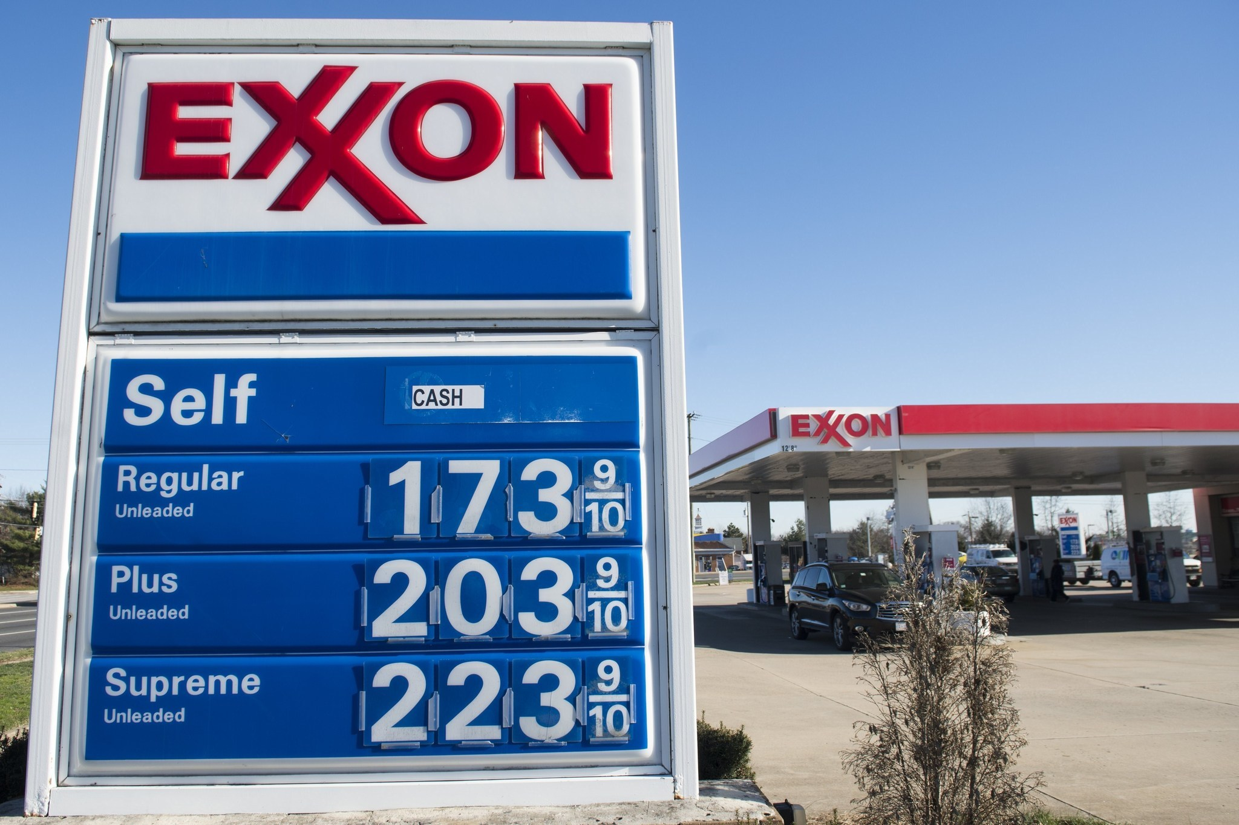
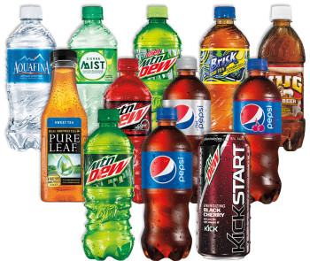
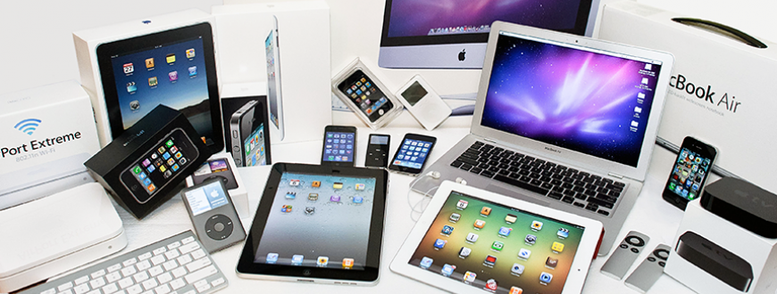
The United States exports many different types of goods and services.

Slide 5
The United States does not produce all of the goods and services that its citizens want and need. We buy, or import, those goods and services from other countries.

Slide 6
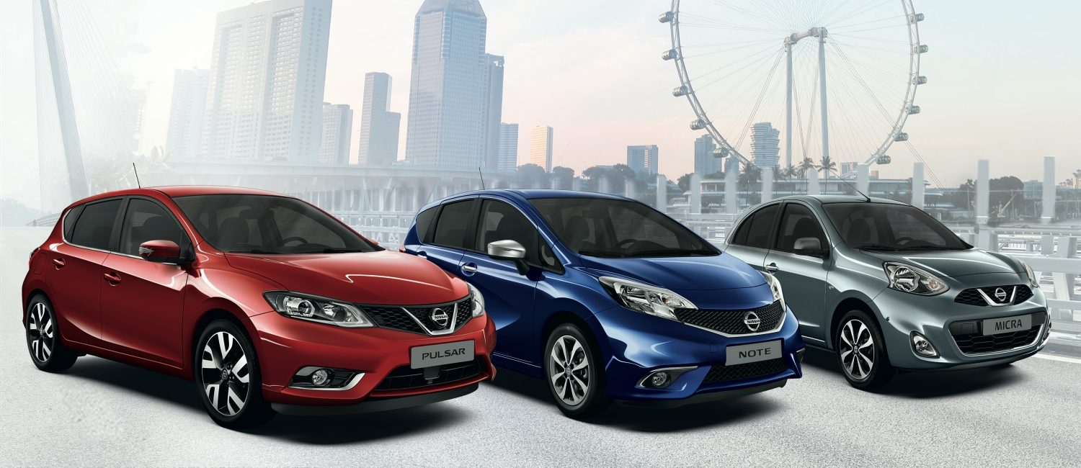
The United States imports many different goods and services.

Slide 7
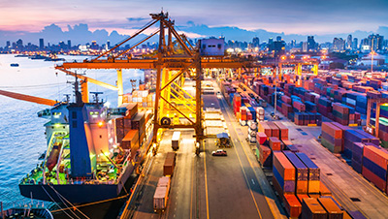
The United States trades with many countries to import and export goods and services.

Slide 8
Photo Credits
https://www.google.com/search?site=&tbm=isch&source=hp&biw=1280&bih=624&q=map+of+the+world&oq=map+of+the+world&gs_l=img.3..0l10.6299.8076.0.8340.16.16.0.0.0.0.106.1076.14j1.15.0....0...1.1.64.img..1.15.1073.hYVRcsxTMuU#imgrc=FljVYNFvBMIXlM:
https://www.google.com/search?site=&tbm=isch&source=hp&biw=1280&bih=624&q=map+of+the+world&oq=map+of+the+world&gs_l=img.3..0l10.6299.8076.0.8340.16.16.0.0.0.0.106.1076.14j1.15.0....0...1.1.64.img..1.15.1073.hYVRcsxTMuU#tbm=isch&q=nissan+cars&imgrc=d-sbI3Resker0M:
https://www.google.com/search?site=&tbm=isch&source=hp&biw=1280&bih=624&q=map+of+the+world&oq=map+of+the+world&gs_l=img.3..0l10.6299.8076.0.8340.16.16.0.0.0.0.106.1076.14j1.15.0....0...1.1.64.img..1.15.1073.hYVRcsxTMuU#tbm=isch&q=apple+products&imgrc=JpRmazPYt8rF7M:
https://www.google.com/search?site=&tbm=isch&source=hp&biw=1280&bih=624&q=map+of+the+world&oq=map+of+the+world&gs_l=img.3..0l10.6299.8076.0.8340.16.16.0.0.0.0.106.1076.14j1.15.0....0...1.1.64.img..1.15.1073.hYVRcsxTMuU#tbm=isch&q=pepsi+products&imgrc=TDEsseJn-CF7xM:
https://www.google.com/search?site=&tbm=isch&source=hp&biw=1280&bih=624&q=map+of+the+world&oq=map+of+the+world&gs_l=img.3..0l10.6299.8076.0.8340.16.16.0.0.0.0.106.1076.14j1.15.0....0...1.1.64.img..1.15.1073.hYVRcsxTMuU#tbm=isch&q=exxon+mobil&imgrc=VTAn_fSAdwnwRM:
http://www.afcinternationalllc.com/customs-brokerage-news/importing-precious-gems/
https://www.google.com/search?site=&tbm=isch&source=hp&biw=1280&bih=624&q=map+of+the+world&oq=map+of+the+world&gs_l=img.3..0l10.6299.8076.0.8340.16.16.0.0.0.0.106.1076.14j1.15.0....0...1.1.64.img..1.15.1073.hYVRcsxTMuU#tbm=isch&q=ikea+&imgrc=VtknIbnHYf2owM:
https://www.google.com/search?site=&tbm=isch&source=hp&biw=1280&bih=624&q=sony&oq=sony&gs_l=img.3..0l10.1443.1946.0.2314.4.4.0.0.0.0.59.220.4.4.0....0...1.1.64.img..0.4.219.B7kecZ3Oj0E#imgrc=4bJmK9I4aoU-JM:
https://www.google.com/search?site=&tbm=isch&source=hp&biw=1280&bih=624&q=sony&oq=sony&gs_l=img.3..0l10.1443.1946.0.2314.4.4.0.0.0.0.59.220.4.4.0....0...1.1.64.img..0.4.219.B7kecZ3Oj0E#tbm=isch&q=trade&imgrc=_

